Slide 1


Sickle Cell Disease
Educational course
Seminar 2: Red Blood Cell Disorders
15 november 2025
Martin Colard MD-PhD

Slide 2


Slide 3


Slide 4
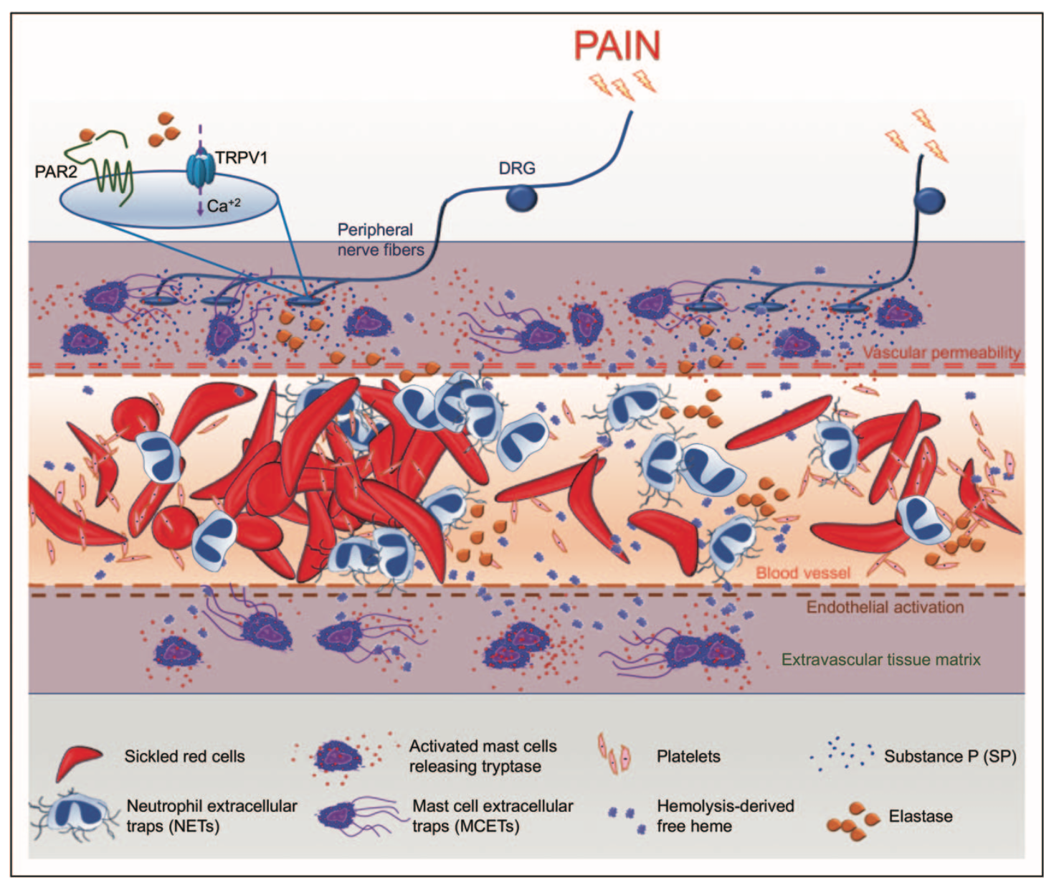
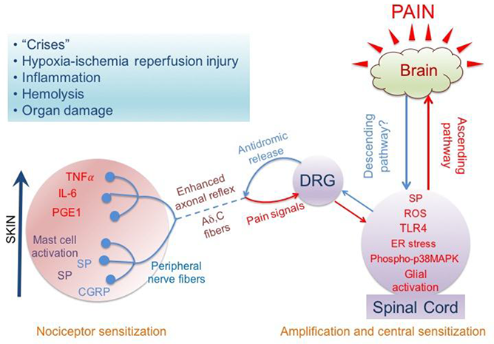
Pain Management

Slide 5


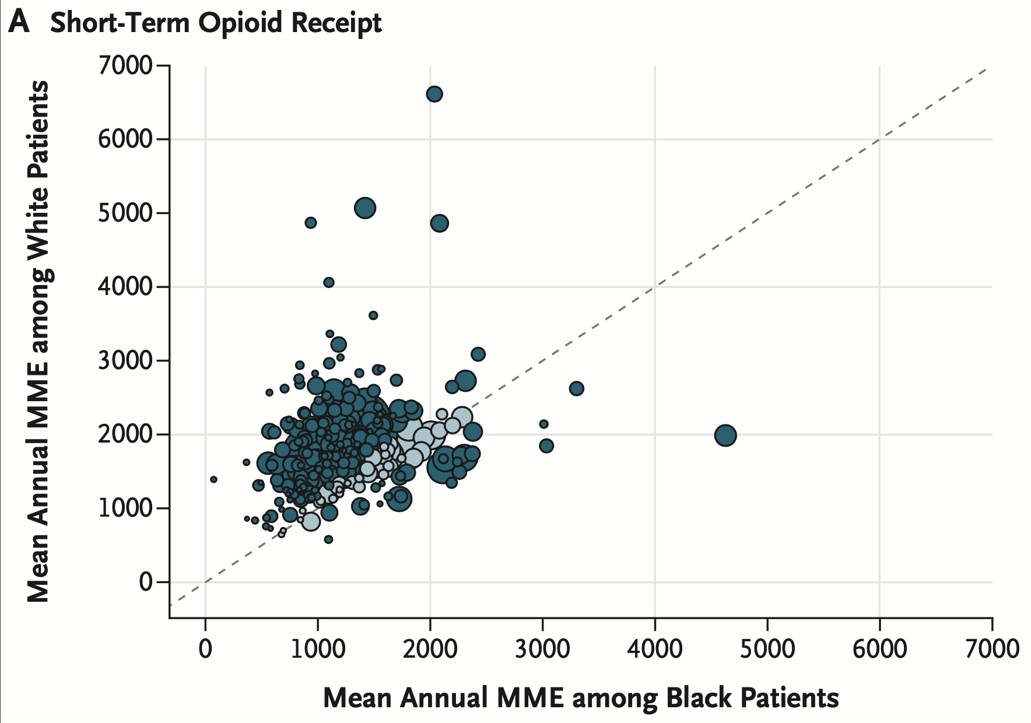

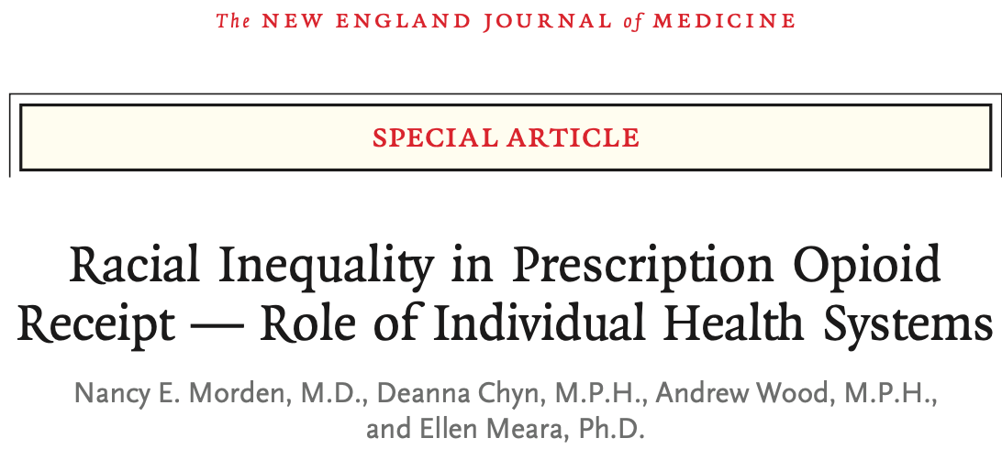
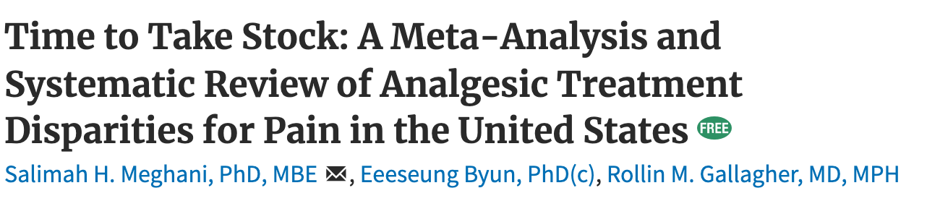
Pain perception versus Pain Expression

Slide 6
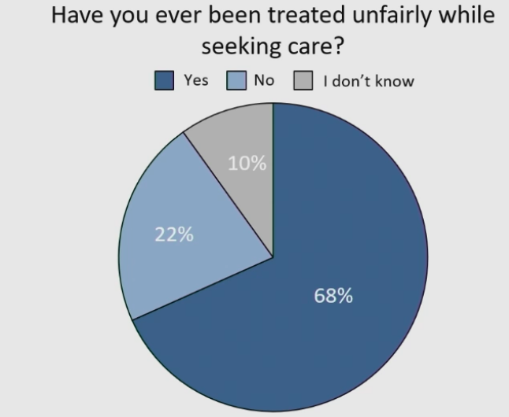
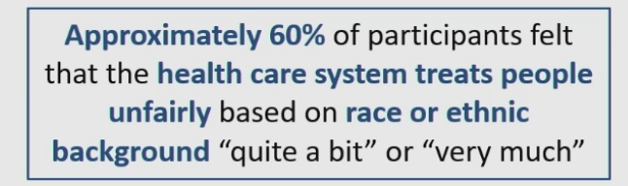
Pain perception versus Pain Expression
Because of requesting more pain medicine (65%)
Because of race (67%)
ASH 2022 – Oral Abstract – #0577 – Drahos et al.

Slide 7
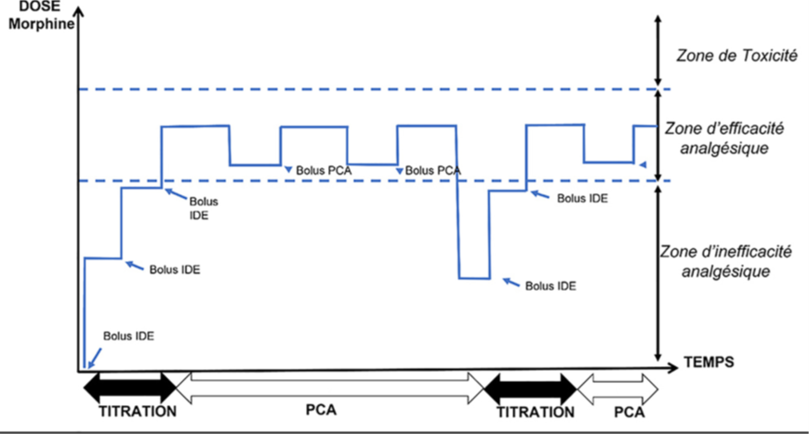
Pain Management
Treatment toxicity zone
Toxicity
Area of ​​analgesic efficacy
IV Bolus
IV Bolus
Area of ​​analgesic ineffectiveness
IV Bolus
IV Bolus
IV Bolus
TIME

Slide 8
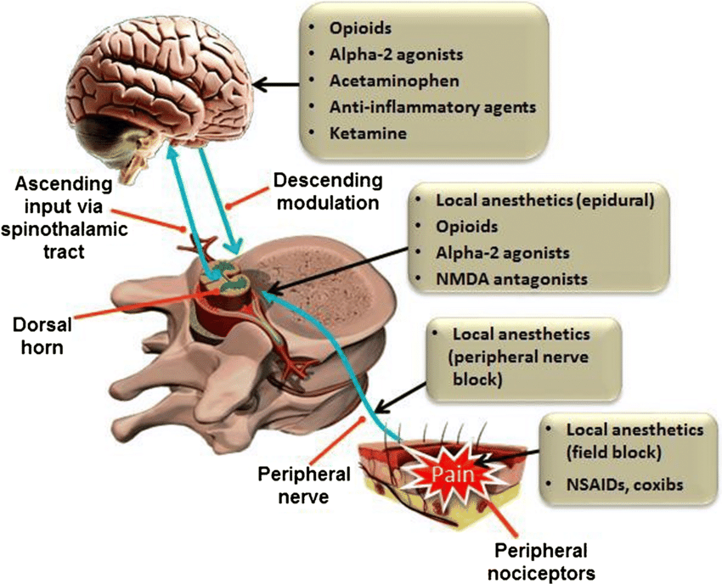
Benefits of multimodal analgesia
Lower doses
Adjuvant effect
Lower risk fo dose related secondary effects

Slide 9
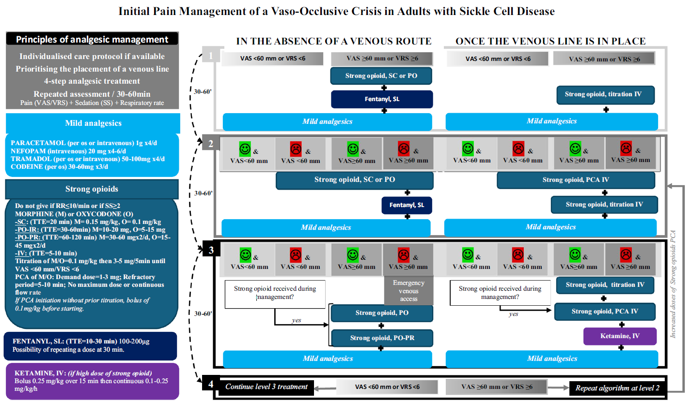
Initial management

Slide 10
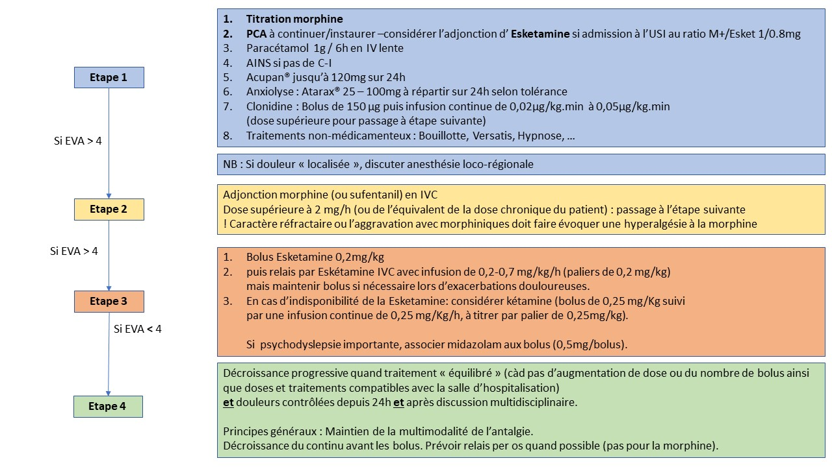
Initial management

Slide 11
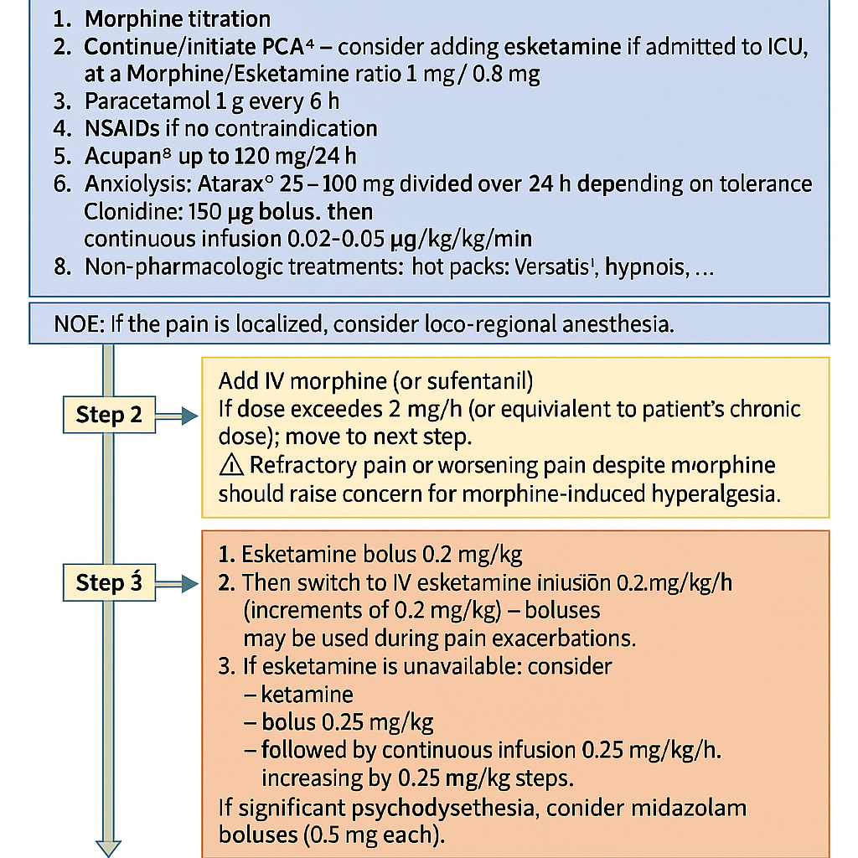
Initial management

Slide 13
Indication for transfusion in acute setting
Acute anemia (> 2g below baseline), poorly tolerated and hypoproliferative
Severe Acute Chest Syndrome
Stroke
Any acute organ damage due to SCD complication or not
Prophylactic transfusion befor major surgery
NOT
Chronic anemia even at a « very » low level
Severe pain
Non-severe ACS
Recently (<30days) transfused patient
Allo-immunized patient

Slide 14
Prophylactic
Transfusion for Surgery

Slide 15
Indication for transfusion in chronic setting
Cerebral vasculopathy or overt stroke
Pulmonary Hypertension
Chronic organ damage due to SCD
Recurrent acute complications (VOC, ACS, priapism) despite optimal treatment
Some selected pregnancies
Right time to start ?
Regular indication revision ?
Venous access ?
QoL impact ?

Slide 16
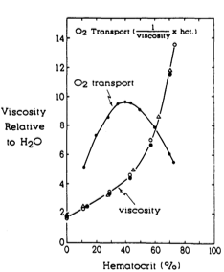
Transfusion
Simple – Top Up
Exchange transfusion
Do not transfusion above
10g/dL – Hct 30%
1U pRBC → Reduction in HbS from 6 to 12%
Wayne et al. Blood (1993)

Slide 17
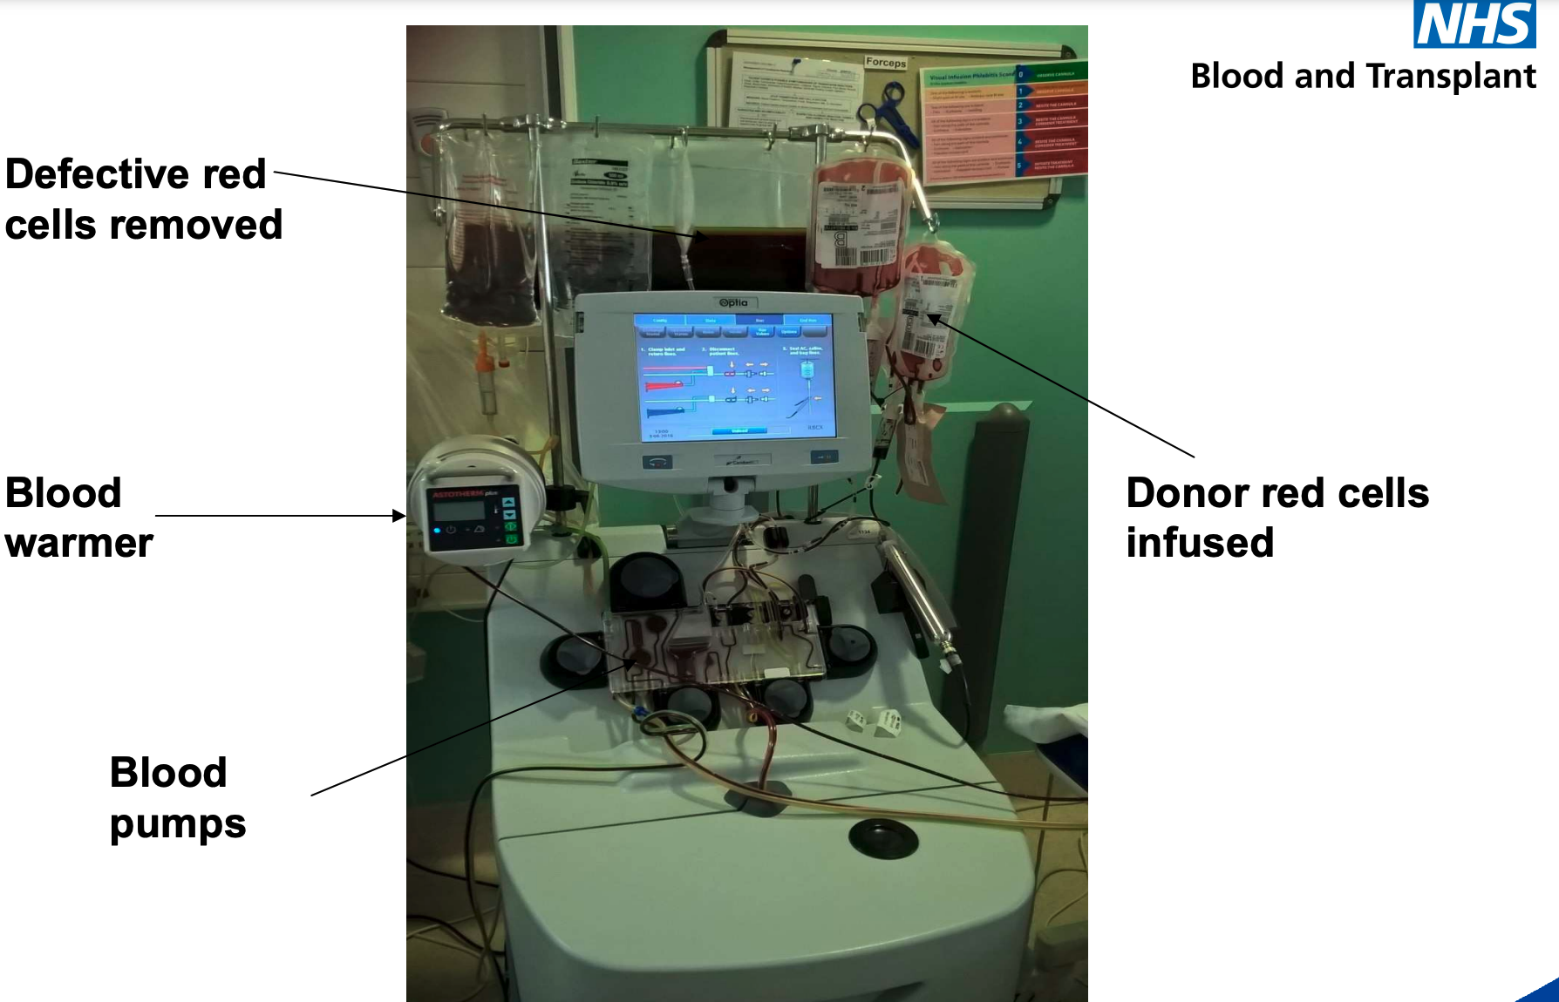
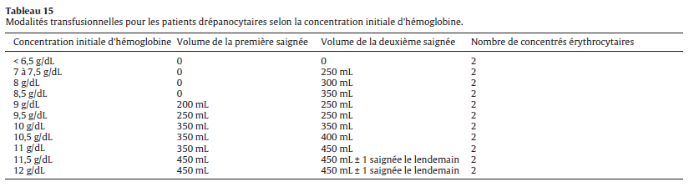
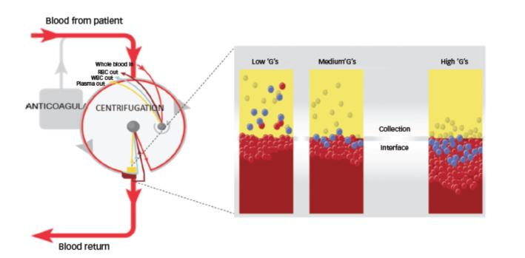
Exchange transfusion
Manual
Automatised = Erythrapheresis
  Blood withdrawal - Transfusion

Slide 18
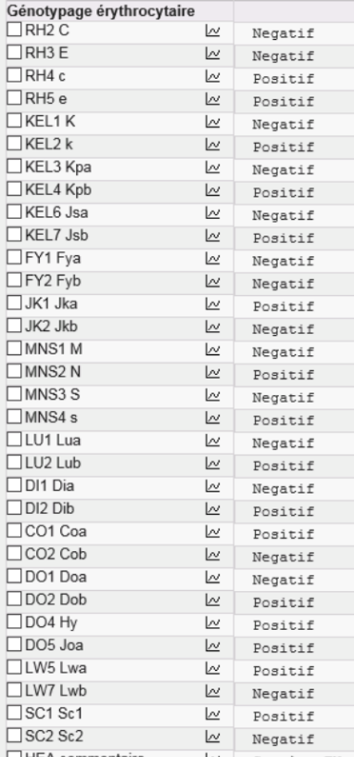
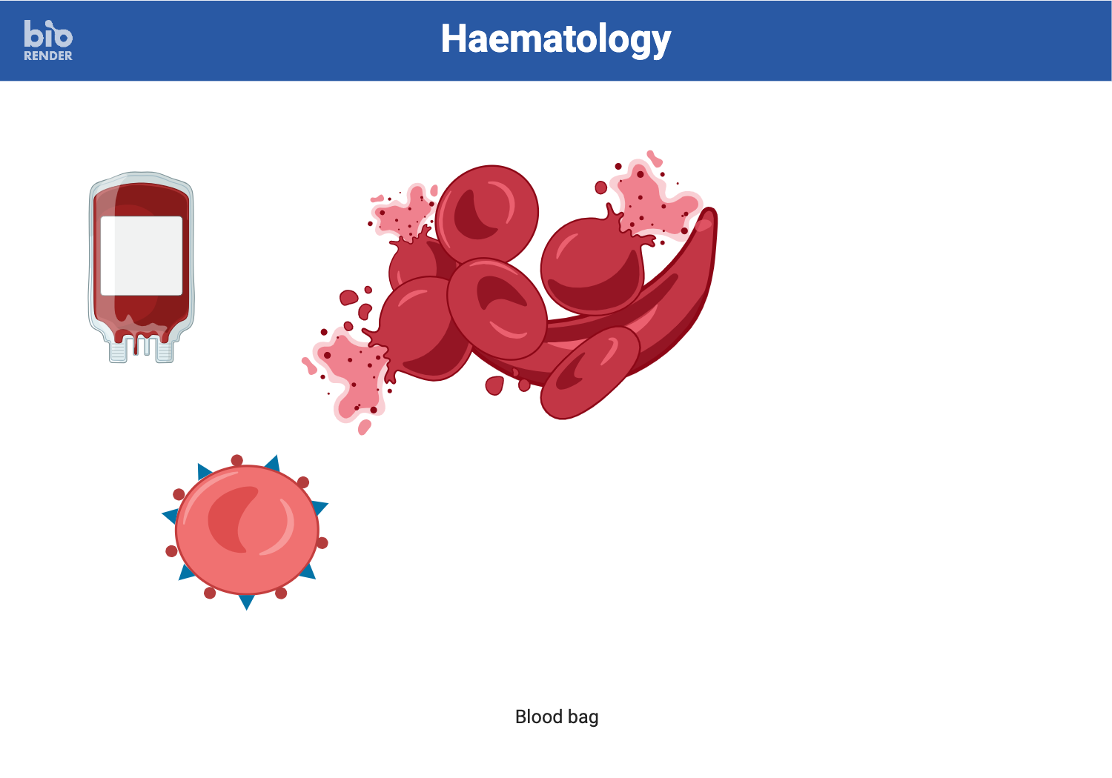
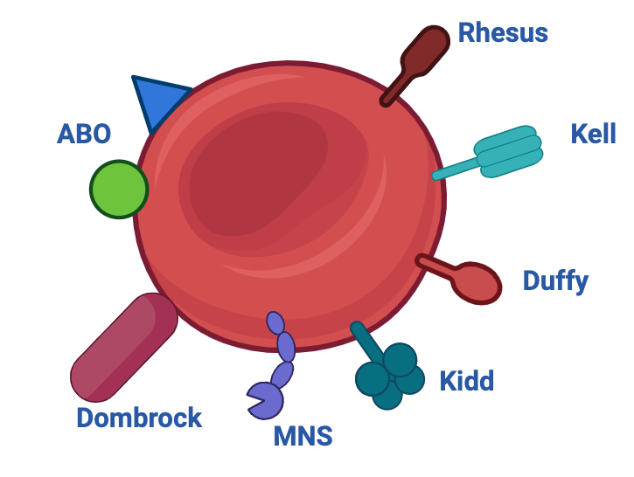
RBC sub-groups and SCD
Delayed Hemolytic
Transfusion Reaction (DHTR)
4% of sporadic transfusion
40% ICU admission
11% mortality rate

Slide 19
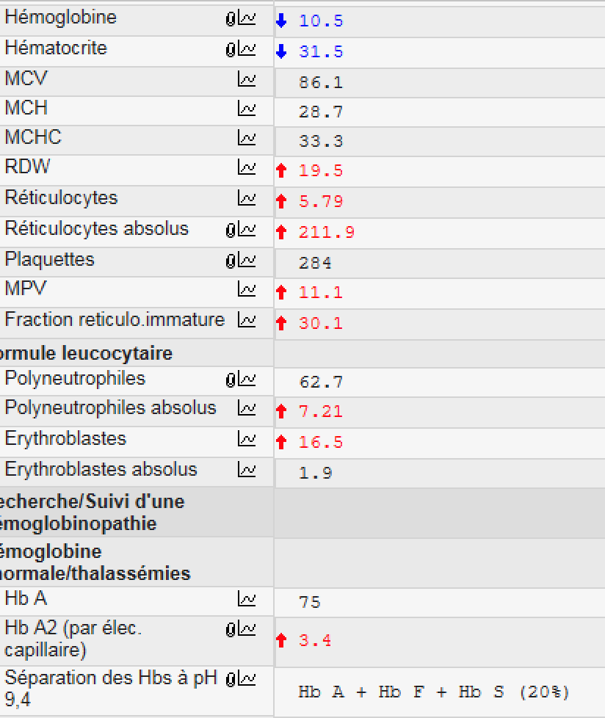
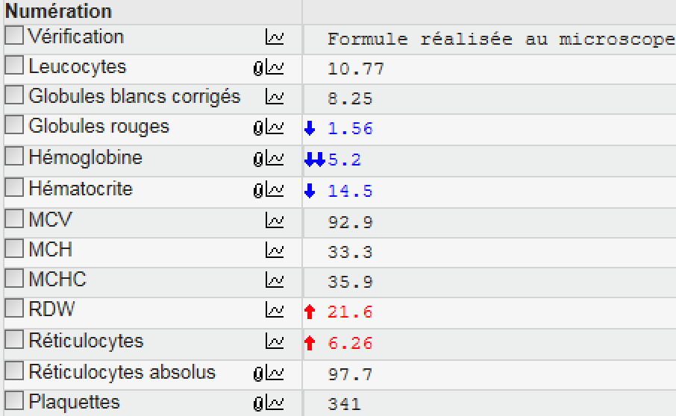
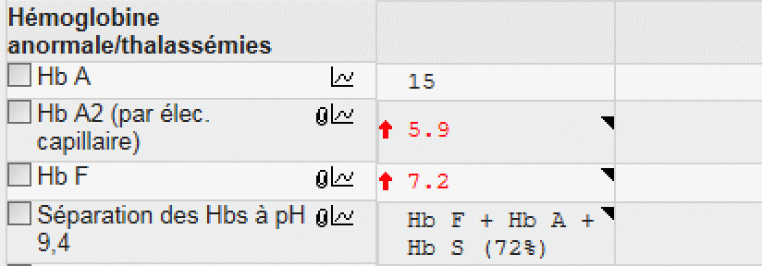
Example
LDH 2650 UI/L

Slide 20
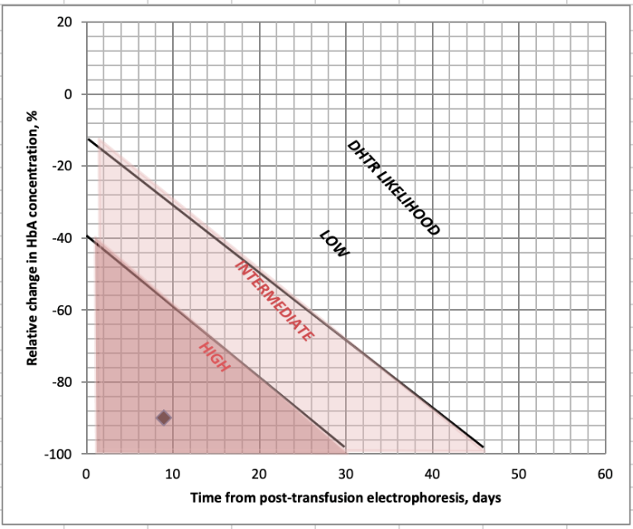
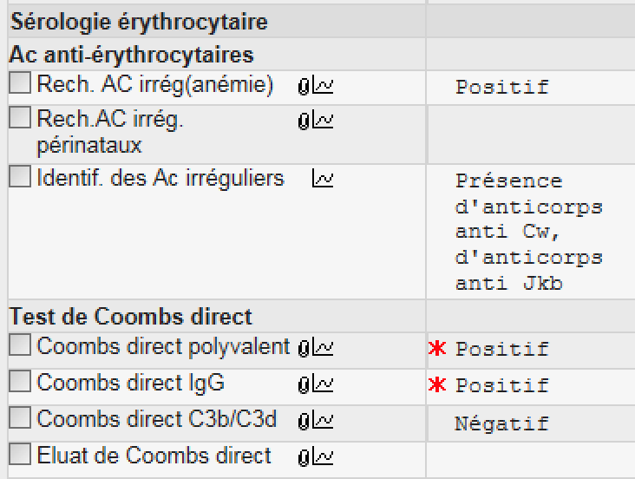
Hémolyse post-transfusionnelle retardée (DHTR)
Diagnostic
  Clinical (VOC, dark urines)
  Biological (Nomogram, LDH)
Treatment
  NO MORE transfusions ! Except…
  EPO +/- iv Iron
  If sign of severity : IV Ig a+/- Eculizumab
  Plasma Exchange
NO transfusion without hematological advice

Slide 22
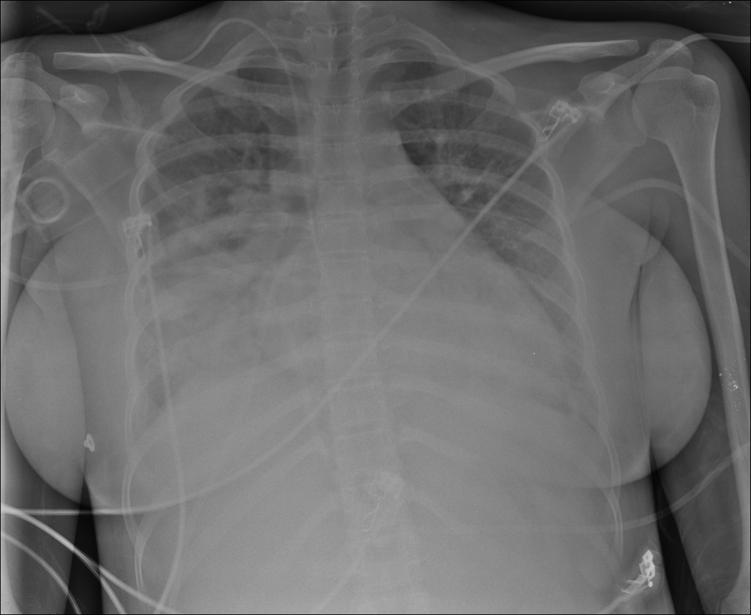
Clinical case
19 yo – SCA patient
  No chronic organ damage
  Hospitalized VOC once a year
Pain on legs, lower back and hips
Hospitalization with controlled pain.
D3 : Saturation drop at 93%. Abnormal lung sounds

Slide 23
Acute Chest Syndrome
Definition
  A least 2 on the 3 following :
    Abnormal auscultation
    New radiological infiltrate [mostly concern lung bases 95%]
    Chest pain (55-95%), respiratory symptoms (50-60%) or fever (60-80%)
Novelli & Gladwin Chest 2016

Slide 24
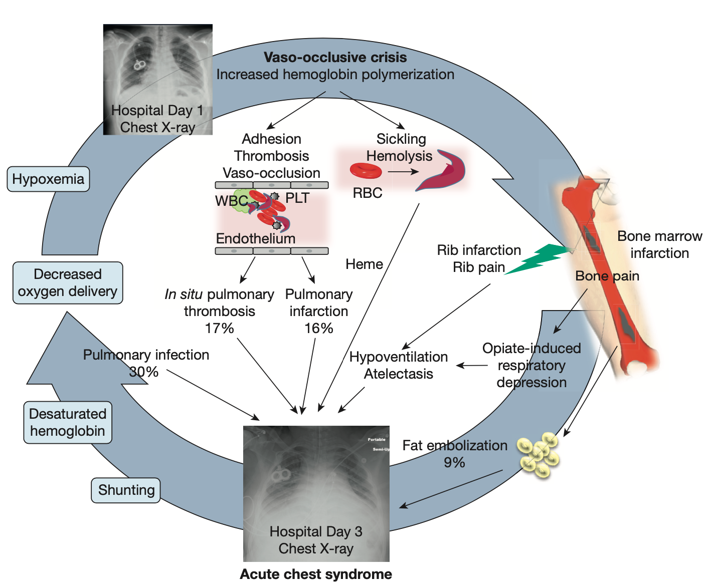
Novelli & Gladwin Chest 2016

Slide 25
Sundd et al. Ann Rev Pathol (2019)

Slide 26
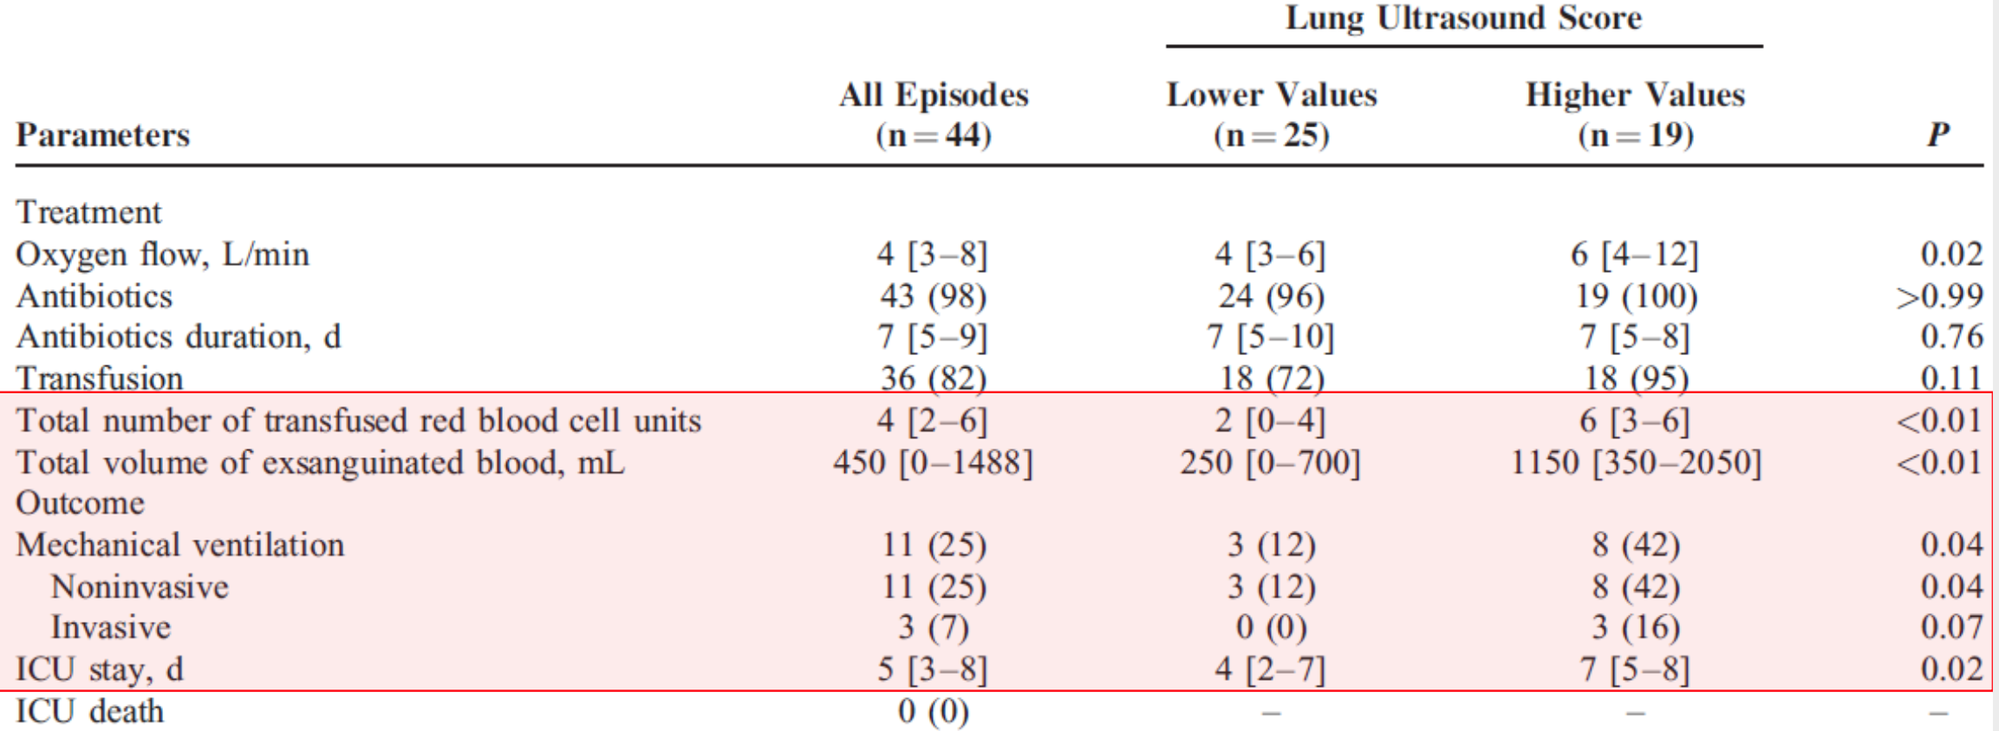
ACS - Evaluation
Biological
    LDH
    NO D-dimers
    NO haptoglobin
Imaging modality
    Lung UltraSound
Razazi, K. et al. Medicine (2016)
LU Score : Bouhemad, B. et al. Critical Care Medicine (2010)
Novelli & Gladwin Chest 2016

Slide 27

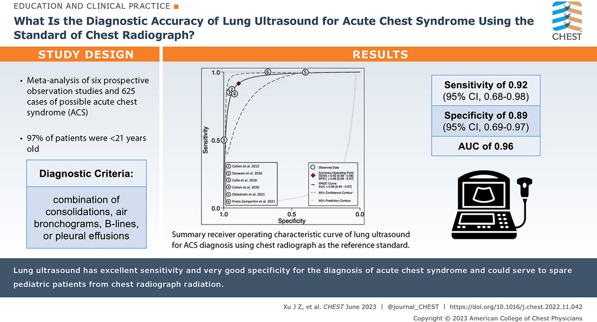
Bed Chest Xray
❑ Se >85%
❑ Sp <60%
Mekontso Dessap et al. Am J Respir Crit Care Med (2008) - OMar et al. Chest (2023

Slide 28
ACS - Evaluation
Biological
    LDH
    NO D-dimers
    NO haptoglobin
Imaging modality
    Lung UltraSound
    Chest X-Ray
    CT pulmonary angiogram ?

Slide 29
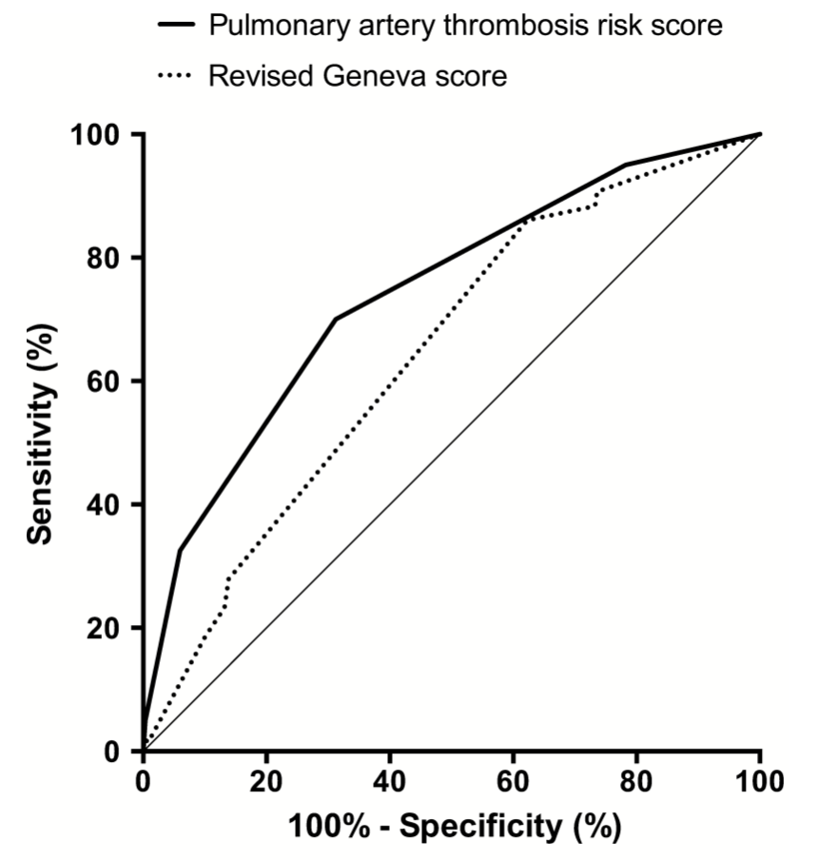
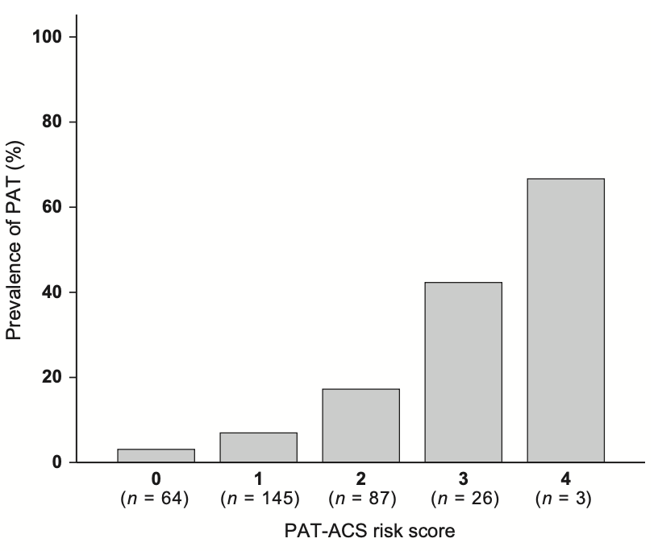
Pulmonary Arterial Thrombosis in ACS - PAT-ACS Risk Score
Variable | OR (95% CI), p value | Score weight
Baseline total hemoglobin > 8.2 g/dL
No | 1 | 0
Yes | 3.32 (1.48-7.45), p=0.004 | 1
No triggering factor*
No | 1 | 0
Yes | 2.00 (0.98-4.11), p=0.057 | 1
Platelet count >440.10⁹/L*
No | 1 | 0
Yes | 3.88 (1.88-8.00), p<0.001 | 1
PaCO2 <38 mmHg*
No | 1 | 0
Yes | 3.14 (1.37-7.18), p=0.007 | 1
Point cut-off* | NPV (95% CI) | PPV (95% CI) | Specificity (95% CI) | Sensitivity (95% CI)
0 | - | 12.3% (8.9-16.4) | 0.0% (0.0-1.3) | 100.0% (91.2-100.0)
1 | 96.9% (89.2-99.6) | 14.6% (10.5-19.4) | 21.8% (17.1-27.0) | 95.0% (83.1-99.4)
2 | 94.2% (90.1-97.0) | 23.9% (16.5-32.7) | 68.8% (63.0-74.1) | 70.0% (53.5-83.4)
3 | 90.8% (87.0-93.9) | 43.3% (25.2-62.9) | 94.0% (90.6-96.5) | 32.5% (18.6-49.1)
4 | 88.2% (84.2-91.0) | 66.7% (9.4-99.2) | 99.7% (98.1-100.0) | 5.0% (0.6-16.9)
Cut-off at 2
Winchenne et al. British Journal of Haematology (2017)

Slide 30
ACS – ICU Admission ?
Severity criteria
    Hypoxmia - PaO2 < 70mmHg
    Any organ faillure or classical severity criteria (hemodynamic, neuro, respiratory, …)
    Pre-existant pulmonary vascular damage
In severe ACS, always perform :
    CT pulmonary angiogram
    Cardiac US
Mekontso Dessap et al. Am J Respir Crit Care Med (2008)

Slide 31
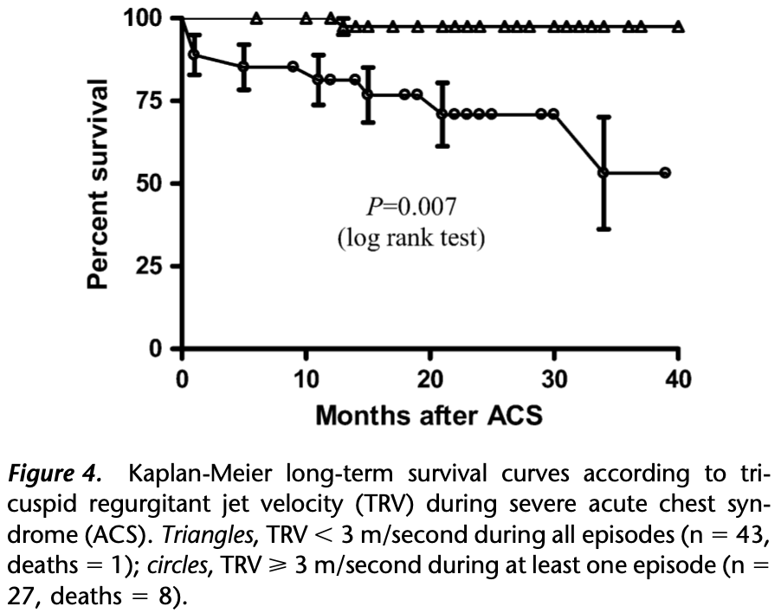
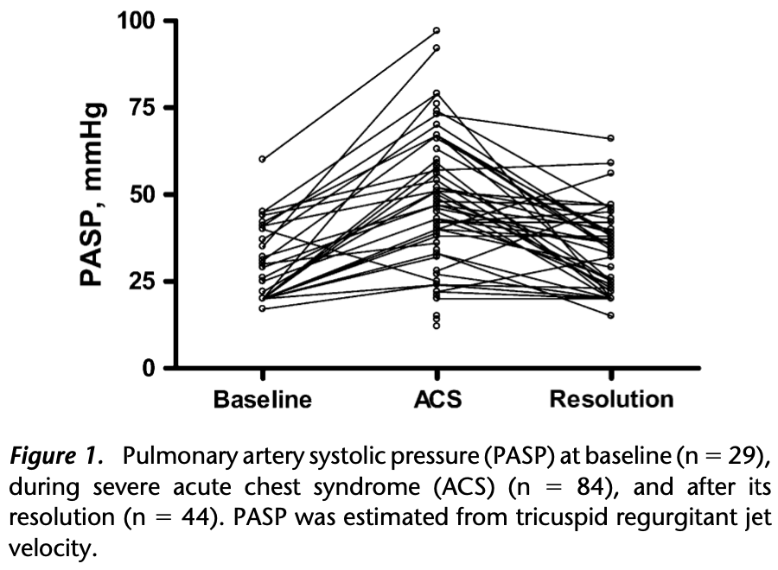
Caveat Cor Pulmonare !

Slide 32
Take-Home Messages
Rapid and aggressive management of pain
Prevention (spirometry, LMWH, analgesia) and
early detection of risk factors or the occurrence of severe complications (ACS)
NO transfusion without discussion with hematology/emergency/intensive care.
Prevention/assessment of DHTR
Coordinated/multidisciplinary management
(Emergency/ICU/Hematology/Transfusion) within and outside the hospital

Slide 33
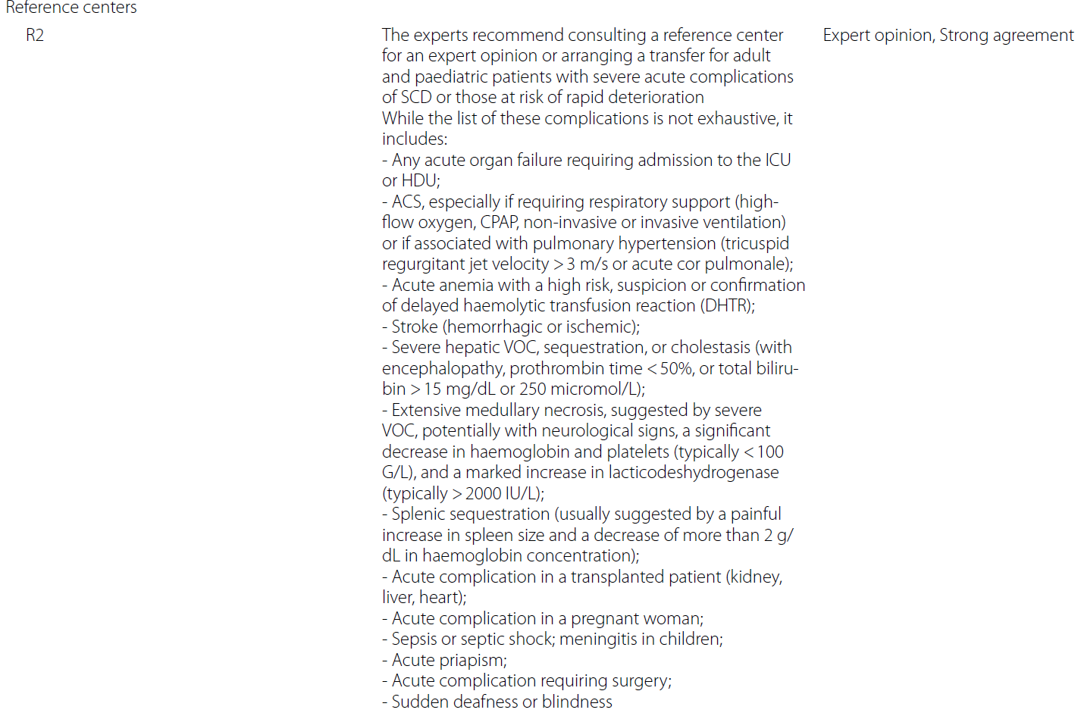
Expert center referal/Consult

Slide 34


Martin Colard
02 555 26 27
Martin.Colard@HUBruxelles.be
Red Blood Cells and Iron Disorders Unit
Pr Martin Colard - Dr Aude Theunissen

