Slide 1

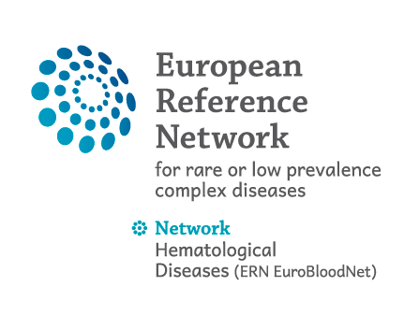
Thalassemia
Educational course
Seminar 2: Red Blood Cell Disorders
15 november 2025
Martin Colard MD-PhD

Slide 2
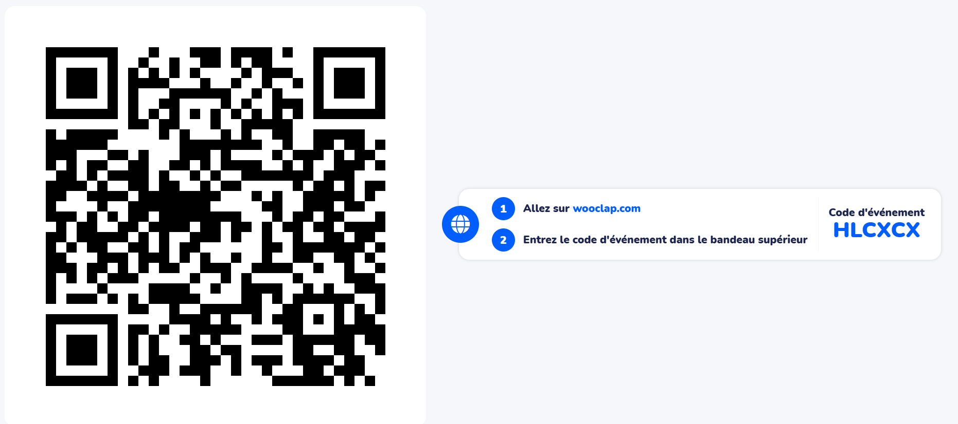

Slide 3
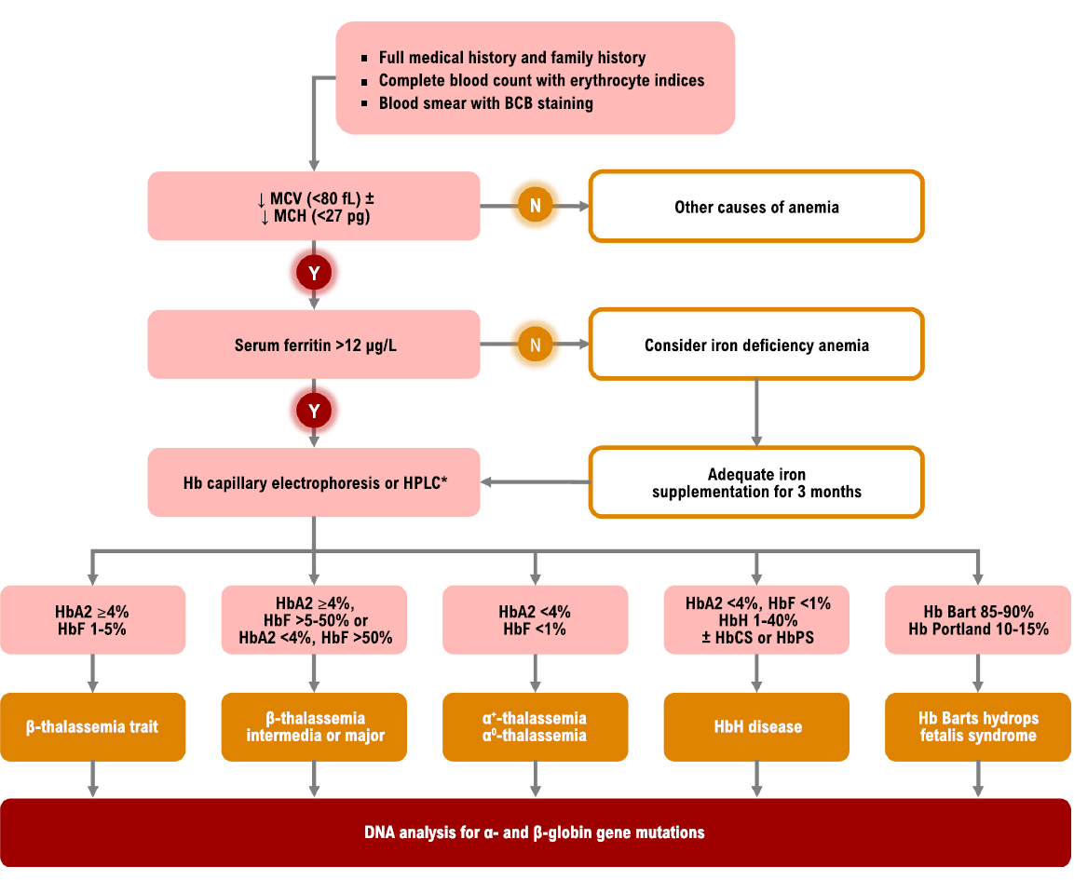
Diagnostic approach of microcytic anemia
Musallam et al. Blood Reviews (2024)

Slide 4
Diagnostic approach of microcytic anemia
Anemia
Microcytosis
Hyporegenerative
Non-carential
Non-toxic
Non-inflammatory
Hb Electrophoresis
Final Diagnostic = Genetics
HbA2 + HbF
Abnormal Fraction of Hb
HbA2 N or dim.
HbA2>3,5%
α-Thalassemia
Rare Etiology
β-Thalassemia

Slide 5
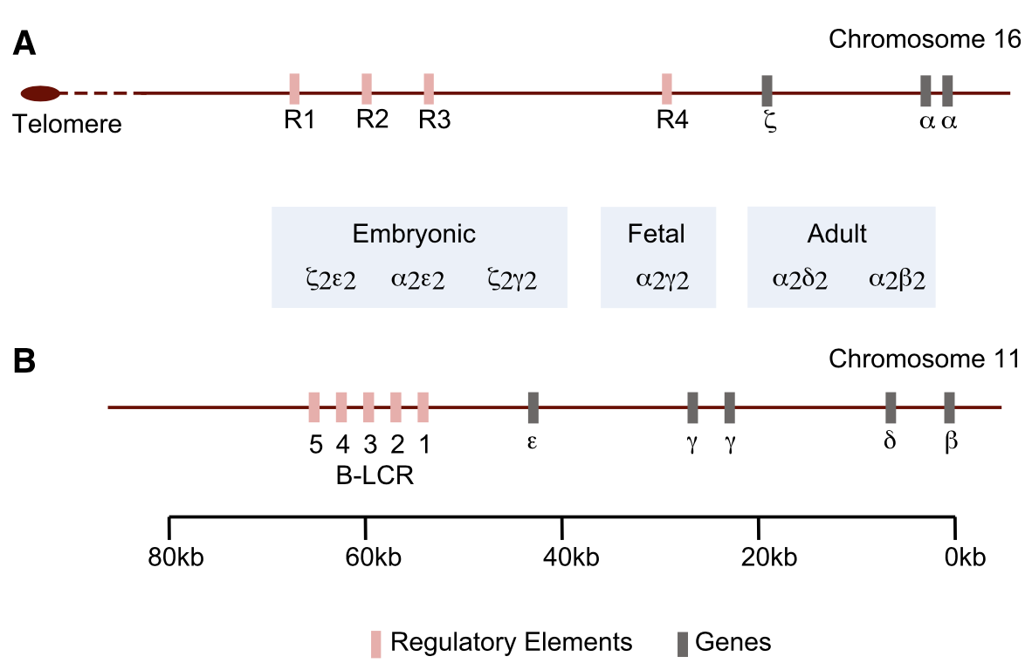
Adapted from Mettananda et al. Blood (2015)

Slide 6

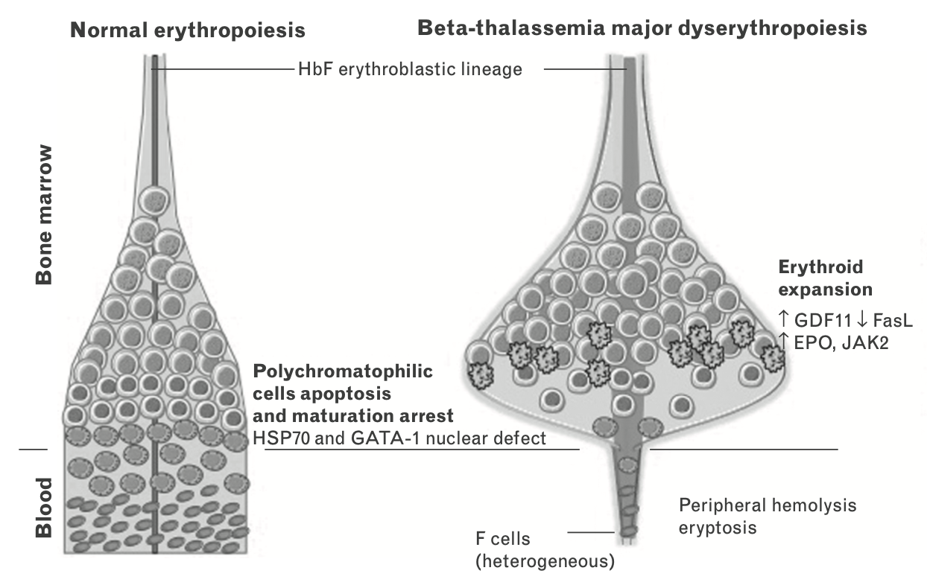
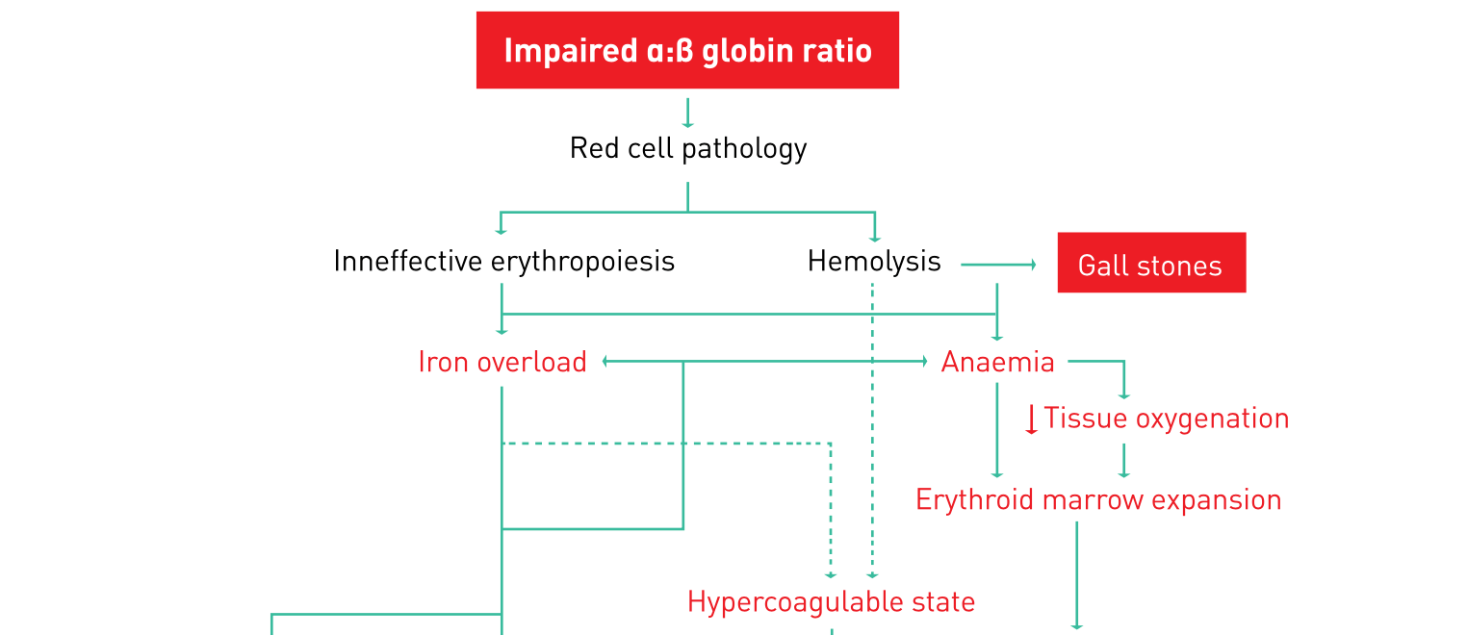
Physiopathology
Alpha-Thalassemia : Hemolytic profile – Few Dyserythropoiesis
Beta-Thalassemia : Major Dyserythropoiesis
Adapted from Taher et al. vol. 19 (TIF Publication, 2013).

Slide 7
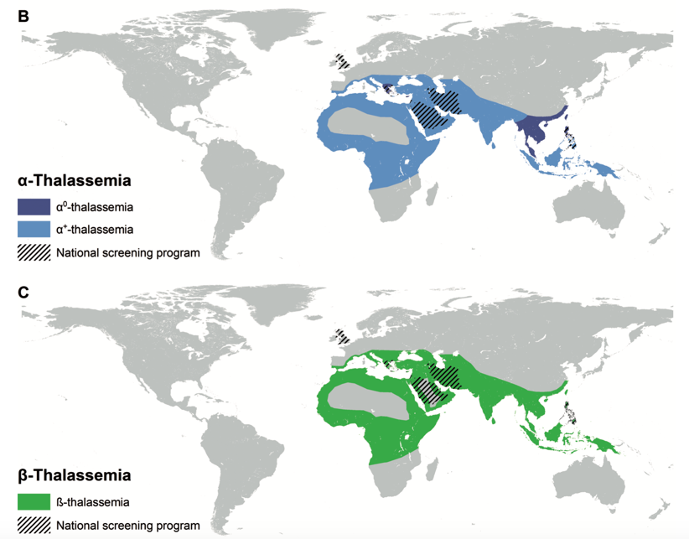
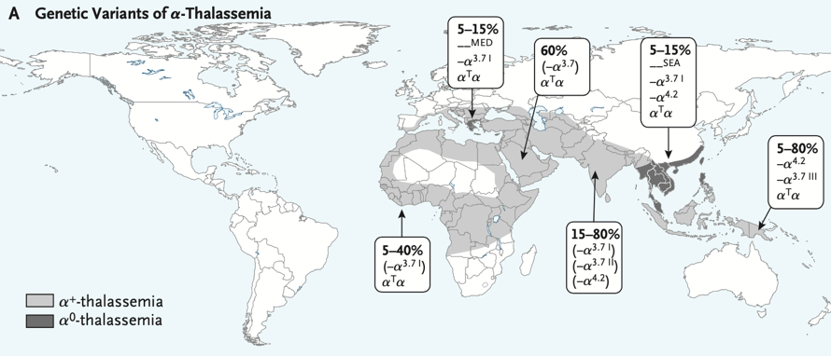
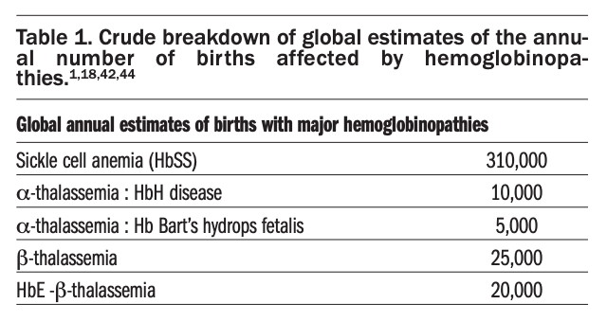
Alpha-Thalassémies
Beta-Thalassémies
5% de la population mondiale
Adapted from Piel et al. NEJM (2014) and Piel EHA - Education Program (2015)
And Gulbis et al. Belg J Hematol (2010)

Slide 8
Alpha-Thalassemia – Genotype / Phenotype
Phenotype | Genotype | Clinical | Electrophoresis
Silent carrier | -α/αα | Asymptomatic | Normal
Trait/Minor | -α/-α or --/αα | Borderline asymptomatic anemia | Normal
HbH disease | --/-α | Mild-moderate anemia Highly variable severity Most frequently NTDT | HbH
Major | --/-- | Hydrops foetalis In utero death | HbBart’s
Adapted from DeLoughery et al. NEJM (2014) and Taher et al. vol. 19 (TIF Publication, 2013).

Slide 9
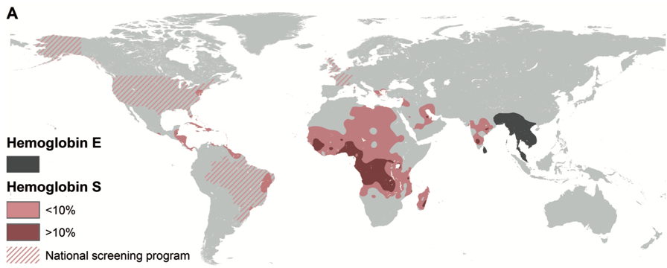
Beta-thalassémies - mutations
Centaines de mutations décrites
  Essentiellement non délétionelles
Classées selon la production résiduelle de chaine β
  β⁺⁺ (ou silent) - β⁺ - β⁰
  Mais grande variabilité de corrélation génotype/phénotype entres les mutations et leurs associations
  + autres modificateurs génétiques
Rôle de l’Hémoglobine E - HbE
  Globine β^{E} « β⁺ » avec instabilité
Piel EHA - Education Program (2015
Taher et al. vol. 19 (TIF Publication, 2013).

Slide 10
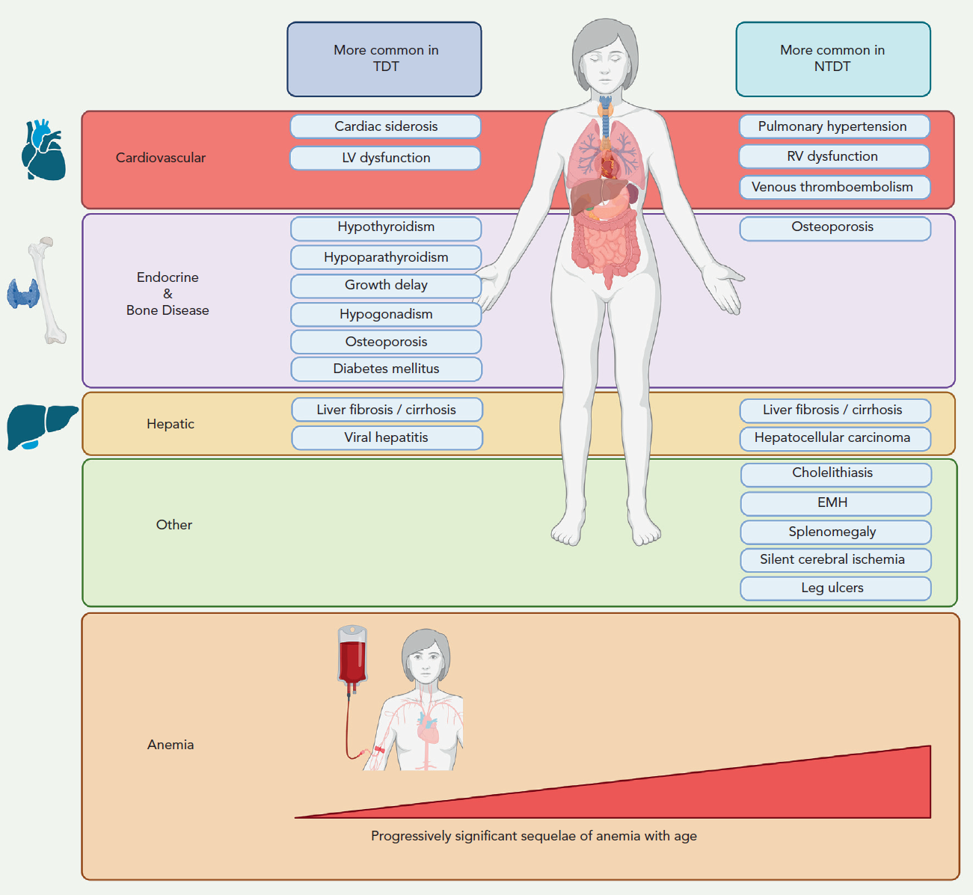
Saliba et al. Blood (2023)

Slide 11
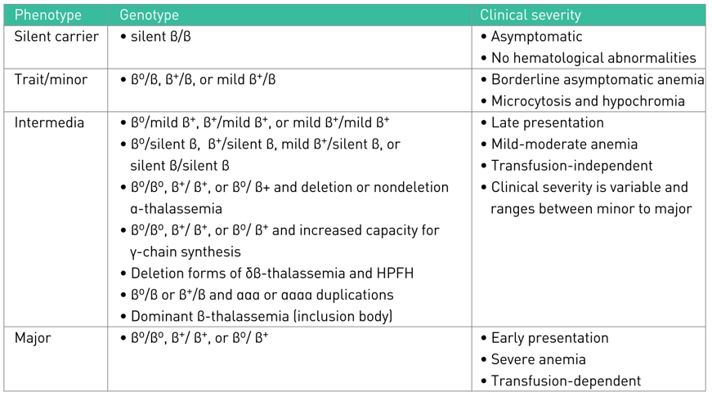
Beta-thalassemia – Genotype/Phenotype
Taher et al. vol. 19 (TIF Publication, 2013).

Slide 12
Beta-thalassemia – Genotype/Phenotype
Genotype | Phenotype | Clinical
β/β⁺⁺ | Silent carrier | Asymptomatic
β/β⁺ β/β⁰ β/β^{Ε} | β−Thalassemic Trait | Borderline asymptomatic microcytic hypochromic anemia
β⁺⁺/β⁺⁺ β⁺/β⁺⁺ β⁺/β⁺ β⁺/β^{Ε} β⁺/β⁰ β⁰/β⁺⁺ β⁰/β^{Ε} β⁰/β⁰ | Non-Transfusion-Dependent Thalassemia (NTDT) | Mild to moderate anemia and symptoms Occasional or frequent transfusions
Major | Transfusion-Dependent Thalassemia (TDT) | Severe anemia and symptoms Transfusions essential for survival

Slide 13
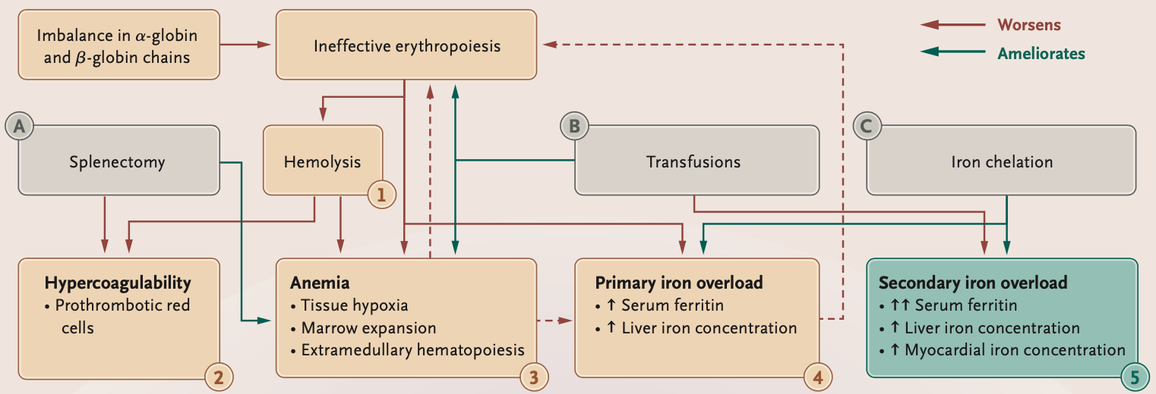
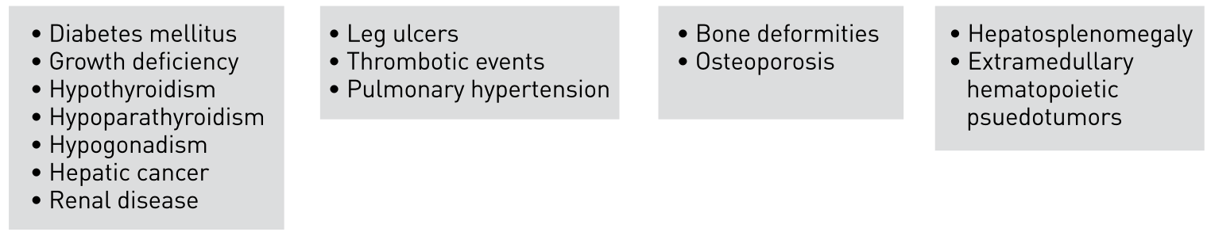
Complications
Adapted fromTaher et al. NEJM (2021) and Capellini et al. TIF (2014)

Slide 14
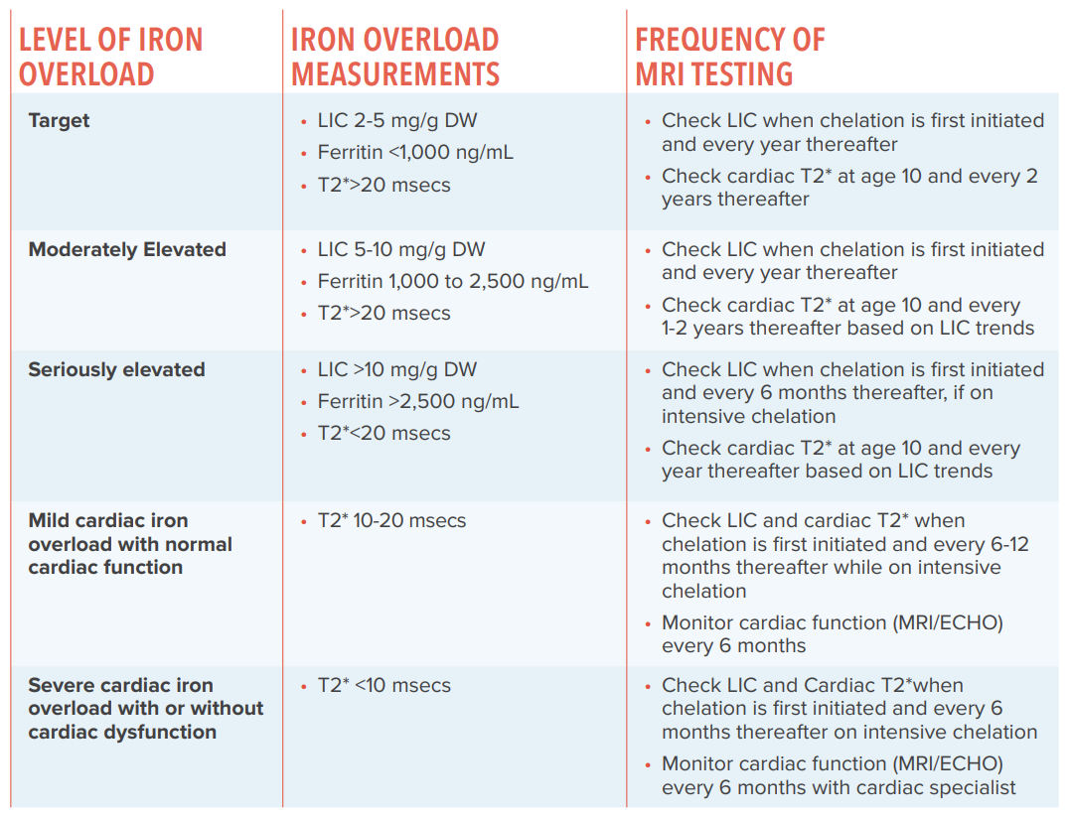
Iron Overload
Sheth. Cooley’s Anemia Foundation

Slide 15
NTDT

Slide 16
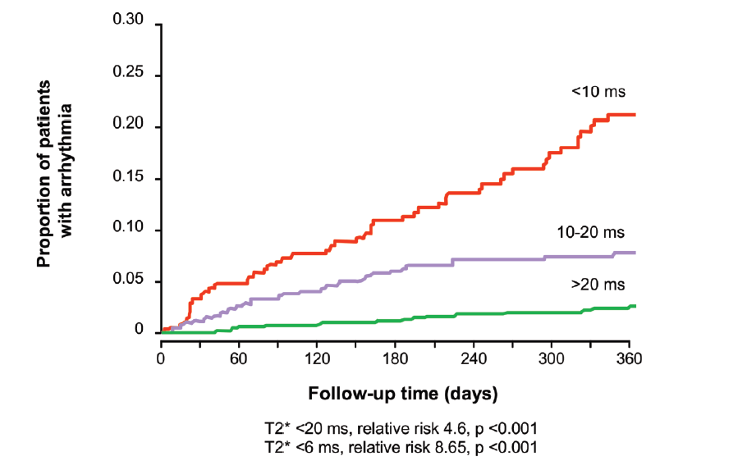
Cardiac
Taher et al. Thalassaemia International Federation, 2025.

Slide 17
NTDT
- Annual ultrasound including TRV measurement
Risk factors: Splenectomy, Platelet count >500 G/L, Anemia <9 g/dL, Iron overload
TDT
- Echocardiogram including ejection fraction measurement
1x/year if LVEF >56% - 1x every 3-6 months if LVEF <56%
- ECG at each echocardiogram
- Holter ECG monitoring if medical history/ECG suggests cardiac overload

Slide 18
Cardiac – MRI follow-up
Taher et al. Thalassaemia International Federation, 2025.

Slide 19
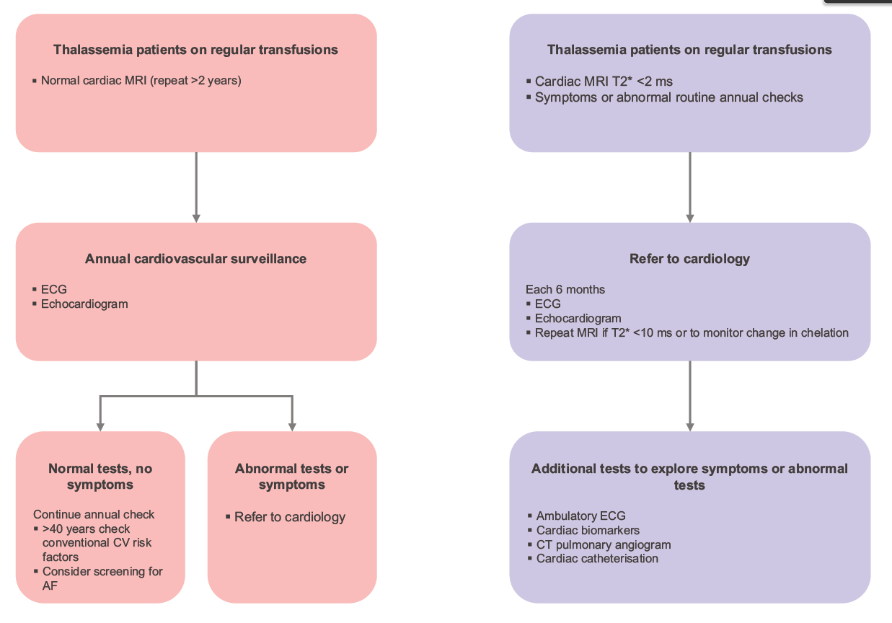
Cardiac – Follow-up
<20 ms
Taher et al. Thalassaemia International Federation, 2025.

Slide 20
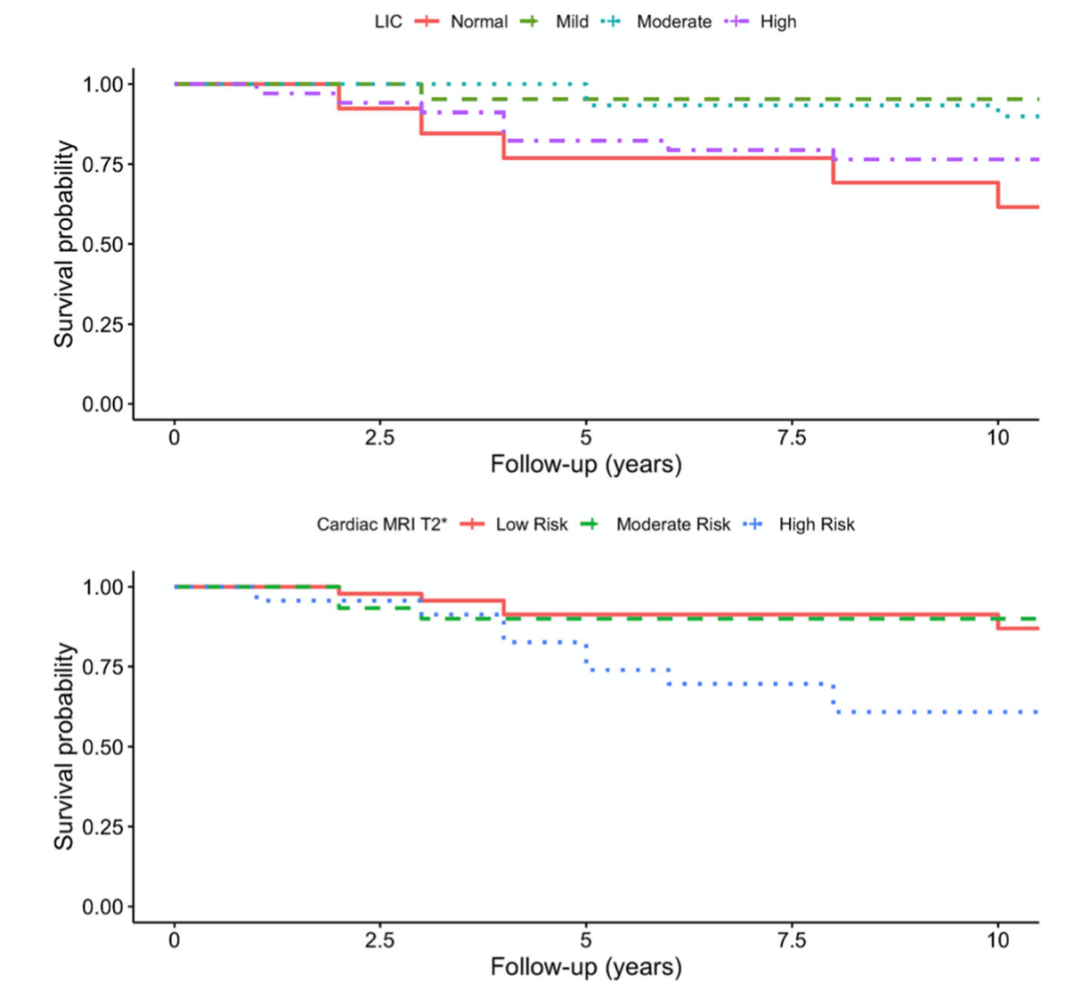
Complications Iron Overload
Daar, et al. Ann Hematol (2020)

Slide 21
Iron Overload
NTDT
- Ferritin / 3 mois
- Liver MRI Q1-2 ans
If overload : >90µmol/g (or ferritin >800ng/mL) : Chelation
- No cardiac monitoring is required for patients who do not receive regular transfusions and do not have significant cardiac overload.

Slide 22
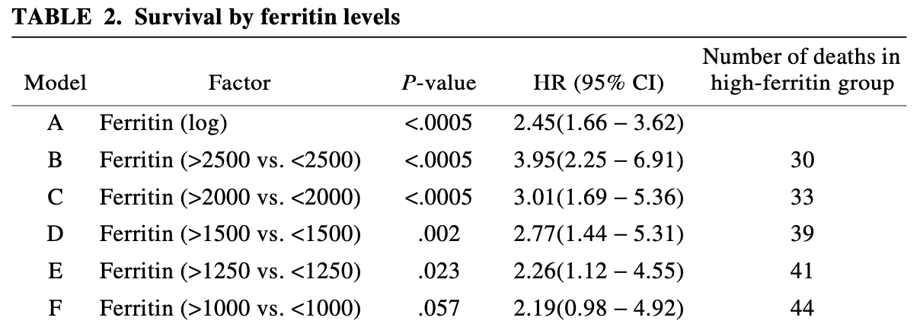
Iron Overload
TDT
Borgna-Pignatti et al. Haematologica (2004) - Borgna‐Pignatti et al. Ann N Y Acad Sci (2005)

Slide 23
Iron Overload
TDT
- Ferritin every 3 months!
Non-linear decline and poorly correlated with FLC
- Liver quantification MRI:
Every 2 years if FLC < 60 µmol/g - Annually if 60 < FLC < 300 µmol/g - Every 6 months if FLC > 300 µmol/g
- Cardiac MRI: T2 measurement*
Every 2 years if > 30 ms
Annually if < 30 ms and > 10 ms - Every 6 months if < 10 ms

Slide 24
Atteinte hépatique
NTDT
- Quarterly liver enzyme tests
- Annual ultrasound if ferritin >800 or liver iron overload >90 µmol/g
- Annual FibroScan® if liver iron overload >90 µmol/g
- Annual viral serology
TDT
- Quarterly liver enzyme testing
- Annual ultrasound and FibroScan®
- Annual viral serology
- Annual aFP if cirrhosis or if age > 45y

Slide 25
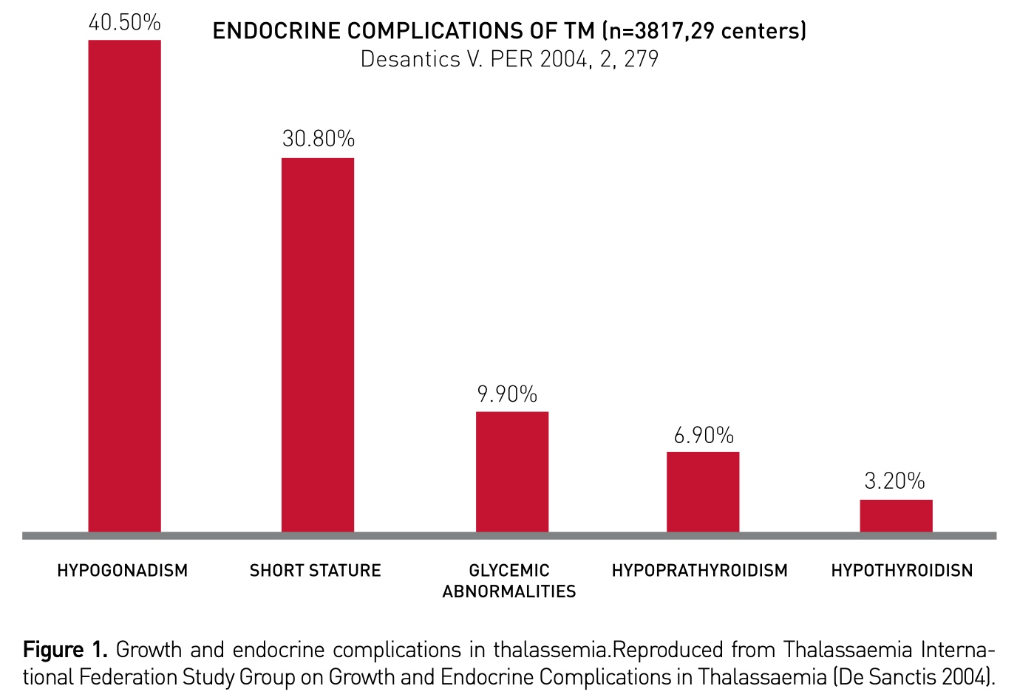
Endocrinopathies

Slide 26
Endocrinopathy
NTDT and TDT
- Clinical hypogonadism
- TSH and free T4 annually
- Hypoparathyroidism: Ca, P, vitamin D, PTH annually
- Bone densitometry: 1x every 2 years
- Fasting glucose! HbA1c not (or barely) interpretable!

Slide 27
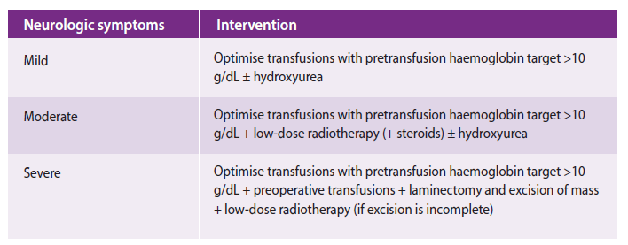
Hématopoïèse extra-médullaire
- Clinical examination including neurological examination and medical history
- Full spine MRI with gadolinium
- More common in NTDT

Slide 28
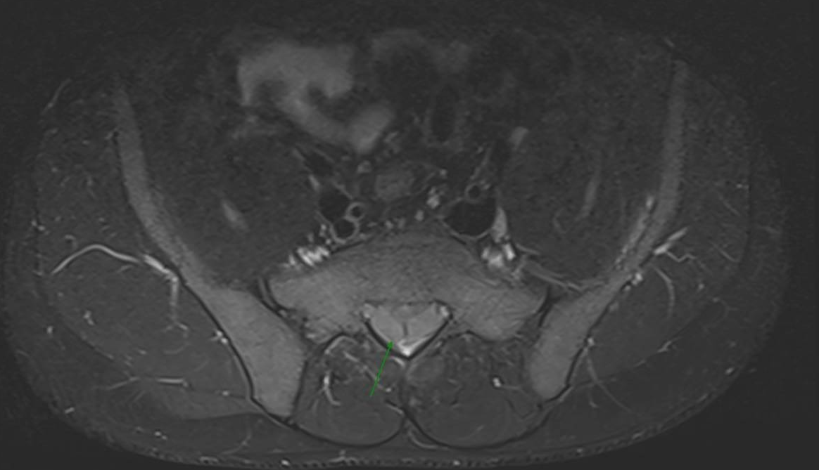
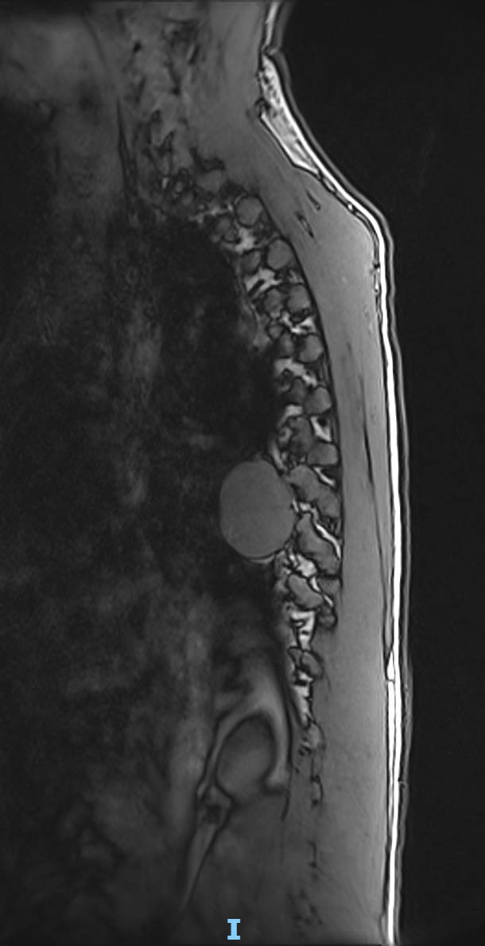
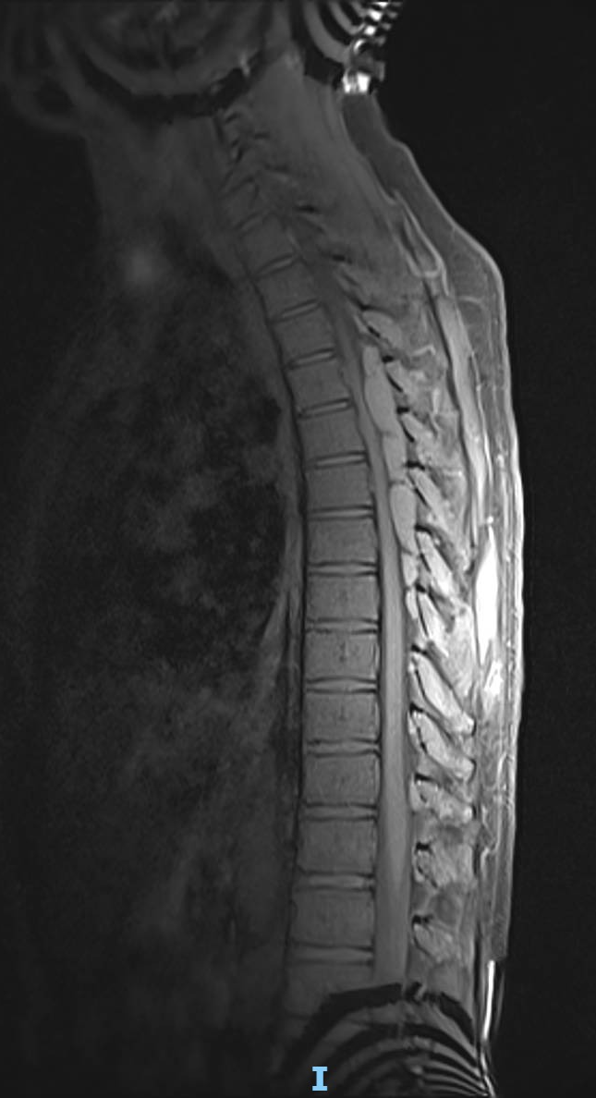
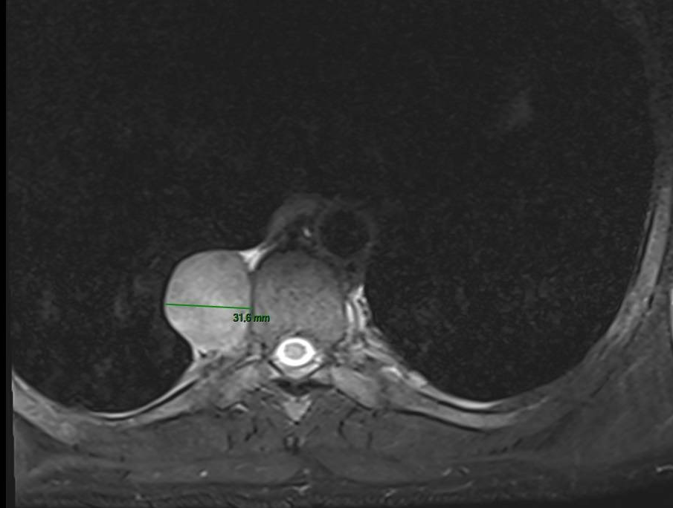
Hématopoïèse extra-médullaire

Slide 29
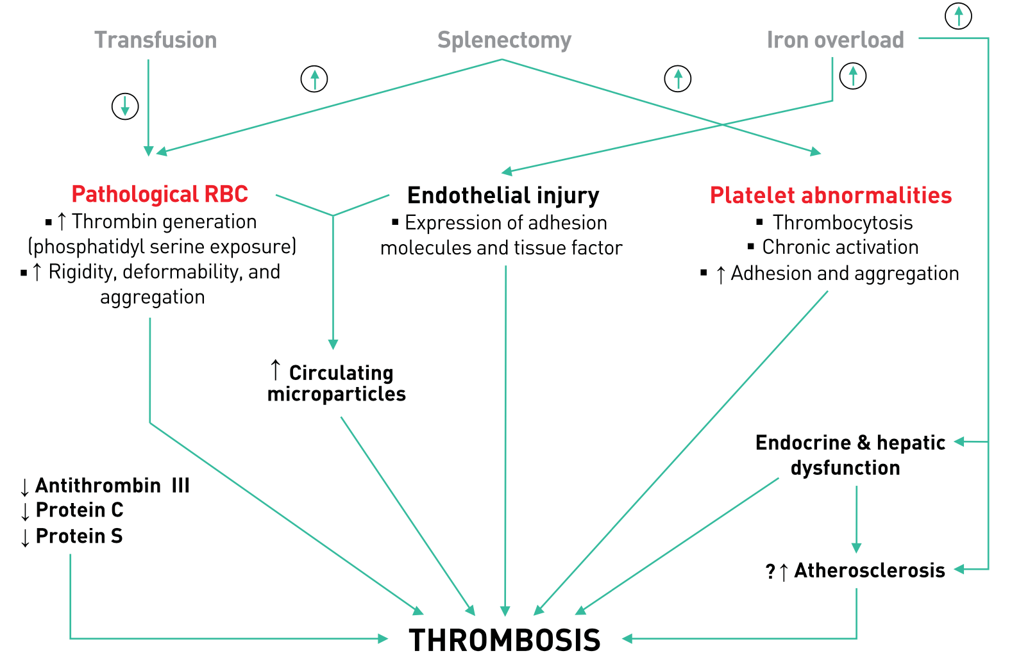
Thromboses
Considered at “High Risk”
Aspirin in NTDT splenectomized or if Plq>500G/L

Slide 30
Liver – Follow-up
<20 ms
Taher et al. Thalassaemia International Federation, 2025.

Slide 31
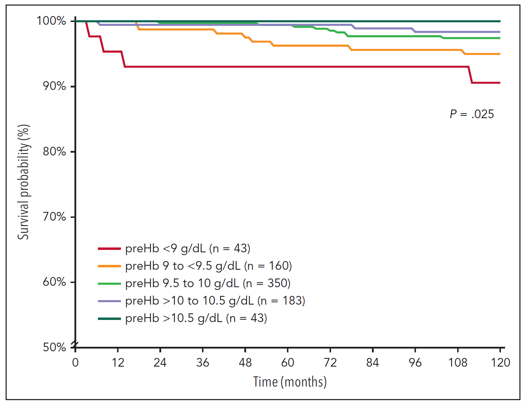
Transfusion Targets
Hb level ALWAYS above 9,5g/dL
Musallam et al. Blood (2024)

Slide 32
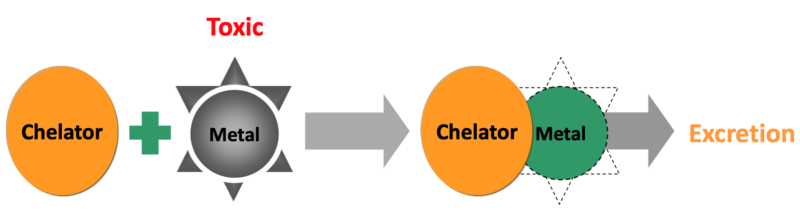
Chelation
NTDT | TDT
Ferritin > 800µg/L LIC > 90µmol/g | All

Slide 33
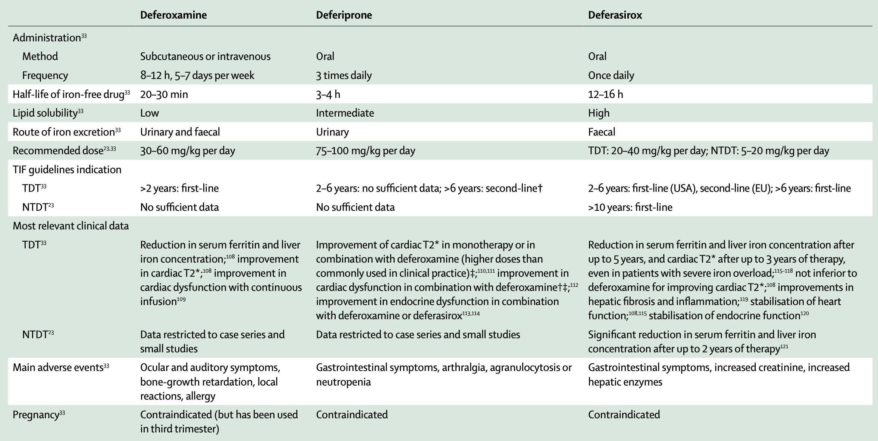
Treatments
Desferral
Ferriprox
Exjade
1
(1)
3
2
2
1
Adapted from Taher et al. Lancet (2018)

Slide 34
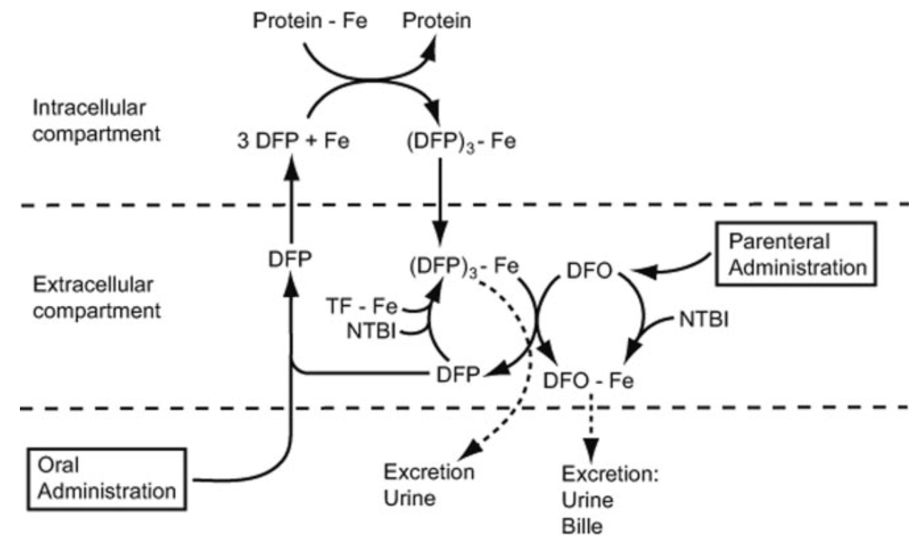

Slide 35
Chelation AE
 | Desferral | Exjade | Ferriprox
Adverse effects | Audition and Eye toxicity | Kidney (Creat and proteinurea) | Agranulocytosis
Contra-indication | Severe retina damage | Severe Liver disease

Slide 36
Traitements – chelation – atteinte cardiaque
Indication d’intensification
T2* <20ms quelle que soit la fonction
Si T2* < 6-10ms ou insuffisance cardiaque = “Rescue therapy”
Choix de chélateur
DFP
DFP +/- DFO
(DFO + DFX)

Slide 37

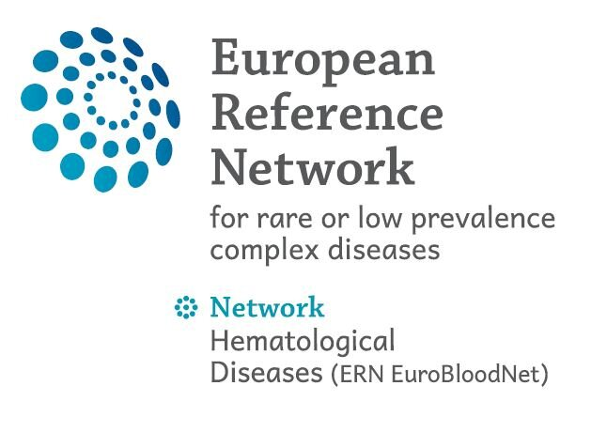
Martin Colard
02 555 26 27
Martin.Colard@HUBruxelles.be
Red Blood Cells and Iron Disorders Unit
Pr Martin Colard - Dr Aude Theunissen

