Slide 1





HEMATOLOGICAL DISORDERS
DURING PREGNANCY
Prof Catherine LAMBERT
Cliniques Universitaires Saint-Luc
Catherine.lambert@uclouvain.be

Slide 2
AGENDA
Physiological hematological changes during normal pregnancy
Thrombocytopenia during pregnancy
Haemostasis changes during normal pregnancy
Pregnancy in women with inherited bleeding disorder
Gestational venous thrombo-embolism
Thrombophilia and obstetrical complications

Slide 3
PHYSIOLOGICAL HEMATOLOGICAL
CHANGES DURING PREGNANCY
Anemia < hemodilution (↗ of plasma volume up to 40%)
< iron deficiency
< folic acid deficiency
  Normal hemoglobin level : > 11 g/dl during pregnancy
Mild elevation of neutrophiles
Platelet count decrease by 10%

Slide 4
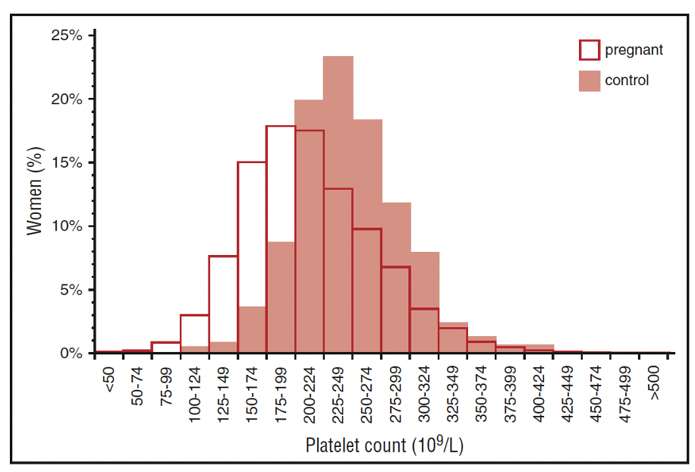
PLATELETS IN HEALTHY
PREGNANT WOMEN AT TERM
Platelet count decrease by 10%
  Platelets 120-150 x10⁹ /L is frequent at the 3rd trimester
  Work-up recommended if platelets < 100 x10⁹ /L
Hemodilution (↗ of plasma volume)
Possible platelet clearance
Left shift of the platelets distribution

Slide 5
DIFFERENTIAL DIAGNOSIS
PSEUDO-THROMBOCYTOPENIA
ISOLATED
GESTATIONAL THROMBOCYTOPENIA
NOT PREGNANCY SPECIFIC
  ITP
  Drug-induced
  …
SYSTEMIC DISORDERS
PREGNANCY SPECIFIC
  - Preeclampsia
  - HELLP syndrome
  - Acute fatty liver
UNSPECIFIC TO PREGNANCY
  Thrombotic microangiopathies : TTP, HUS
  Systemic lupus
  Antiphospholipid antibodies
  Disseminated intra-vascular coagulation
  Viral infection
  Bone marrow dysfuction
  Nutrional deficiencies (folate deficiency)
  …

Slide 6
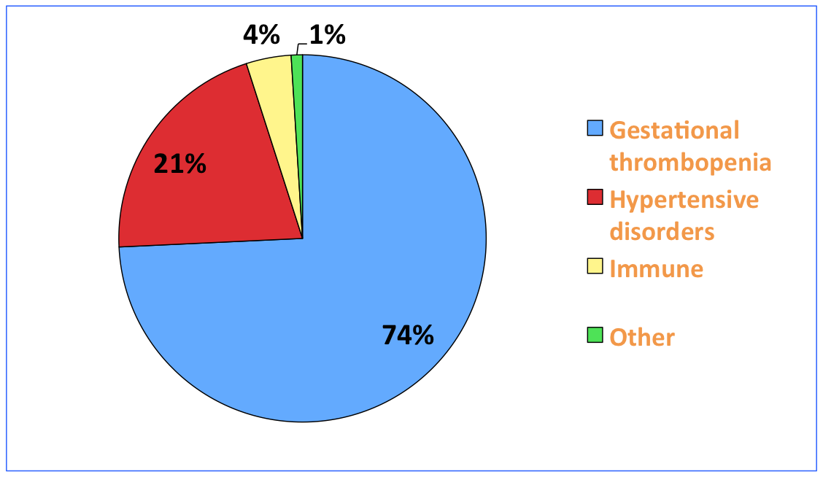
THROMBOCYTOPENIA DURING PREGNANCY
The most common hematological abnomality during pregnancy : 7-15%
BUT
Difficult to distinguish from ITP
Thrombocytopenia can be an indicator of severe complications like eclampsia, DIC, TTP…
⇨ assessment is required, especially when platelets < 100 x10⁹ /L

Slide 7
GESTATIONAL THROMBOCYTOPENIA
4.4-11.6% of healthy pregnant women
Unknown pathogenesis
Mild to moderate thrombopenia
Generally occurs in the 3rd trimester
No maternal bleeding risk
No fetal or neonatal thrombocytopenia or bleeding risk
Platelets are normal before pregnancy
Return to normal within 1-2 months after the delivery
No biomarkers to confirm the diagnosis

Slide 8
ITP IN PREGNANCY
3% of thrombocytopenia (1/1000-10 000 pregnancies)
Can be present before conception or early in pregnancy
Risk of maternal bleeding and fetal thrombocytopenia (IgG cross the placenta)
Exclusion diagnosis
Work-up is similar in nonpregnant women + exclude hypertensive disorders
Detection of antiplatelets antibodies is not recommended

Slide 9
ITP IN PREGNANCY
Who needs a treatment ?
When to treat ?
How to treat ?
Epidural analgesia ?
Management of the delivery
Neonate ?

Slide 10
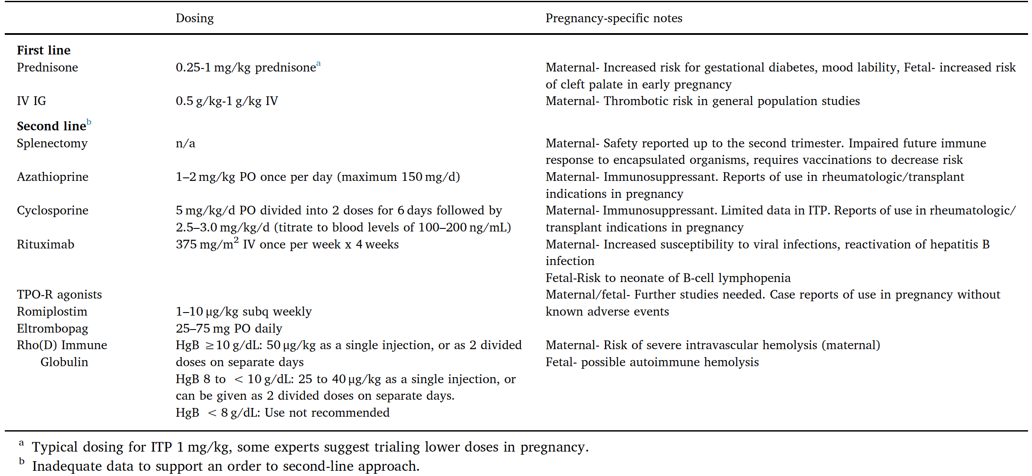
TREATMENT OF ITP DURING PREGNANCY
Platelets < 20 - 30x10⁹/L
Bleeding symptoms
Invasive procedure
Co-morbidities
Preparation for the delivery
Neuraxial anesthesia
Close monitoring from week 34
Pishko A, et al. Blood Reviews 2020;40:100638. Cines D et al. Blood 2017;130 :2271-2277. Gernsheimer T et al. Blood 2013;121:38-47

Slide 11

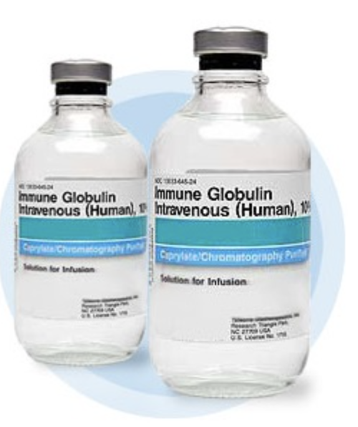
1st LINE THERAPY OF ITP DURING PREGNANCY
No RCT for the optimal dosage and schedule of steroids and IVIG during pregnancy
STEROIDS
Shortest and lower dosage - adjusted to hemostatically effective PLT count
Dexamethasone avoided because of its fetal effects
Weight gain, gestational diabetes, hypertension, mood lability, osteoporosis, gastritis
IVIG
Rapid increase of platelet count- transient efficacy
If steroids are contra indicated – preparation for delivery
Thrombotic risk ∽ general population
Rodeghiero F, et al. Expert Review of Hematology 2020 ;13:175-185. Eslick R, et al. Platelets 2020;31:300-306
Notes:
Onset median of 16 days ; Prednisone 10-20mg/day – target 20-30x10exp9 PLTS

Slide 12
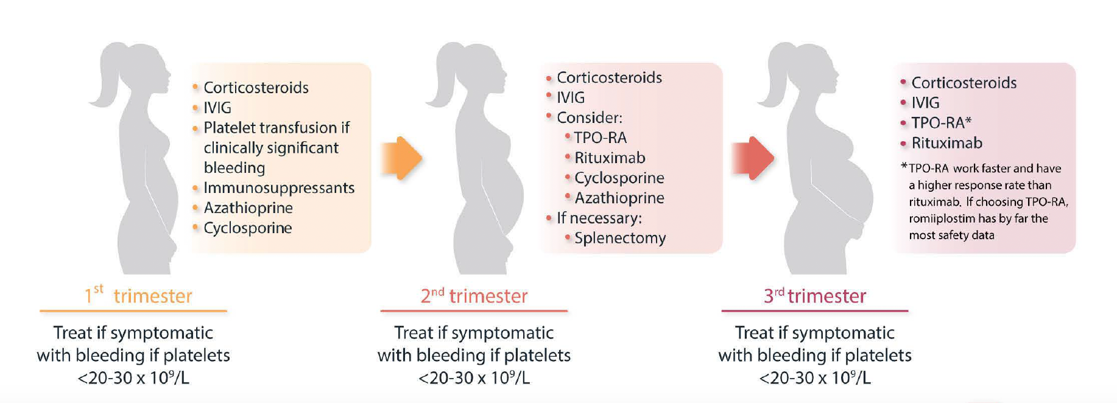
2nd LINE THERAPY OF ITP DURING PREGNANCY
Balance the potential benefit for the mother and the fetal risk
Bussel B, et al. Haematologica 2022

Slide 13
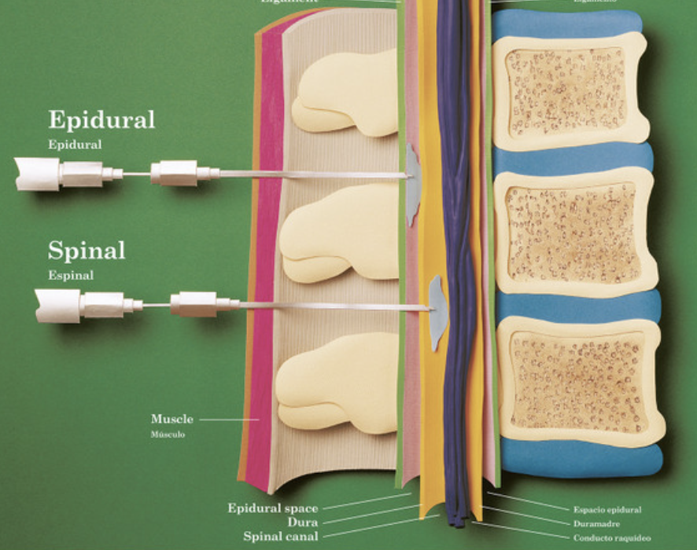
NEURAXIAL ANESTHESIA
The true magnitude of neuraxial hematoma in women with ITP is unkown.
It is usually to request PLT > 80x10⁹/L for the epidural anesthesia
The risk of an epidural hematoma is low (0-11%), even with PLT < 50x10⁹/L¹
Spinal block : PLT > 50x10⁹/L seems to be safe²
1.Lee LO et al. Anesthesiology 2017 – 2. Bauer M et al. Anesth Analg 2021;132:1531-1544

Slide 14
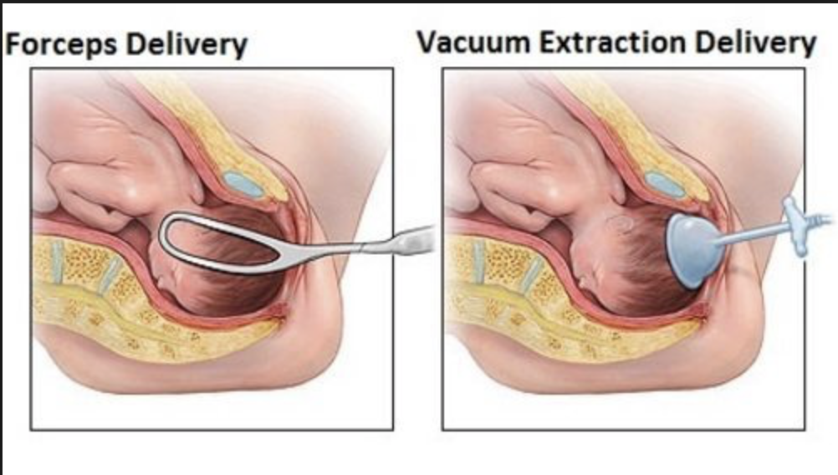
DELIVERY IN WOMEN WITH ITP
Mode of delivery based on the obstetrical condition - delivery plan
Platelets > 50x10⁹/L is usually recommended for caesarian section, less is possible for a vaginal delivery
Instrumental delivery should be avoided (forceps - vacuum extraction - scalp electrode)
NO cordocentesis or fetal blood sampling
Blood cord sampling
Avoid IM injections in the newborn
Pishko A, et al. Blood Reviews 2020;40:100638. Gernsheimer T et al. Blood 2013;121:38-47

Slide 15
POST-PARTUM IN ITP
The incidence of post-partum haemorrhage (PPH) is slightly increased in women with ITP
1,9-22% of PPH with an increased risk if PLT <50x10⁹/L
Obstetric causes account for the majority of PPH/complication of steroids
Tranexamic acid and ureterotonic drugs to reduce PPH
Avoid NSAID if low platelet count
Thromboprophylaxis when indicated
Eslick R, et al. Platelets 2020;31:300-306.
Cines D et al. Blood 2017;130 :2271-2277.
Poston J, et al. Ann Blood 2021;6:5
Notes:
NSAID following platelet count and presence of other risk factors for bleeding, epidural anesthesia

Slide 16
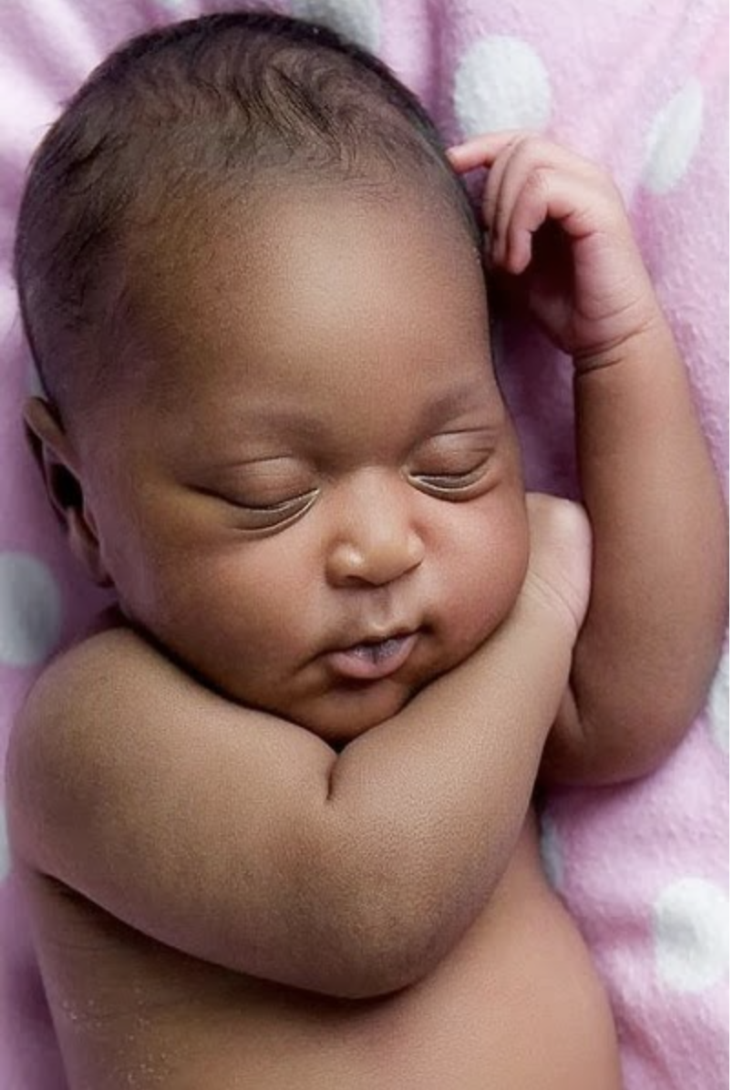
NEONATAL THROMBOCYTOPENIA
10% of neonates have PLT <50x10⁹/L and 5% PLT <20x10⁹/L
Nadir occurs after 2-5 days
Intracranial hemorrhage is very rare (0-1.5%)
Ultrasound if PLT <50x10⁹/L
No difference in ICH incidence between vaginally or caesarian deliveries
If PLT <30x10⁹/L or bleed: IVIG, steroids, platelet transfusion
Thrombocytopenia can last weeks or months
Stop breastfeeding may be useful if persistent thrombocytopenia
Rodeghiero F, et al. Expert Review of Hematology 2020 ;13:175-185. Gernsheimer T et al. Blood 2013;121:38-47.
Gonzalez-Porras JR et al, TH Open 2022Aug 29;6(3):e230-e237

Slide 17
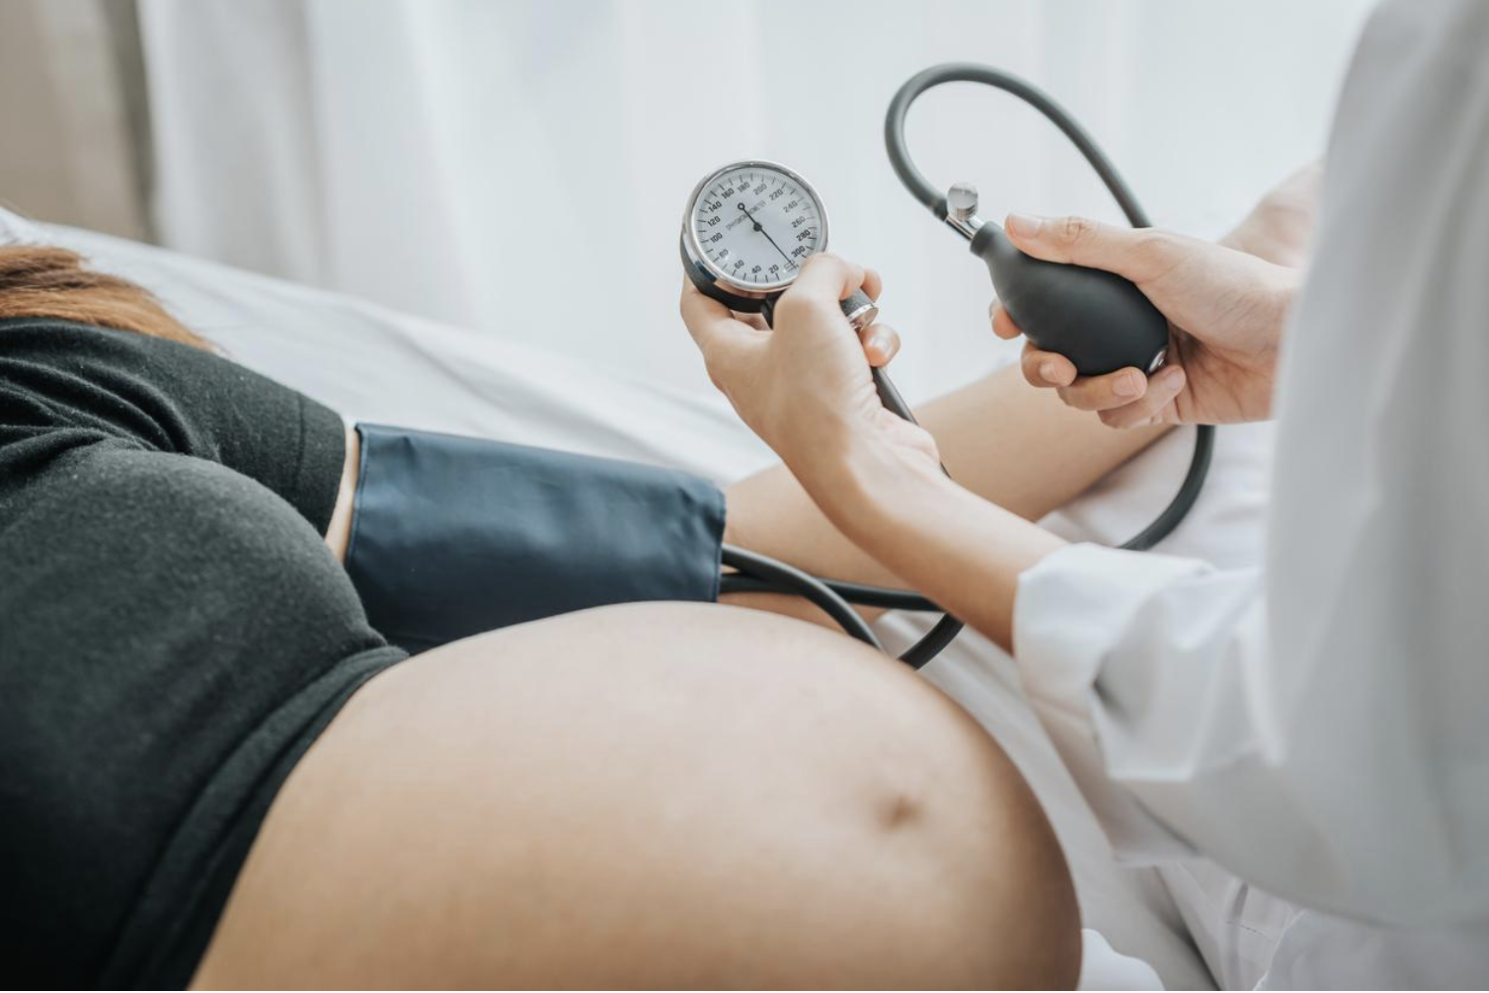
PREGNANCY SPECIFIC
HYPERTENSIVE DISORDERS
Occurs in 6% of all pregnancies
Thrombocytopenia is usually moderate
Bleeding is uncommon (unless DIC develops)
Neonatal thrombocytopenia is uncommon
Treatment : delivery, MgSO4, management of hypertension
Platelets transfusion if bleeding or platelets < 50 x10⁹ /l
Low dose aspirin in subsequent pregnancies

Slide 18
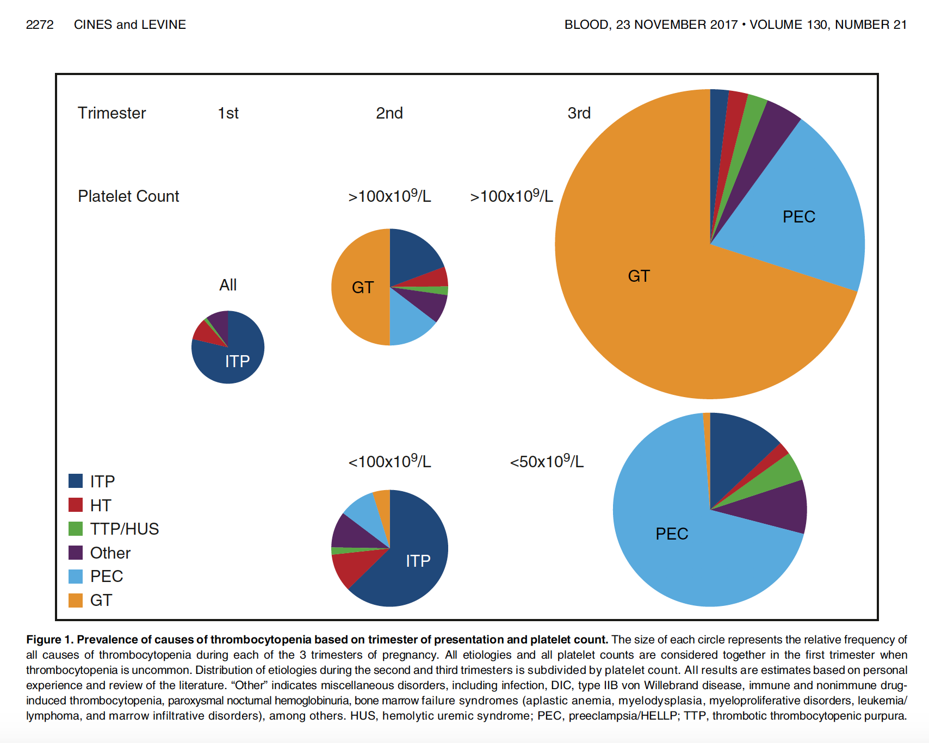

Slide 19
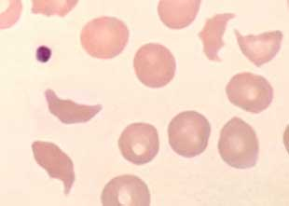
TMAs NOT SPECIFIC TO PREGNANCY
Occurs in 1/25000 pregnancy
May reveal congenital TMA
  Non-immune hemolytic anemia with schistocytes
  Thrombocytopenia (usually < 20 x10⁹ /l)
  Organ impairment (i.e. kidneys, heart, brain)
Overlap with other hypertensive disorders
Can occur before and after delivery
Suspicion if no improvement of preeclampsia or HELLP after delivery
Treatment : plasma exchange, steroids, Rituximab, Eculizumab,…
George, et al. Hematology 2015

Slide 20
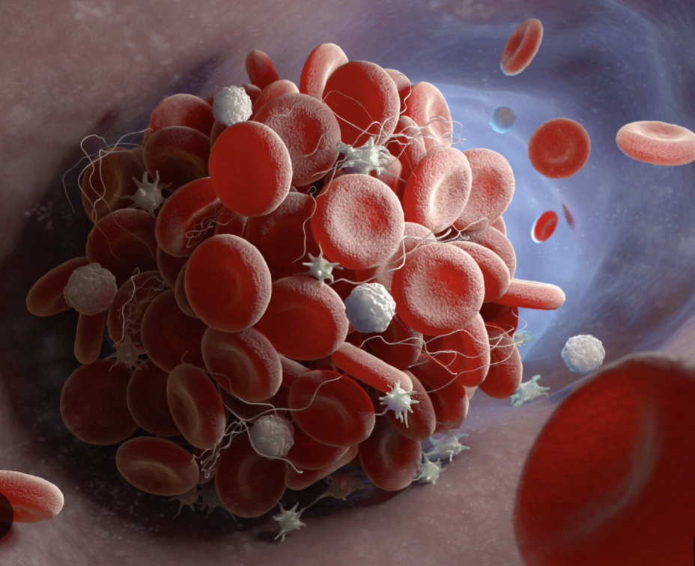
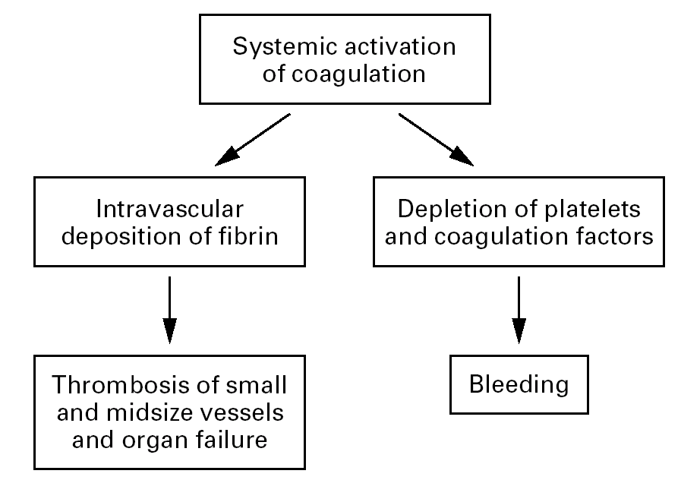
DISSEMINATED INTRAVASCULAR COAGULATION

Slide 21
DISSEMINATED INTRAVASCULAR COAGULATION
Causes of DIC specific to pregnancy
  Placenta abruptio
  Eclampsia and preeclampsia
  Abortion
  Acute fatty liver
  Intra uterine fetal death
  Sepsis
  Amniotic embolism
Biological findings
  ↗ prothrombin time and APTT
  ↘ fibrinogen
  Severe thrombocytopenia
  ↗ fibrin and degradation fibrin product (D-dimers), TAT
  Microangiopathic hemolytic anaemia (schistocytes)

Slide 22
OTHER CAUSES OF THROMBOCYTOPENIA
NOT SPECIFIC TO PREGNANCY
Drugs (LMWH)
Infection (viral, bacteria, parasites, Mycobacteria, rickettsia)
Systemic lupus and antiphospholipid syndrome (APLS)
Hematological malignancies
Congenital :
  Bernard-Soulier
  von Willebrand type IIb
  Hereditary macrothombocytopenia

Slide 23
PREGNANCY = HYPERCOAGULABILITY STATE
Protection from bleeding during delivery
Predisposing to thromboembolism

Slide 24
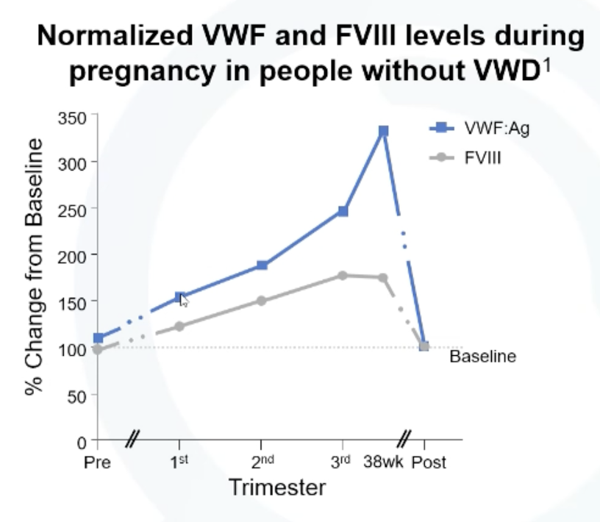
EFFECTS OF PREGNANCY
ON THE COAGULATION
↑ factors VIII, VII, FX, Fibrinogen
↑ von Willebrand factor (vWF)
Factors II, V , IX, XI are stable
↓ natural inhibitors of coagulation
  ↓ Proteins S
  ↓ Antithrombin
Protein C remains stable
↓ fibrinolysis inhibition (hypofibrinolysis)
  ↑ PAI-1 and PAI-2

Slide 25
PREGNANCY IN WOMEN
WITH INHERITED BLEEDING DISORDERS
Von Willebrand disease
Carriers of hemophilia (+/- FVIII or FIX deficiency)
Other rare coagulation factor deficiency (FXI, VII, FI…)
Platelet dysfunction

Slide 26

MANAGEMENT OF PREGNANCIES IN WOMEN WITH INHERITED BLEEDING DISORDERS
Obstetrician
Pediatrician
Hematologist
Anesthesiologist
CONCEPTION
DELIVERY
BEFORE
CONCEPTION
Hemostatic treatment
Bleeding
Invasive procedure
WEEK 34
POST-PARTUM
CLEAR DIAGNOSIS ?
GENETIC COUNSELING
WORK-UP
PLAN DELIVERY
ANALGESIA
PPH ?
NEONATE
PRENATAL DIAGNOSIS
Notes:
Let’s move to another important topic that is the management of pregnancies in women with ITP
On this cartoon, I tried to summarize the important steps that will be addressed
Finally the different steps will require a close collaboration of the hemato …

Slide 27
THERAPEUTIC HEMOSTATIC OPTIONS
Coagulation disorder | Treatment
Primary hemostasis | Plaquettes transfusion DDAVP (Minrin) Concentrate FVIII-vWF Anti-fibrinolytics (EXACYL) Immunoglobulins, steroids,…
Coagulation cascade Thormbin generation Fibrin formation | Fresh frozen plasma FVIII, FIX, (FXI) FI (Fibrinogen) rFVIIa (Novoseven) FXIII PPSB (II, VII, IX et X) Vitamine K
Fibrinolysis | Tranexamic acid (Exacyl)

Slide 28

MANAGEMENT OF PERI-
AND POST-PARTUM PERIOD
Check coagulation parameters at week 34 – clear plan
Factor levels kept > 50 % 3-4 days vaginal delivery and 5 cesarean section
Hospital delivery
Avoid instrumental/prolonged delivery
Avoid invasive monitoring of the fœtus
Check coagulation parameters of the neonate
Check hemoglobin at discharge
Communication between anesthesiologist, obstetrician and pediatrician

Slide 29
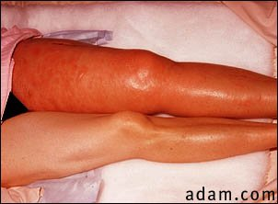
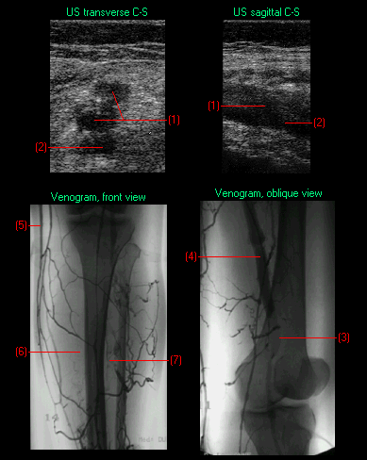
VENOUS THROMBO-EMBOLISM AND PREGNANCY

Slide 30
PREGNANCY AND VTE
Risk of VTE : ↑ 5-10 x during pregnancy and 15-35 x in post-partum
Incidence : 0.5-2.2/1000 pregnancies (0.71: DVT - 0.15 : PE)
Leading cause of non-obstetric maternal death in develop countries. Increased morbidity
Lack of high quality data specific to pregnancy

Slide 31
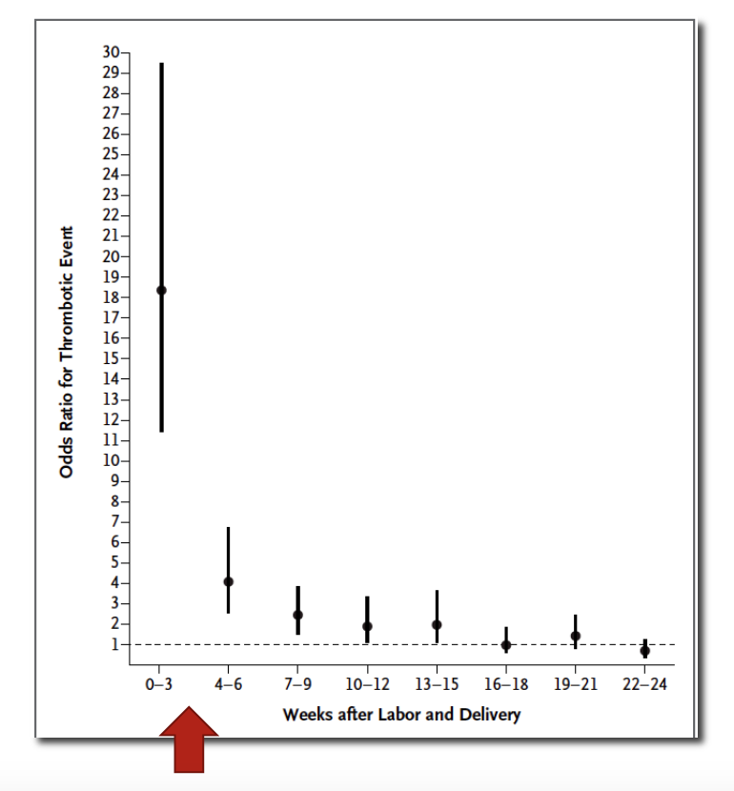
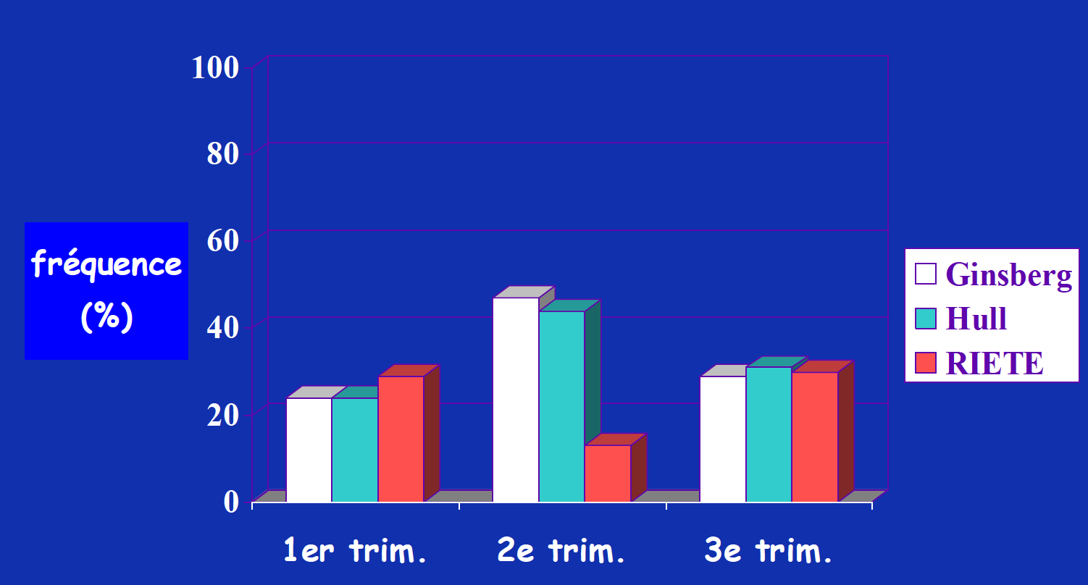
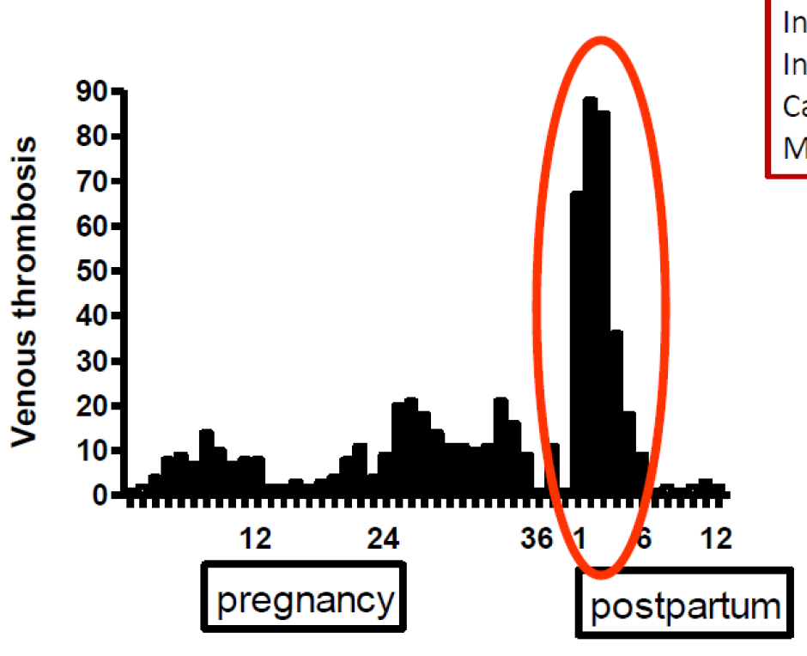
INCIDENCE VTE IN PREGNANCY
50% of the thrombotic events occur during 6 weeks post-partum.
Ginsberg JS Thromb Haemost 1992; 67:519-20
Hull RD Ann Inter Med 1990;112:663-7
Riete Registry Thromb Haemost 2007;97:186-90
Jacobsen AF Am J Obstet Gynecol 2008;198:233 e1-7
Risk of VTE : ↑ 5-10 x during pregnancy and 15-35 x in post-partum
Incidence : 0.5-2.2/1000 pregnancies (0.71: DVT - 0.15 : PE)
Leading cause of non-obstetric maternal death in develop countries.
Kamel H NEJM 2014;370:1307-1315
Meng K J Matern Fetal Neonatal Med 2014:7:1-9

Slide 32
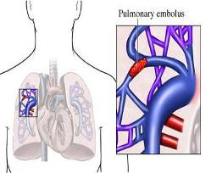
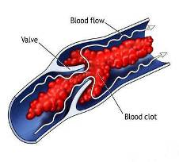
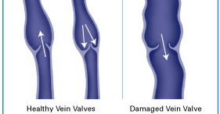
CONSEQUENCES OF VTE IN PREGNANCY
Maternal mortality
Recurrent VTE
Venous insufficiency
Post-thrombotic syndrome (PTS)
Pulmonary
Embolism
Post-thrombotic
Syndrome
Recurrent DVT

Slide 33
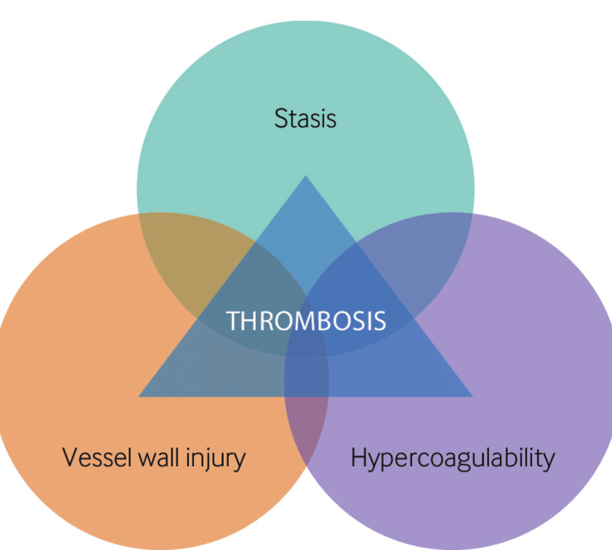
PREGNANCY AND RISK FACTORS FOR VTE
STASIS – Mechanical factors
Slowdown of blood flow
Reduction of vascular tone
Compression of veins by uterus (left > right)
Decreased mobility
HYPERCOAGULABILITY STATE
Increase of Fibrinogen, FVIII and VWF
Reduction of inhibitors (protein S and activated prot C resistance)
Hypofibrinolysis
VASCULAR INJURY / LESION
  - Delivery

Slide 34
INDIVIDUAL RISK ASSESSMENT FOR VTE
BEFORE PREGNANCY
  History of unprovoked or estrogen-related VTE
  Thrombophilia
  Age > 35 years
  Obesity
  Multiparity
  Venous insufficiency
  Nephrotic syndrome, systemic disease (sickle cell and LED)
DURING PREGNANCY
  Immobility
  Hyperemesis
  Dehydration
  Ovarian hyperstimulation
  Preeclampsia
  Cesarean section
  Infection or inflammatory process

Slide 35
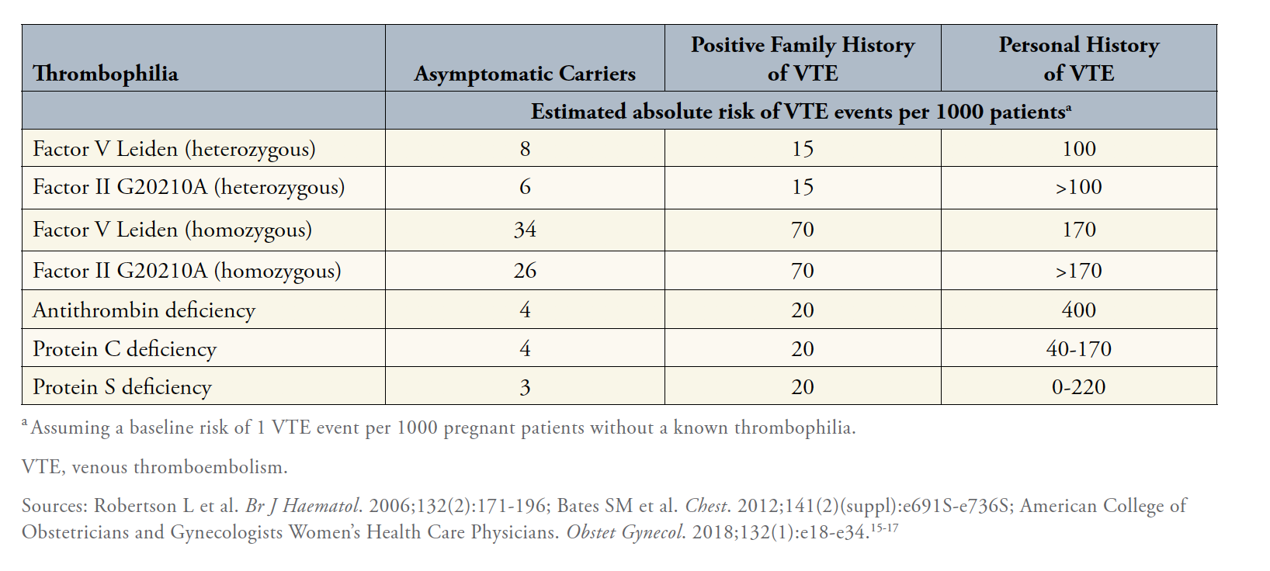
THROMBOPHILIA AND RISK OF DVT
DURING PREGNANCY

Slide 36
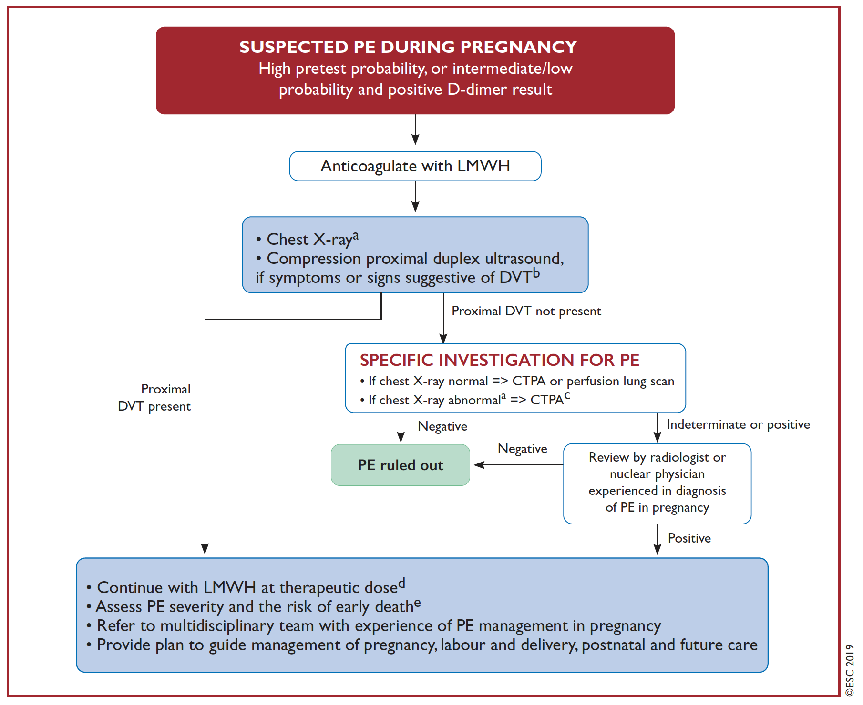
DIAGNOSIS OF VTE DURING PREGNANCY
ESC 2019

Slide 37
ANTITHROMBOTIC DRUGS
DURING PREGNANCY
VKA (Sintrom, Marevan, Marcoumar) relatively contra-indicated
  Cross the placenta
  Risk of bleeding and pregnancy loss
  Teratogenic (6-12 weeks)
LMWH : anticoagulant agent of choice (except in HIT)
  Excellent bioavailability and predictable effect
  Does not cross the placenta
  Short half-life
Fondaparinux has been safely used in case of HIT or allergy to heparin
DOACs : contra-indicated during pregnancy and breast feeding

Slide 38
VTE TREATMENT DURING PREGNANCY
Dose and duration of LMWH:
  Twice a day (over once a day treatment*)
  Throughout pregnancy and at least 6 weeks postpartum or at least 3 months
  If distal DVT : consider reduced LMWH after 3 months of full treatment
Monitoring :
  Anti-Xa activity if < body weight <50 or >100 kg, renal insufficiency, increased bleeding risk - 3 hours after LMWH injection
  Platelet count
Outpatient treatment if clinically stable, no increased bleeding risk, no maternal co-morbidities and good social support
*personal opinion

Slide 39
VTE PROPHYLAXIS DURING PREGNANCY
AND POST-PARTUM
Individualized risk-benefit assessment for prophylaxis during pregnancy
Patient’s perspective
Vigilance versus prophylactic anticoagulation
Standard or intermediate LMWH dose antepartum
Standard or intermediate LMWH dose in the post-partum
Factors to consider: personal or familial history of VTE, circumstances of VTE, the recurrence of VTE, long-term anticoagulation and the type of thrombophilia.

Slide 40
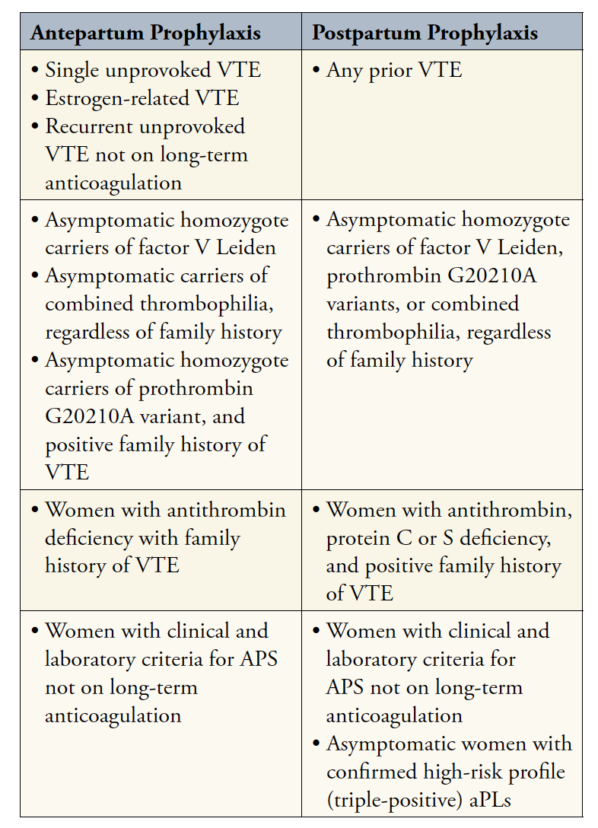
VTE prophylaxis during pregnancy
and post-partum period

Slide 41
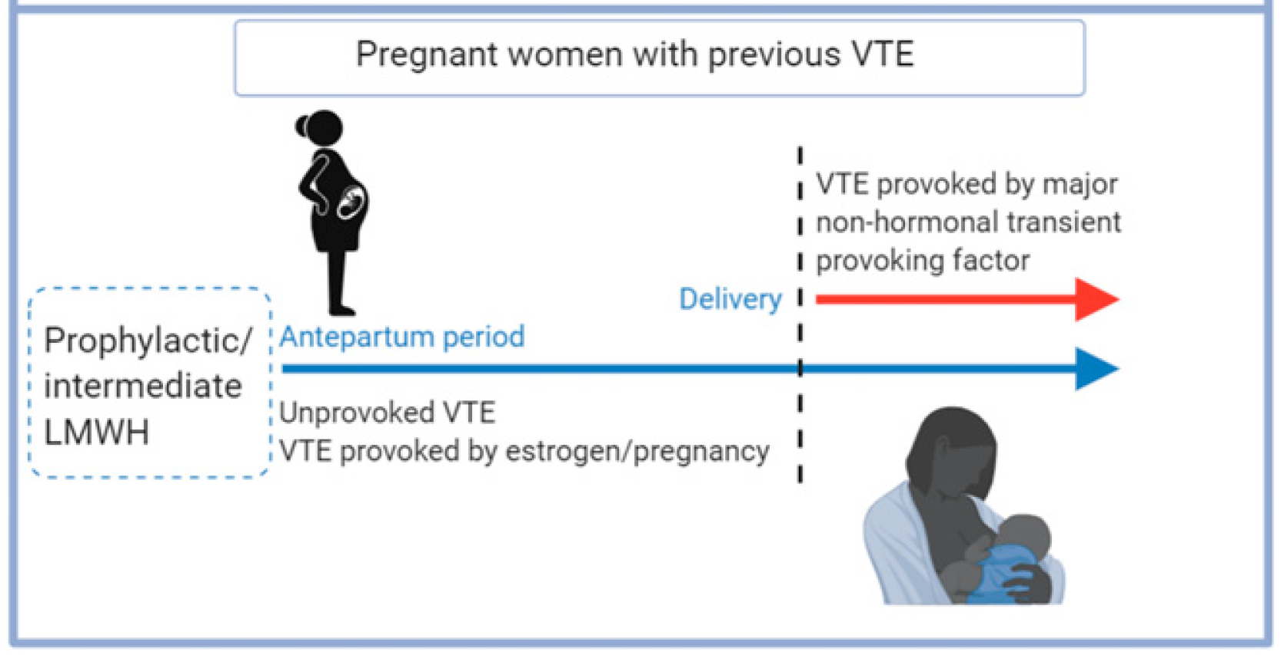
VTE prophylaxis during pregnancy and post-partum
1 episode of VTE provoked by a transient risk factor - unrelated to pregnancy or estrogen use - no thrombophilia
→ surveillance antepartum and prophylaxis postpartum (6 weeks)
Confirmed obstretric APS: LMWH + aspirine
Prior VTE and long-term anticoaguation
→ intermediate or full dose LMWH antepartum

Slide 42
Epidural analgesia and LMWH
Planned delivery if therapeutic anticoagulation.
Insertion of the needle when the anticoagulant effect is minimal (10-12 hours after last prophylactic injection and 24 hours after last therapeutic injection).
Resume prophylactic LMWH 4-12 hours following delivery and at least 6 hours after insertion/removal of the catheter.
Resume therapeutic LMWH 24 hours following delivery and 24 hours after removal of the catheter.

Slide 43
THROMBOPHILIA
Inherited or acquired predisposition towards thrombosis
Associated with an increased risk of venous thromboembolic disease
Can be associated with adverse pregnancy outcomes (APL)
Avoid testing during pregnancy (< 12 weeks) and hormonal therapy
Who should be screened for thrombophilia ?
Family history of VTE
Idiopathic VTE (or after a trivial provocation)
VTE < 60 years old
Recurrent VTE
Unusual site of VTE
Suspicion of APS

Slide 44
Thank you for your attention

Slide 45
Bibliography
American Society of Hematology 2018 guidelines for management of venous thromboembolism: venous thromboembolism in the context of pregnancy. Bates S et al. Blood Advances. 2018.
Updated international consensus report on the investigation and management of primary immune thrombocytopenia. Provan D et al. Blood Advances. 2019.
Pregnancy-adapted years algorithm for diagnosis of suspected pulmonary embolism. Van der Pol LM. NEJM 2019.
Thrombocytopenia in pregnancy. Cines D. Blood 2017.
Risk Factors for and clinical management of venous thromboembolism during pregnancy. Rybstein M. Clin Adv Hematol Oncol. 2019.

