Slide 1
Immunophenotyping and NGS of iNHL
15 Feb 2025
BHS Course on ‘Indolent Lymphoma’

Slide 2
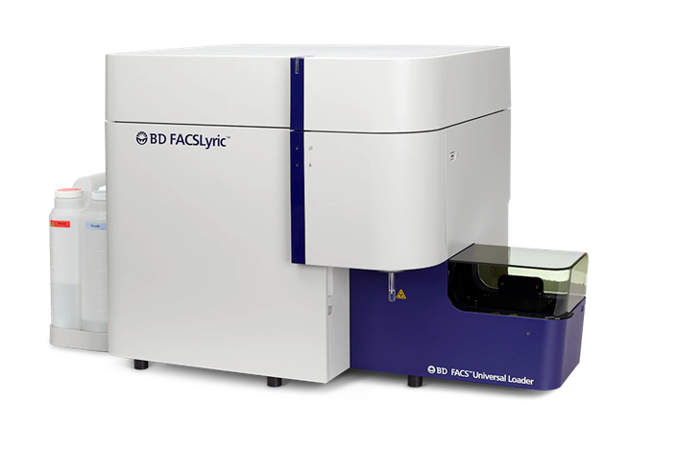
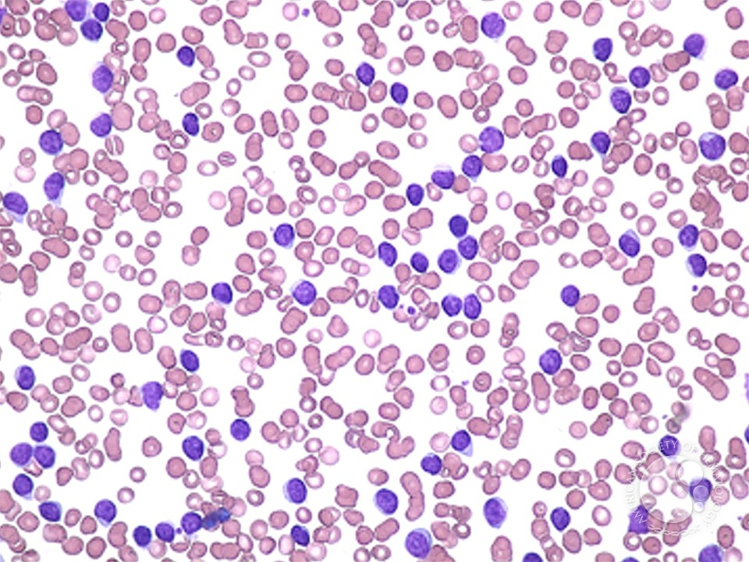
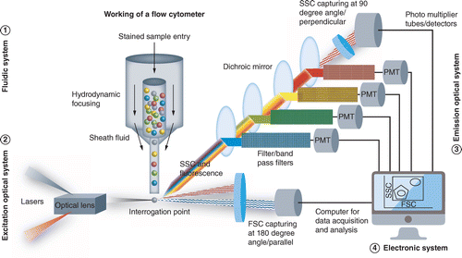



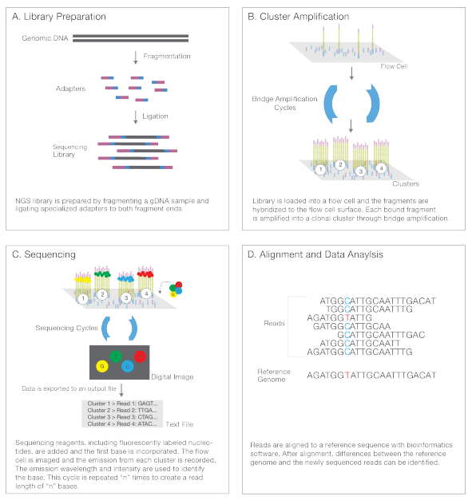
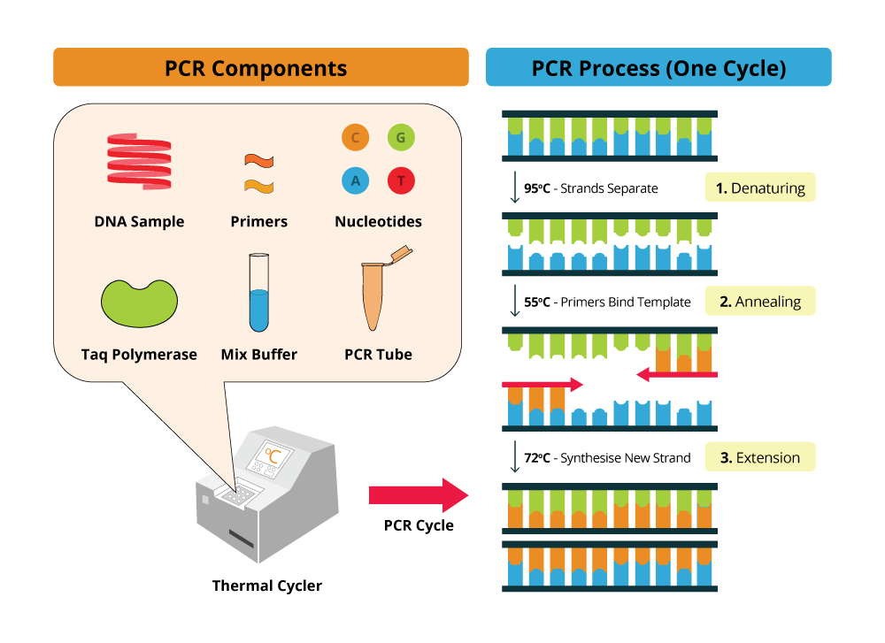
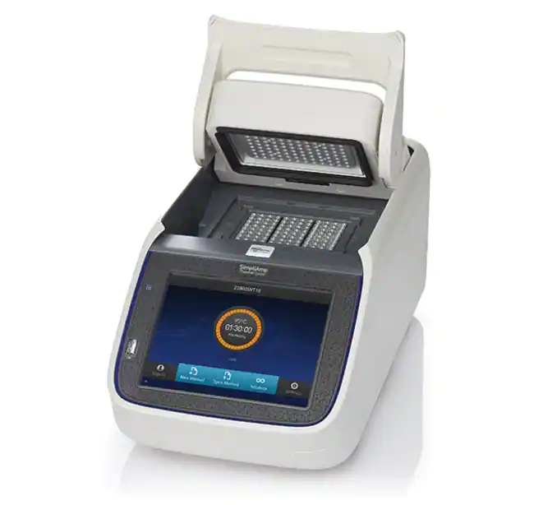
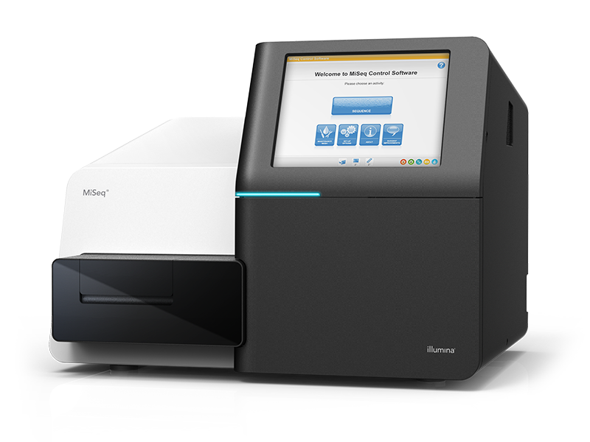

Microscopy
blood smear
Flowcytometry
Next Generation Sequencing
Molecular Diagnostics
Lymphoma workup in a clinical biology lab

Slide 3
Microscopy
blood smear
Flowcytometry
Next Generation Sequencing
Molecular Diagnostics
Lymphoma workup in a clinical biology lab

Slide 4
Principles of immunophenotyping
Immunophenotyping = flow cytometry
= laser-based technology that measures and analyses different physical and chemical properties of cells and particles flowing in a stream of fluid through a beam of light
Fluidics: transportation of particles in a stream to the laser beam
Optics: lasers to illuminate the particles and optical filters to direct the resulting light signal to the appropriate detectors
Electronics: convertation of the detected light signal into electronic signal

Slide 5
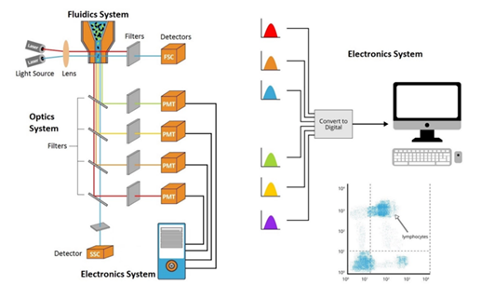
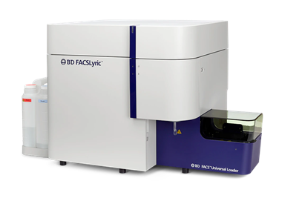
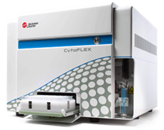
Principles of immunophenotyping

Slide 6
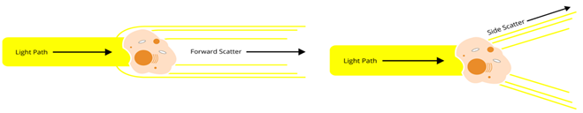
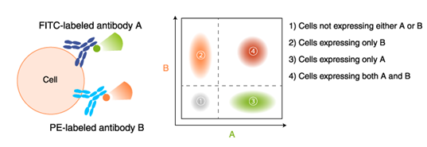
Principles of immunophenotyping

Slide 7
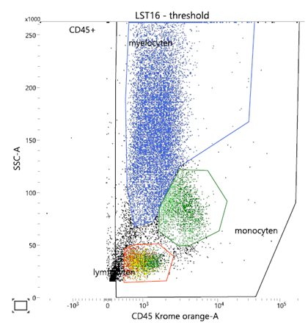
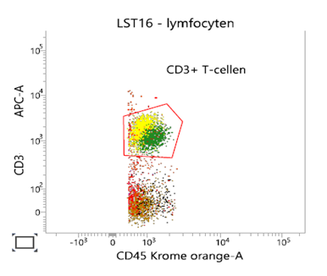
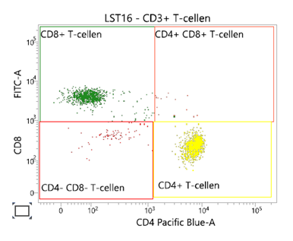
Principles of immunophenotyping

Slide 8
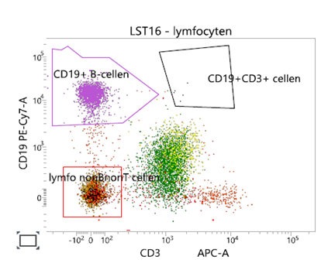
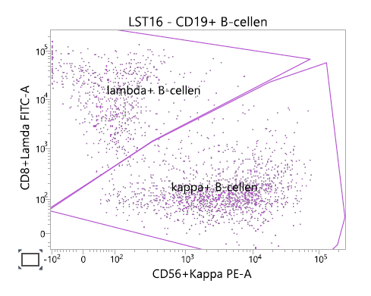
Principles of immunophenotyping
Polyclonal B-lymphocytes

Slide 9
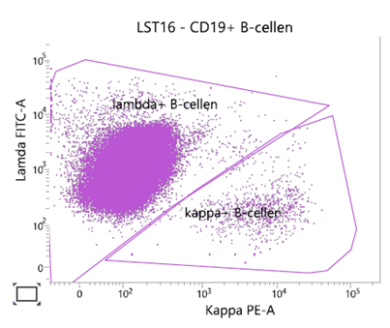
Principles of immunophenotyping
Monoclonal B-lymphocytes

Slide 10
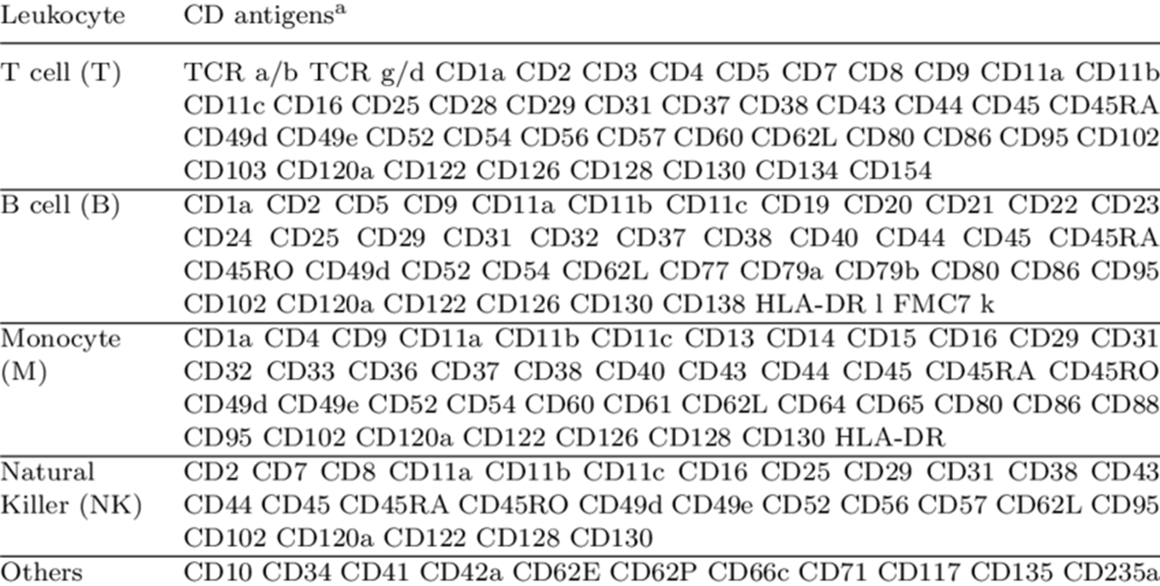
Cluster of differentiation
Ho et al. Genome Inform 2008;21:126-37

Slide 11
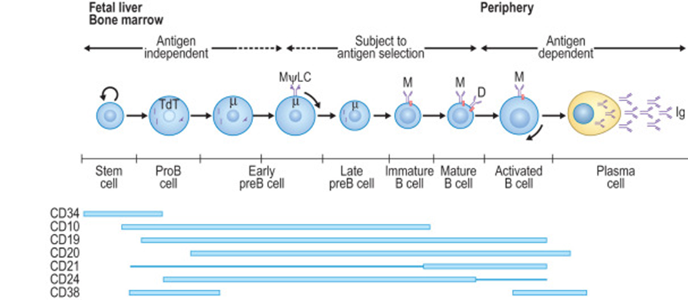
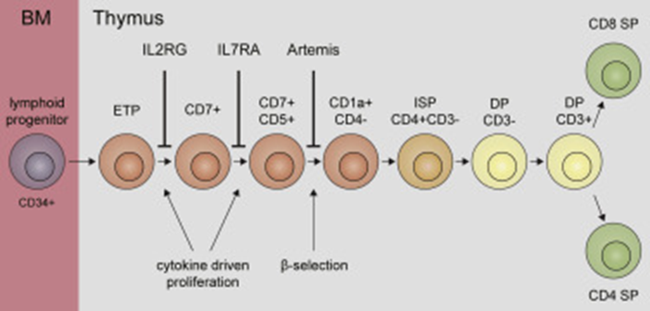
CD expression during maturation
Wiekmeijer et al. J Allergy Clin Immunol 2016;137:517-26
Schroeder et al. Clin Immunol 2019; 107-118

Slide 12
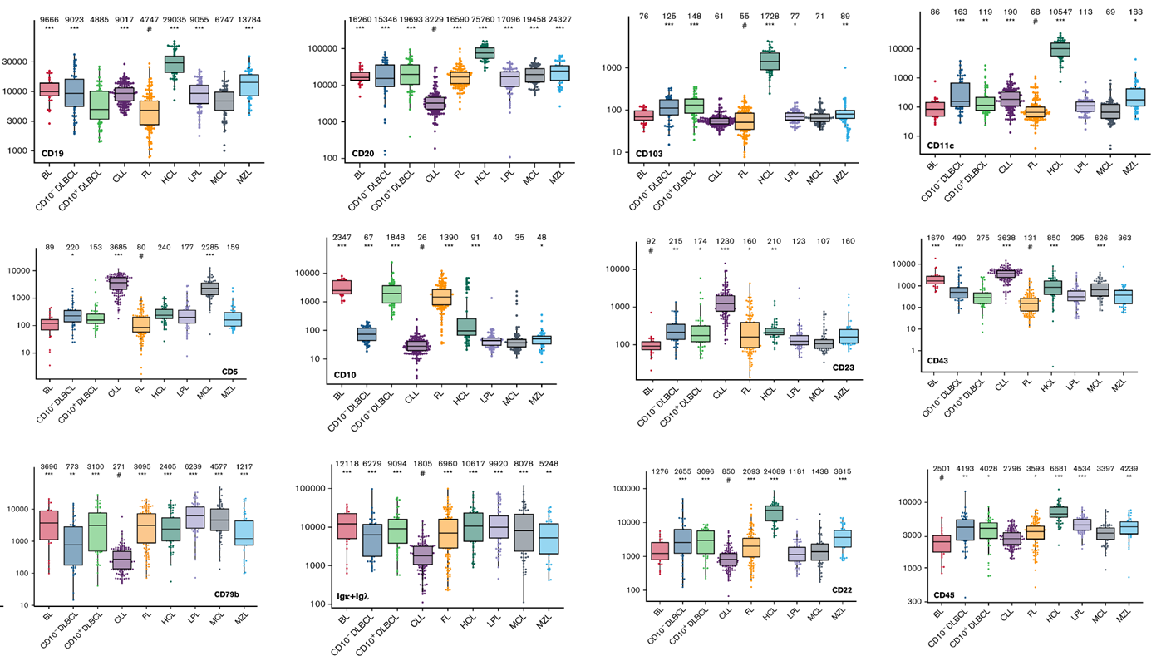
CD expression in relation to lymphoid neoplasm
Böttcher et al. Blood Adv 2022;6:976-92

Slide 13
CD expression in relation to lymphoid neoplasm
Böttcher et al. Blood Adv 2022;6:976-92

Slide 14
CD expression in relation to lymphoid neoplasm
Böttcher et al. Blood Adv 2022;6:976-92

Slide 15
CD expression in relation to lymphoid neoplasm
Böttcher et al. Blood Adv 2022;6:976-92

Slide 16
CD expression in relation to lymphoid neoplasm
Böttcher et al. Blood Adv 2022;6:976-92

Slide 17
Pitfalls
Inaccurate sampling
Inadequate sampling size
Lack of uniform involvement of the tissue sample
eg. plasma cell myeloma
Cell fragility, apoptosis and necrosis
  more common issue in biopsy and aspirates
  very frequent in large B-cell lymphoma (Burkitt, DLBCL)
  estimated underdiagnosis in more than 35% of cases

Slide 18
Microscopy
blood smear
Flowcytometry
Next Generation Sequencing
Molecular Diagnostics
Lymphoma workup in a clinical biology lab

Slide 19
Microscopy
blood smear
Flowcytometry
Next Generation Sequencing
Molecular Diagnostics
Lymphoma workup in a clinical biology lab

Slide 20
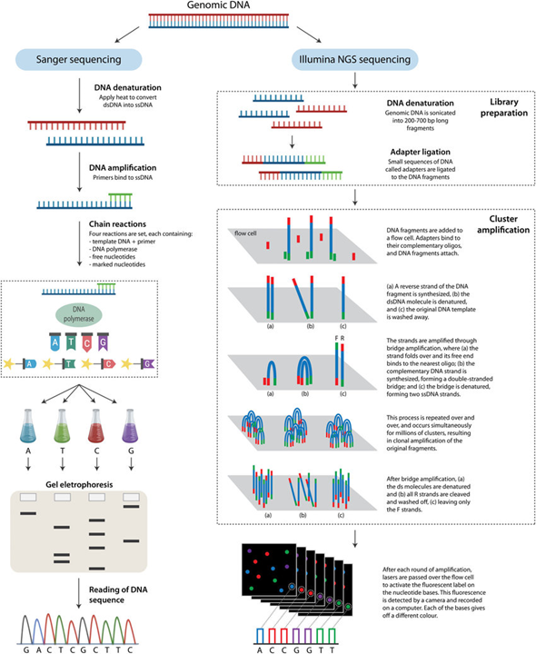
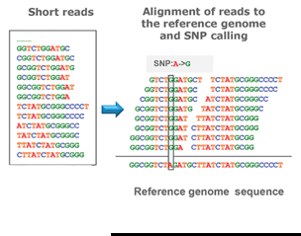
NGS principle

Slide 21
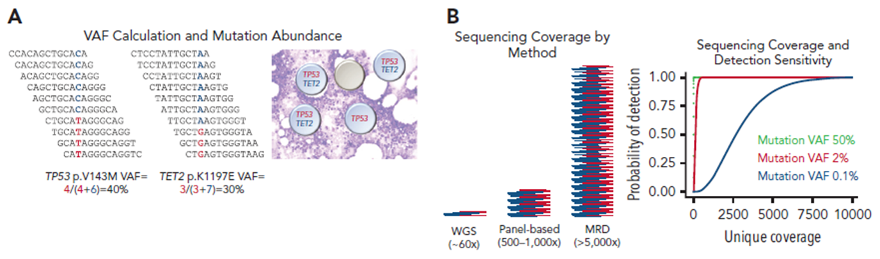
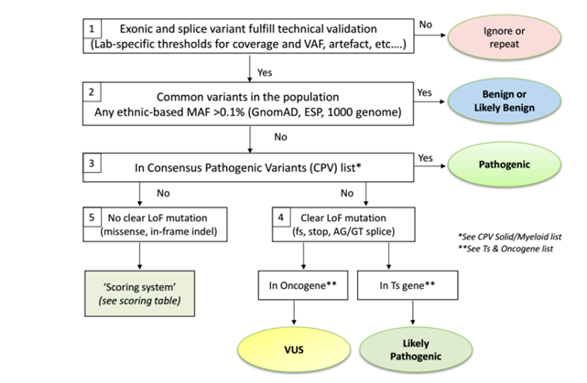
NGS terminology
Duncavage et al. Blood 2022;140:2228-47
Froyen et al. Cancers 2019;11:2030

Slide 22
NGS in lymphoma
Emerging field of research
New insights
Reimbursement in Belgium:
  CLL
  Mantel cel lymphoma
  Lymphoplasmacytic lymphoma
  T-Large Granular Lymphocytic Leukemia
  Follicular helper T-cell lymphoma

Slide 23
NGS in CLL
TP53 mutational analysis (NGS)
Molecular cytogenetics (del17p)
IGHV somatic hypermutation analysis
→ prognosis & start of treatment
Second line (progression after first line BTK inhibitor)
  BTK
  PLCG2
→ therapy

Slide 24
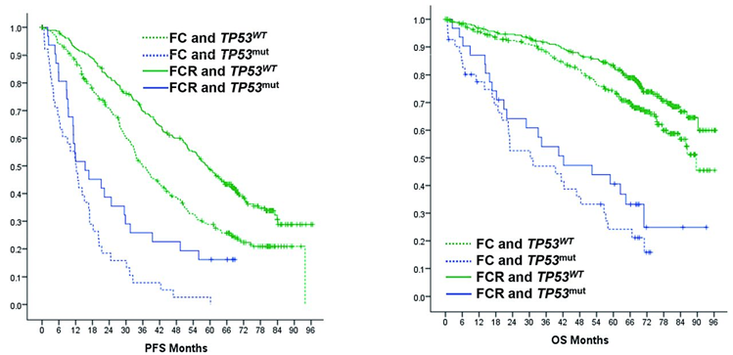
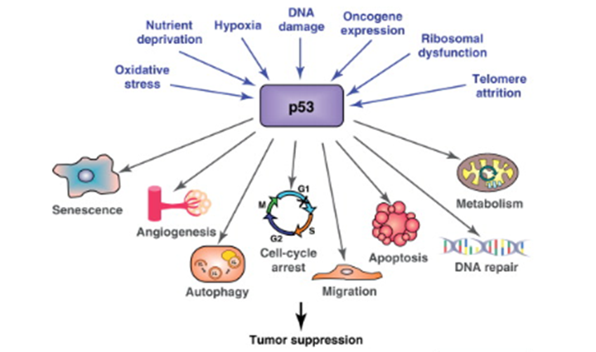
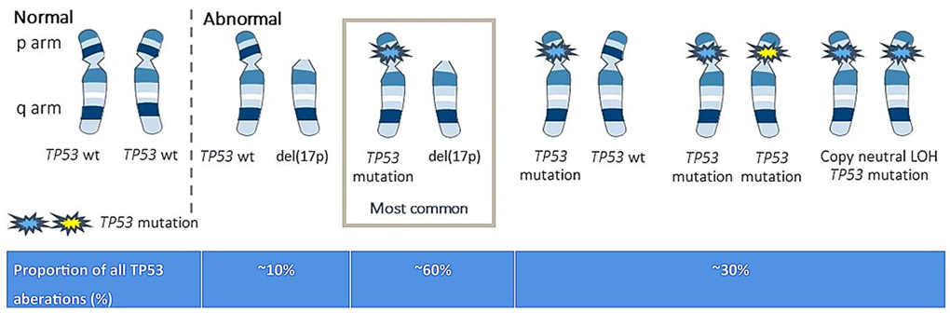
NGS in CLL
Moulder et al. Cancers 2018;10:189
Campo et al. Haematologica 2018;103:1956-68

Slide 25
NGS in MCL
TP53
→ prognosis: associated with inferior prognosis
5th Ed. WHO Classification 2022
ICC Classification 2022

Slide 26
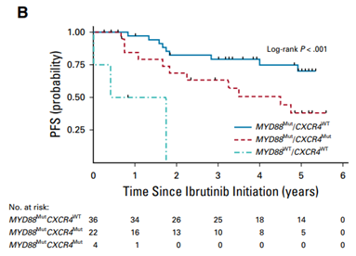
NGS in LPL
MYD88
  diagnosis: driver mutation in 90% of patients
  prognosis: patients without MYD88 L265P (wild-type) more aggressive disease
  therapy: patients without MYD88 L265P (wild-type) treatment-resistant disease
CXCR4
  therapy: predictive of resistance to ibrutinib therapy
5th Ed. WHO Classification 2022
ICC Classification 2022
Treon et al. J Clin Oncol 2021;20:565-75

Slide 27
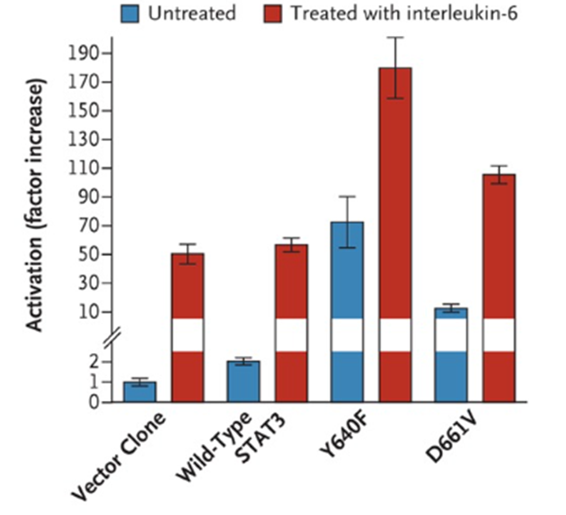
NGS in T-LGL
STAT3
STAT5B
  diagnosis: in case there is no clear diagnosis based on morphology and/or flow cytometry
  T-LGL and even pseudoclonality is present in case of viral infection and autoimmune disorders
  40% of T-LGL cases have activating mutations in STAT3
  STAT3 prevents BCL2-induced apoptosis in T-cells
  T-cell proliferation
  STAT3-inhibitors in early clinical trials
5th Ed. WHO Classification 2022
ICC Classification 2022
Koskela et al. N Eng J Med 2012;366:1905-13

Slide 28
NGS in Follicular T-Helper Cell Lymphoma
DNMT3A
IDH2
RHOA
TET2
  diagnosis
5th Ed. WHO Classification 2022
ICC Classification 2022

Slide 29



