Slide 1



Leucocytosis / Leucopenia
J Caers
Laboratory of Hematology, Uliège
Department of Hematology, CHU de Liège

Slide 2
1. Leucopenia
2. Leucocytosis

Slide 3

1. Leucopenia
2. Leucocytosis

Slide 4
Neutropenia
Central (decreased production)
- Pancytopenia (BM infiltration, BM aplasia, MDS, chemotherapy, nutritional, HLH ...)
- Isolated neutropenia :
- Drug-induced
- Viral infections
- Congenital
- Bacterial infections
- MDS...
Peripheral (excessive destruction)
- Ethnicity : African descent and some Middle Eastern ethnic groups
- Splenic sequestration
- Autoimmune (idiopathic or secondary)
Systemic lupus erythematous
RA (Felty’s syndrome)
Large Granular Lymphocytic leukemia

Slide 5
Transient (< 3 months)
Infections
Drugs
Chronic
Acquired
Congenital

Slide 6
Transient Neutropenia
Transient - Infections
Viral :
- Almost any virus
- Profound and ‘ long-lasting ’ : CMV, EBV, HIV, Influenza, Parvovirus B19
Overwhelming acute bacterial sepsis
- Poor prognosis
Depletion of the BM storage pool
Brucella, BK, Tularemia, (para)Typhoid, Ehrlichia
Transient – Drugs

Slide 7
Transient Neutropenia
Transient - Infections
Viral :
- Almost any virus
- Profound and ‘ long-lasting ’ : CMV, EBV, HIV, Influenza, Parvovirus B19
Overwhelming acute bacterial sepsis
- Poor prognosis
Depletion of the BM storage pool
Brucella, BK, Tularemia, (para)Typhoid, Ehrlichia
Transient – Drugs
1. Direct or indirect toxicity to progenitors :
- Chemotherapy, Anti-epileptica, colchicine, azathioprine,
ganciclovir... ....
- Presentation may be delayed for months
- Usually asymptomatic
- Dose-dependent
2. Immune mediated (AB or cell-mediated) : agranulocytosis (mortality 5%)
- Days or weeks after beginning treatment
- Often acute and explosive symptoms
- Rechallenge or inadvertent re-administration : prompt recurrence with low dose

Slide 8
Transient Neutropenia
Prominent drugs causing transient neutropenia
Anticonvulsant: Carbamazepine, Valproate
Antibiotics: Sulfonamides, penicillins, TMP/SMT, vancomycin, linezolid
Antipsychotic Clozapine, olanzapine, phenothiazines
Antirheumati: MTX, levamisole, penicillamine
Antithyroid :Thiamazole, propylthiouracil
Other Aminopyrine, deferiprone, rituximab, ticlopidine, sulfasalazine, metamizol(novalgine)
Transient – Drugs
1. Direct or indirect toxicity to progenitors :
- Chemotherapy, Anti-epileptica, colchicine, azathioprine,
ganciclovir... ....
- Presentation may be delayed for months
- Usually asymptomatic
- Dose-dependent
2. Immune mediated (AB or cell-mediated) : agranulocytosis (mortality 5%)
- Days or weeks after beginning treatment
- Often acute and explosive symptoms
- Rechallenge or inadvertent re-administration : prompt recurrence with low dose
Neutropenia can occur at any time of therapy
with almost any drug

Slide 9
Rituximab-associated late-onset neutropenia
Isolated neutropenia > 3-4 weeks after the last dose
Usually moderate, sometimes severe
Unknown mechanism
Decreased granulopoiesis and maturation arrest
6-9% NHL population
Median time : 75-120 days after the last dose
Median duration : 6-77 days
Recurrence may occur (after re-adminstration or not)
G-CSF hastens recovery but do not change outcome
Infections : not very frequent (17%), not very severe

Slide 10
Chronic acquired neutropenia
1. Chronic autoimmune/idiopathic neutropenias : overlapping
- Lack of reliable antibody test
- 5F/1M
- No serious infection
- If severe : recurrent stomatitis and skin/respiratory infections
4. B12, folic acid, copper, protein-caloric
nutritional deficiencies
2. Chronic inflammatory and autoimmune diseases (SLE, RA..)
- Mild and often intermittent
- Felty : RA, severe neutropenia, splenomegaly
5. Hematological diseases ...
- MDS, Aplastic anemia, PNH
- HCL
3. LGL leukemia
- Isolated chronic neutropenia in older adults
- Clonal expansion of activated T / NK cells
- Stat-3 mutations
- Both autoimmune and cytokine mediated
- Associated conditions: RA, auto-immune diseases
6. Splenic sequestration

Slide 11


Slide 12
Congenital neutropenia
BM failure is often not the only feature
Skin, nail, musculoskeletal, urogenital, or other phenotypic abnormalities.
Marrow failure may even be absent or present later than other syndromic manifestations in some patients.
Clinical presentations and severity may vary between patients with the same disorder, due to differences in specific mutations, modifying genes, or environmental factors.
Single lineage abnormalities may manifest before pancytopenia

Slide 13
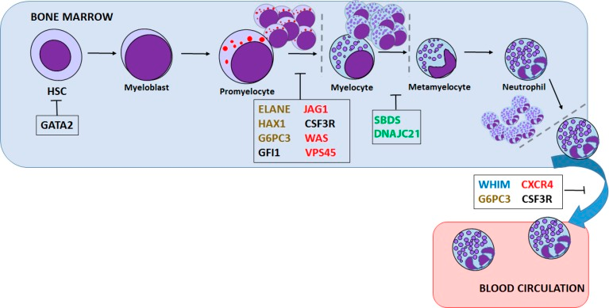
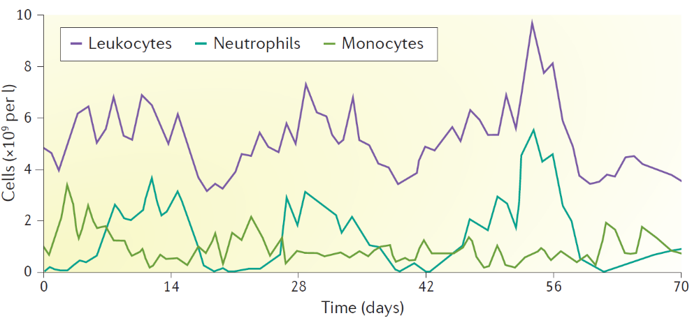
Severe congenital neutropenia
Inherited disorders of haematopoiesis that are character
ized by impaired differentiation of neutrophilic granulocytes and, as a result, severe chronic neutropenia
Skokowa J, Dale DC, Touw IP, Zeidler C, Welte K. Severe congenital neutropenias. Nat Rev Dis Primers. 2017

Slide 14
Severe congenital neutropenia

Slide 15
Severe congenital neutropenia
Diagnosis
Repeated infections
WBC count
BM cytology:
  Exclude MDS/AML
  maturation arrest of granulopoiesis: Increased numbers of promyelocytes and myelocytes and a paucity of metamyelocytes, band cells and mature neutrophils.
Genetic analyses.
Management
Initiation of G‑CSF therapy at diagnosis
  a ‘non-responder’ at G‑CSF dosages of 25 -50 μg/kg/d and ANCs of <0.5 × 109 cells
SCT
  Mild conditioning regimes
  5‑year OS of 80%
  Important to obtain full donor chimerism

Slide 16
Syndrome | Median age at diagnosis (years) | Congenital features | Hematologic features | Malignancy risk | Key diagnostic features | Germline genetic cause and somatic mutations
Telomere biology disorders | ~15 | Classic triad (rare) of nail dystrophy, abnormal skin pigmentation and oral leukoplakia; pulmonary fibrosis, liver fibrosis, vascular abnormalities, esophageal strictures, early hair graying, cerebellar hypoplasia, retinopathy | Pancytopenia, hypocellular BM +/− dysplasia | MDS/AML (low risk); solid tumors including head and neck and anorectal carcinomas | Very short telomere length in peripheral blood using flow-FISH | Germline: DKC1, TINF2, TERT, TERC, and RTEL1 account for ~60% of cases
GATA2 deficiency | ~20 (MDS/AML) | Hearing loss, lymphedema, hydrocele, verrucosis, thrombosis, autism, attention deficit/hyperactivity | Variable cytopenias, hypocellular BM +/− dysplasia | MDS/AML (high risk) | Monosomy 7, der1;7, low monocytes, B/NK cells, reverted CD4/8 ratios | Germline: GATA2 Somatic: MDS type mutations (SETBP1, ASXL1STAG2, etc)

Slide 17
Neutropenia
Fever
ANC < 500
Yes
Admit
IV antibiotics
Consider G-CSF
Jacobson and Berliner. Wintrobe’s Clinical Hematology, 2011

Slide 18
Neutropenia
Low VitB12, Folate ?
Autoimmune disorder ?
Fever
ANC < 500
No
Drug or toxin
Yes
Drug- or toxin-induced neutropenia
Yes
New onset
No
Ethnic or benign familial neutropenia.
Admit
IV antibiotics
Consider G-CSF
Yes
Single or multlineage
Pancytopenia
Low VitB12, Folate ?
Autoimmune disorder?
Isolated
BM biopsy, aspiration,
flow cytometry
No
Low B12,
folate
Autoimmunity
Megaloblastic anemia
Immune
cytopenia
Jacobson and Berliner. Wintrobe’s Clinical Hematology, 2011

Slide 19
Neutropenia
Low VitB12, Folate ?
Autoimmune disorder ?
Fever
ANC < 500
No
Drug or toxin
Yes
Drug- or toxin-induced neutropenia
Yes
New onset
No
Ethnic or benign familial neutropenia.
Admit
IV antibiotics
Consider G-CSF
Yes
Single or multlineage
Pancytopenia
Low VitB12, Folate ?
Autoimmune disorder?
Abnl Cytogenetics
Isolated
MDS
BM biopsy, aspiration,
flow cytometry
No
Idiopathic
neutropenia
Nl
LGL by flow
Low B12,
folate
Autoimmunity
LGL
Megaloblastic anemia
Immune
cytopenia
Jacobson and Berliner. Wintrobe’s Clinical Hematology, 2011

Slide 20
Lymphopenia
Lymphocytes < 1 000 / mm3
Causes
Acquired
Infections (viral, HIV, TBC, thyphoïd…)
Iatrogenic : immunosuppressive agents, chemotherapy, radiotherapy, corticosteroids, fludarabine, …
Lymphoma
Sarcoïdosis, Cushing,
Renal failure, undernutrition, Zn deficiency, alcool,
Congenital (immunodeficiency syndromes)
Risk : Infections
- Viral (herpes zoster, CMV, …)
- Fungal (Pneumocystis, … )
- Tuberculosis
Prophylaxis if chronic
Trimethoprime + Sulfamethoxazole:
Aciclovir

Slide 21
Moncytopenia
Risk : infection (atypical mycobacterial infection)
Two conditions (excluding generalized BMF) :
Hairy cell leukemia
GATA2 deficiency

Slide 22

1. Leucopenia
2. Leucocytosis

Slide 23
Hyperleucocytosis
> 10.000 WBC/mm³
Normal Cells
Abnormal cells or blastic cells
Infections ? Neutrophilia (> 7.500/mm³) Acute Leukemias
Lymphocytosis (> 4.500/mm³) Chronic Myelomonocytic Leukemias
Chronic Lymhocytic leukemia
Chronic Myeloid Leukemia
Non Hodgkin Lymphoma
Chronic Monocytosis (> 800/mm³) …
Inflammations? Eosinophilia (> 400/mm³)
Basophilia (> 100/mm³)

Slide 24
Leukoerythroblastic reaction
Cytopenia with
immature RBCs (normoblasts)
immature WBCs
(agranular neutrophils, myelocytes, metamyelocytes )
Causes
BM infiltration
Solid tumor or hematological malignancy
Myelofibrosis
Strong BM stimulation
Infection, inflammation, hypoxia, trauma
Severe Hemolytic or megaloblastic anemia
Massive bleeding

Slide 25
Leukemoid reaction
Leucocytosis ( > 50.000) similar to CML
Causes
- Infection (TB…)
- Intensive care
Laboratory abnormalities
- WBC > 50,000/µL
- Formula deviated: immature WBC
→ hyposegmented neutrophils
→ métamyelocytes, myelocytes, promyelocytes,

Slide 26
Leucocytosis
Secondary to other disease entities
Infection
Chronic Inflammation
Cigarette smoking and Stress
Drug induced (Corticosteroids, beta agonists, lithium, G-CSF etc)
Heat Stroke
Marrow stimulation and Post splenectomy status
Primary hematologic etiology :
Chronic idiopathic neutrophilia
Myeloproliferative disorders (eg, CML, PV,ET)
Cigarette smoking and Stress
Drug induced (Corticosteroids, beta agonists, lithium, G-CSF etc)
Heat Stroke
Marrow stimulation and Post splenectomy status

Slide 27
CASE 1: ♂ 65 years old
2009 Leucocytosis with neutrophilia
BLOOD CELL COUNT
53,4⁺ | WBC (10⁹/L)
4.72 | RBC(10¹²/L)
13,3 | Hb (g/dl)
38 | Hct (%)
82 | MCV (fl)
34 | CMH (pg)
34 | CCMH (g/L)
9 | MPV (fl)
251 | Platelets
Differential Counts (%)
- | Blasts
1% | Myélocytes
25 %⁺ | Métamyelocytes
- | Non segmented
59 | Neutrophils
4 | Lymphocytes
25 | Monocytes
5 | Eosinophils
0 | Basophils

Slide 28
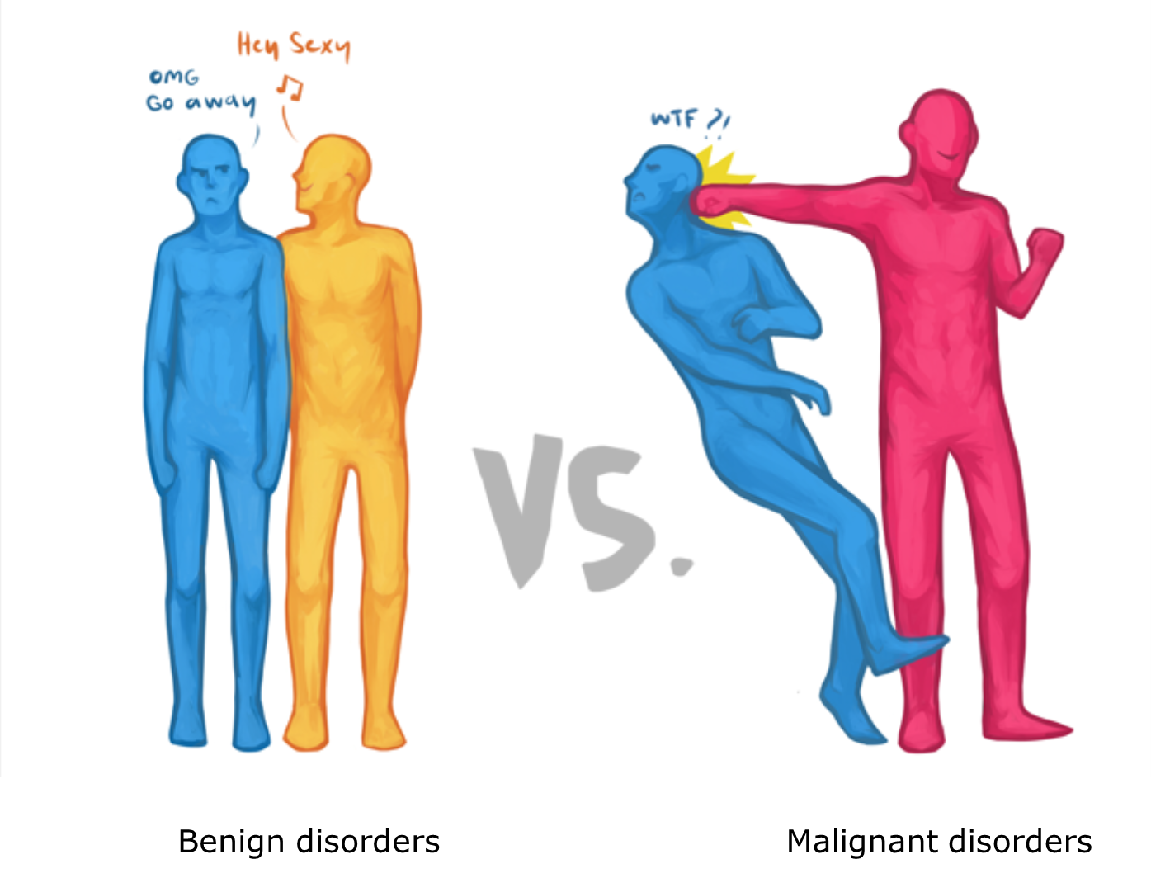
Reactive
Cigarette smoking
Obesity
Drug-induced
(Cortico, B-Agonists, Lithium, G-CSF)
Infection
Inflammatory disease
Rheumatologic, IBD, Sweet's syndrome
Endocrine
(Thyrotoxicosis, Hypercortisolism)
Occult malignancy
Severe stress
(trauma/emotional or physical; panic)
Asplenia
Hereditary neutrophilia
Malignant
CML
MPN
Overlap syndrome MDS/MPN
Benign disorders
Malignant disorders

Slide 29
qRT-PCR BCR-ABL: negative
BM cytology: hypercellular bone marrow, increased granulopoieses and megakaryopoiesis
BM biopsy: hypercellular bone marrow (CML-like) but with signs of dysplasia
Cytogenetics: nl

Slide 30
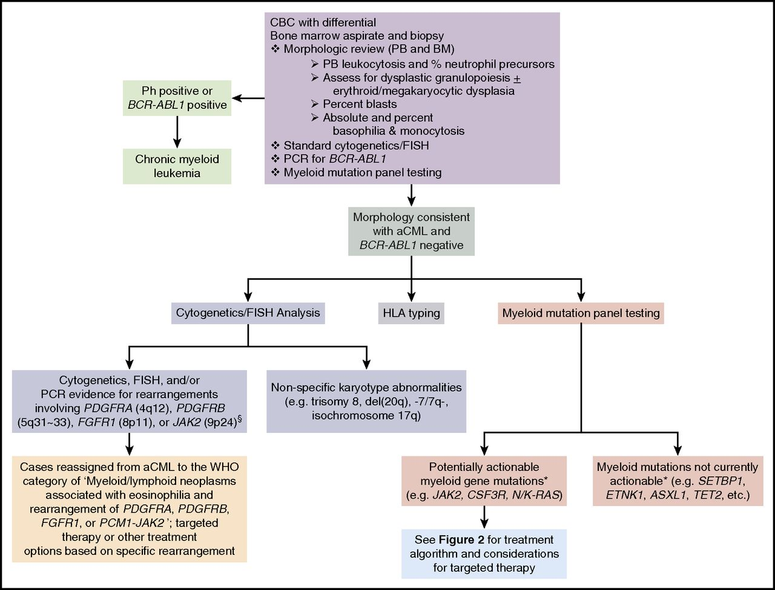
Atypical CML
MDS/MPN overlap disorder
Jason Gotlib,Blood, 2017

Slide 31
NGS
  Mutation in ASXL1, KRAS, NRAS, SRSF2, CEBPa
  Treated with hydroxyurea + allo SCT

Slide 32
CASE 2: ♀ 45 years old
Leucocytosis discovered during « check-up » for asthenia
past History : Smoking
Physical exam : Slenomegaly 2 cm below costal margin,
No hepatomegaly, no lymphnodes.

Slide 33
CASE 2: ♀ 45 years old
BLOOD CELL COUNT
22⁺ | WBC (10⁹/L)
4.88 | RBC(10¹²/L)
14.8 | Hb (g/dl)
44 | Hct (%)
90 | MCV (fl)
30.3 | CMH (pg)
34 | CCMH (g/L)
9 | MPV (fl)
183 | Platelets
Differential Counts (%)
- | Blasts
- | Myélocytes
- | Métamyelocytes
- | Non segmented
12.3 | Neutrophils
85.9⁺ | Lymphocytes
0.0⁻ | Monocytes
0.9 | Eosinophils
0.9 | Basophils

Slide 34
Lymphocytosis > 4.500 Ly/mm³
Atypical lympocytes ?
EBV serology
monoclonality
pos
neg
B monoclonality
T monoclonality
Infectious mononucleosis
(T8↑, T4/T8↓)
CMV (T8↑)
Hepatitis (T8↑)
Toxoplasmosis
HIV (T4↓)
CLL / HCL / NHL
MM (Ig intraC)
ATCL/LGL
T NHL
Sezary S. (T4↑)

Slide 35
Lymphocytosis > 4.500 Ly/mm³
Atypical lympocytes
Normal lympocytes
No monoclonolity
Viral
Brucellosis
Mycoplasma
Pertussis
Tuberculosis
Sarcoïdosis
Wegener
Syphilis III
Thyreotoxicosis
adrenal insufficiency
EBV serology
monoclonality
Acute
B monoclonality
T monoclonality
CMV serology (T8↑)
Hepatitis (T8↑)
Toxoplasmosis
HIV serology (T4↓)
Chronic
Infectious mononucleosis
(T8↑, T4/T8↓)
CLL / HCL / NHL
MM (Ig intraC)
ATCL/LGL
T NHL
Sezary S. (T4↑)

Slide 36
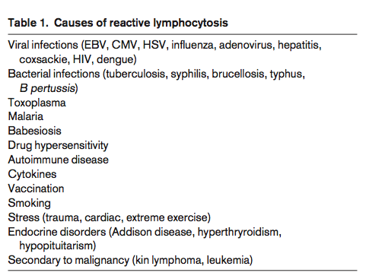
^{Pereira I et al} Atlas of Peripheral Blood,2012.

Slide 37
B-polyclonal Lymphocytosis related to heavy smoking
Young ladies
Binucleated Lymphocytes
Polyclonal lymphocytes population
Splenomégaly : +/-
↑ polyclonal IgM
Association with HLA-DR7
Benign Evolution
Leukemia – Lymphoma 1996: 275-279

Slide 38
Phenotype of Peripheral Blood LYMPHOCYTES
 | T = CD3: 60 - 85% CD4: 40 - 60% CD8: 20 - 40% B = CD19: 5 - 15% | CD4/CD8: 1.5 - 3 κ/λ : 1.5 à 2
Values in our patient :
Phenotype : 45% of B- lymphocytes (IgM, λ) , CD5⁻ CD23⁻ FMC7⁺, CD25⁺
CRP : < 0.5 mg/dl , LDH : NL , Viral Serology : NL

Slide 39
DIFFERENTIAL DIAGNOSIS OF B- LYMPHOCYTOSIS
 | Chronic lymphocytic LK CLL | Hairy cell LK HCL | Prolymphocytic LK PLL | F Follicular Lymphoma F NHL | Mantle Cell Lymphomas MCL* | Splenic vilous lymphomas SVL
↑↑ lympho | ++ | + | +++ | + | + | +++
Spleen | +/- | ++ | ++ | +/- | +/- | +++
CD19 | + + | ++ | ++ | ++ | ++ | ++
CD5 | ++ | - | -/+ | - | ++ | -
CD23 | + | - | - | -/+ | - | -
CD10 | - |  | - | + | - | -
CD11c | +/- | ++ | - | - | - | -
FMC7 | - | - | ++ | + | + | +
CD103/25 | - | + | - | - | - | -/+
Notes:
³⁹

Slide 40
Mature T-cell lymphoproliferative disorders
Marker | T-LGLL | NK-LGLL | T-PLL | ATLL | SS
TdT* | - | - | - | - | -
CD2 | + | + | + | + | +
CD3 | ++ | - | ++ | ++ | ++
CD4 | - | - | +/- | ++ | ++
CD5 | + | + | + | + | +
CD7 | -/+ | - | +++ | - | -/+
CD8 | ++ | - | -/+ | - | -
CD16 | + | + | - | - | -
CD25 | - | - | -/+ | ++ | --
CD56 | -/+ | + | - | - | -
Other |  | CD11b+ CD16+ CD57+ |  | HTLV1+
T-LGLL, T-cell large granular lymphocyte leukemia; NK-LGLL, NK-cell large granular lymphocyte leukemia; T-PLL, T cell prolymphocytic leukemia; ATLL, adult T cell leukemia/lymphoma; SS, Serazy syndrome. *TdT : terminal deoxynucleotidyl transferase differentiates these cells from lymphoblasts of ALL

Slide 41
CASE 3: ♂ 23 years old
Back from a stay in China for professional reasons
Complaints : Fatigue, NS, subT° , Weight loss +/- 2kg, No pruritus , no diarrhea.
Past history : unremarkable
Treatment : none
Alcohol / tabacco : moderate
Phys Exam : 5 cm diameter left Sub-clavicular LN

Slide 42
CASE 3: ♂ 23 years old
BLOOD CELL COUNT
19.6⁺ | WBC (10⁹/L)
4.3 | RBC (10¹²/L)
12.8 | Hb (g/dl)
37.7 | Hct (%)
88.5 | MCV (fl)
29.6 | MCH(pg)
33.9 | MCCH (g/L)
6.6 | MPV (fl)
473.000⁺ | Platelets
Differential (%)
- | Blasts
- | Myelocytes
- | Métamyelocytes
- | Non segmented
66.2⁺ | Neutrophils
7.9 | Lymphocytes
7.3⁺ | Monocytes
18.3⁺ | Eosinophils
0.6 | Basophils

Slide 43
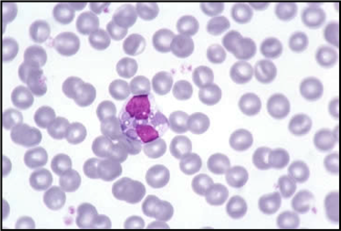
Causes of Eosinophilia
Mild > 500, Moderate >1500, high >5000/ul
Allergies (industrialised countries)
  atopia
  Drug (Il-2 treatment)
Parasitosis (especially in developing countries)
Neoplasia
  Hematological
  - clonal eosinophilia in myeloid pathologies
  - Polyclonal paraneoplasic eosinophilia in lymphoid pathologies
  Solid tumors (uterus, lung, colon)
Idiopathic (SHE, GI eosinophilia, Eos pneumonia, Eosinophilic Fasceitis)
AI Diseases (Churg-Strauss Vasculitis , Crohn, RA, Psoriasis….)

Slide 44
Myeloproliferative disorders
« clonal » hyperéosinophilia
Chronic myelomonocytic leucemia (CMML)
Chronic myeloid leukemia (Caryotype, B12)
Systemic mastocytosis
Chronic eosinophilic leucemia
  Mature eosinophils in chronic fase
  Specific cytogenetic abnormalities (FIP1L1/PDGF RA)
  Blastic transformation
Notes:
LMMC anomalies caryotype chrom 16, chrom 5 (tranloc 5;12) …

Slide 45
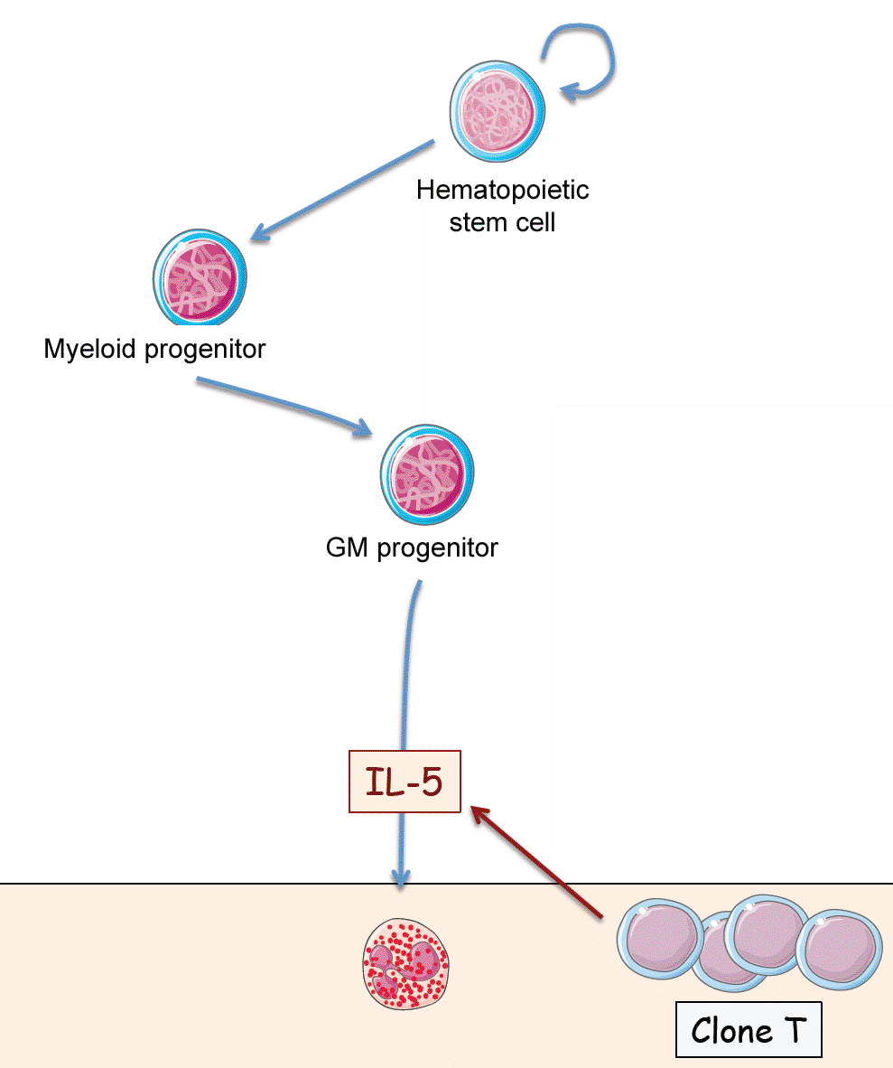
non-myeloid disorders
« polyclonal » reactive hypereosinophilia
(non) Hodgkin lymphoma
  T cell lymphoma (TCR rearrgt, FACS, IgE)
  Skin lymphoma (CD4+), ATLL (HTVL1+)

Slide 46
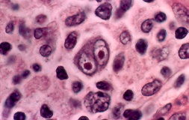
Reed- Sternberg cell
CASE 3: ♂ 23 years old
Diagnosis : Hodgkin’s Lymphoma

Slide 47
CASE 4: ♂ 72 years old
Complaints : fatigue, anorexia, max 37⁷ (evening )
Past history : Controlled hypertensive cardiomyopathy
Phys. Exam. : BP : 15/9 – HR : 90’ rég, GGL 0, Liver N, sensitive spleen without clinical SM

Slide 48
CASE 4: ♂ 72 years old
Differential (%)
- | Blasts
- | Myélocytes
- | Métamyélocytes
- | Non segmented
16⁻ | Neutrophils
43 | Lymphocytes
39⁺ | Monocytes
2 | Eosinophils
0 | Basophils
8 | Réticulocytes (‰)
BLOOD CELL COUNTS
^{12.4+} | WBC (10⁹/L)
^{3.30} | RBC (10¹²/L)
^{11.6-} | Hb (g/dl)
^{34.3} | Hct (%)
¹⁰⁴⁺ | MCV(fl)
^{35.2} | MCH (pg)
^{33.8} | CCMH (g/L)
⁷ | MPV (fl)
¹⁴¹⁻ | Platelets

Slide 49
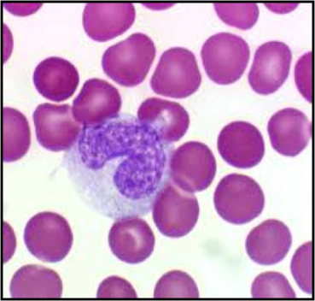
Monocytosis > 800/mm³
> 1.000 µL
Etiologie
- MDS/MPN
• CMMC
• JMML
- Infections
• Malaria
• Trypanosomiase
• Typhus
• TB
• Endocarditis
• Brucellosis
- Recovery after chemotherapy/transplant
- GM-CSF > G-CSF
- Cancers
• Lymphoma
• AML (types M4 & M5)
Medullar aspiration / biopsy
Chronic Myelo-Monocytic
Leukemia (CMML)

Slide 50
Leukocytosis
No
Blood Smear
Increased blasts
Evaluate for MDS or acute leukemia
BM analysis
Cytology, Flow Cytometry, Cytogenetics.

Slide 51
Leukocytosis
No
Blood Smear
Increased blasts
Evaluate for MDS or acute leukemia
Monocytosis
Persistence, dysplasia, blasts
BM analysis
Cytology, Flow Cytometry, Cytogenetics.
Reactive
Chronic inflammation
Corticosteroids
Sarcoidosis
Infection (TBC, Syphilis)
Malignancy
Splenectomy
Auto-immune (Lupus)
Regenerating BM

Slide 52
Leukocytosis
Neutrophilia
No
Blood Smear
Favor reactive
WBC < 50.000
Left shift, toxic granulation
Increased blasts
Favor malignant
WBC > 50.000
Marked left shift
Basophilia,
Signs of dysplasia
Cigarette smoking
Obesity
Drug-induced
(Cortico, B-Agonists, Lithium, G-CSF)
Infection
Inflammatory disease
Rheumatologic, IBD, Sweet's syndrome
Endocrine
(Thyrotoxicosis, Hypercortisolism)
Occult malignancy
Severe stress
(trauma/emotional or physical; panic)
Asplenia
Hereditary neutrophilia
Eclampsia
BM analysis
Cytology, Flow Cytometry, Cytogenetics.
CML
MPN
Overlap syndrome MDS/MPN

Slide 53
Leukocytosis
Neutrophilia
No
Blood Smear
Increased blasts
Lymphocytosis
Monocytosis
Monomorph
Pleomorph
Floc cytometry, Genetic testing
BM or lymph node
Mononucleosis syndrome
(CMV, EBV)
Other infections
HIV, Toxoplasmosis,
Basbestiosis,
Bartonella (Cat-scratch disease)
Drug-induced
Reactive granular lymphocytosis
CLL
Benign monoclonal lymphocytosis
Indolent lymphoma

Slide 54
Leukocytosis
Neutrophilia
No
Blood Smear
Increased blasts
Lymphocytosis
Monocytosis
Eosinophilia
Reactive
Pathologic
Allergic rhinitis
Ashma
Tissue invasive parasite
Drug reaction
Aspergillosis
Coccidioidal infection
Occult malignancy
Pulmonary syndromes
Hypereosinophilic syndromes (HES)
Myeloid variants
T cell lymphocytic variants
Idiopathic HES
Organ-restricted HES
Specific syndromes

Slide 55


